Slide 1

ICON Activity Indicator
ITS
Notes:
- 15-20min of slides

Slide 2

Purpose
Equip advising staff with a tool that helps identify students that are struggling early and to give advising staff insight into a student’s ICON engagement.

Slide 3
Current Landscape
Elements of Success
  Built as a tool for students and faculty
  Works best in specific courses
Course Activity Insights (CAI)
Excelling@Iowa
Manual interventions

Slide 4
Goals for Iowa
Create an indicator for ‘Low-Engagement Enrollments’
Create a simple dashboard for advisers
Do this in a way to not include any non-ICON information
  Student’s have a blank slate at the start of each semester

Slide 5
Scoring Engagement

Slide 6
Student Engagement Score
75% = Gradebook Score + Assignment Submissions
25% = Days active in the course site + Materials accessed
Scores are within the same ICON course site

Slide 7
Student Engagement Score Continued
Performance is the primary component of this status
  Students with a "low" status are likely not performing well
  Students with a "very low" status are likely underperforming and not engaging with ICON
In very easy or difficult courses, interpret with caution
  Status is relative to other students in that course
  Status will be more relevant in larger courses
This status is available early in the semester (week 4)
  Can nudge students while there is still time to improve
  The utility of the status will increase with more high stakes grades (e.g. exams)

Slide 8
Application

Slide 9
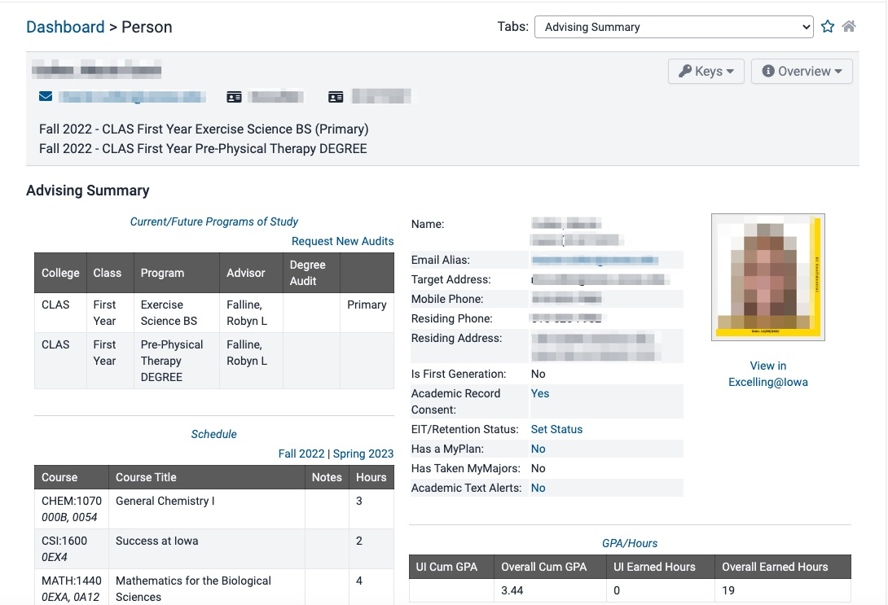

Advising Summary Dashboard

Slide 10
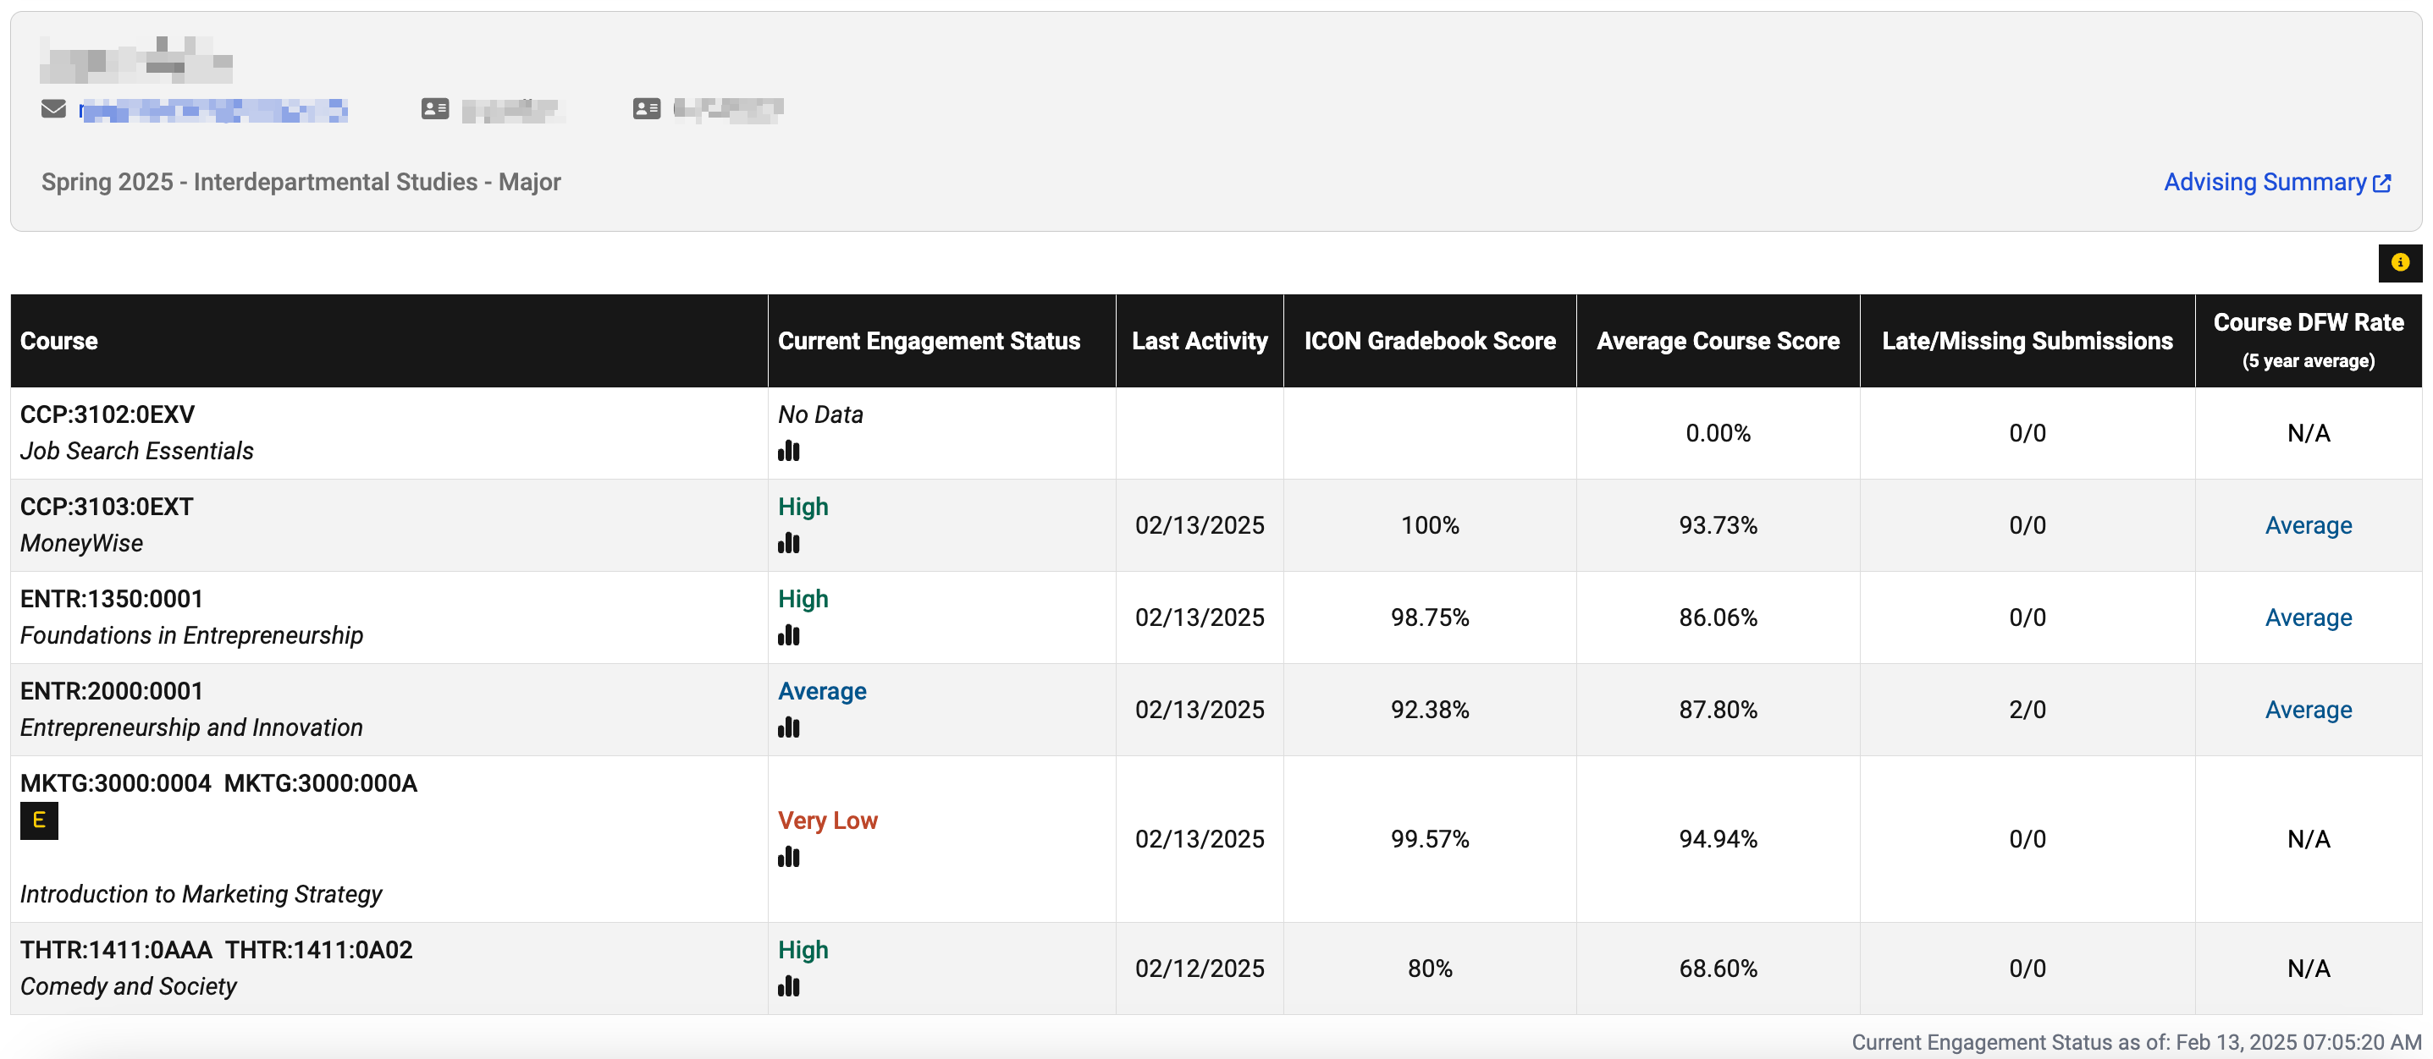
ICON Indicator Dashboard
Notes:
Course Engagement Status
Last Activity
ICON Gradebook Score
Average Course Score
Late/Missing Submissions
Course DFW Rate
Elements of Success
Advising Summary link

Slide 11

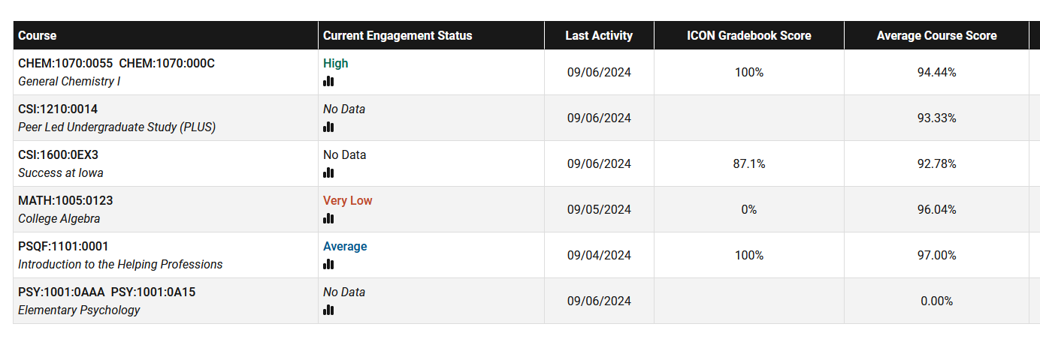
Current Engagement Status
Provide a summary metric of how students are currently doing in their courses
Used to generate an early alert to help identify students who might be at risk of failing
A tool to get a conversation started

Slide 12
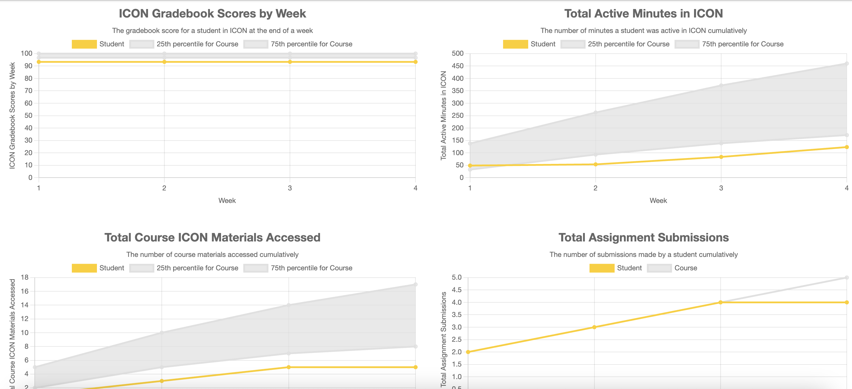
Metrics
Notes:
Grey is normal range
Gold line is student performance
Expect student to be in grey range

Slide 13
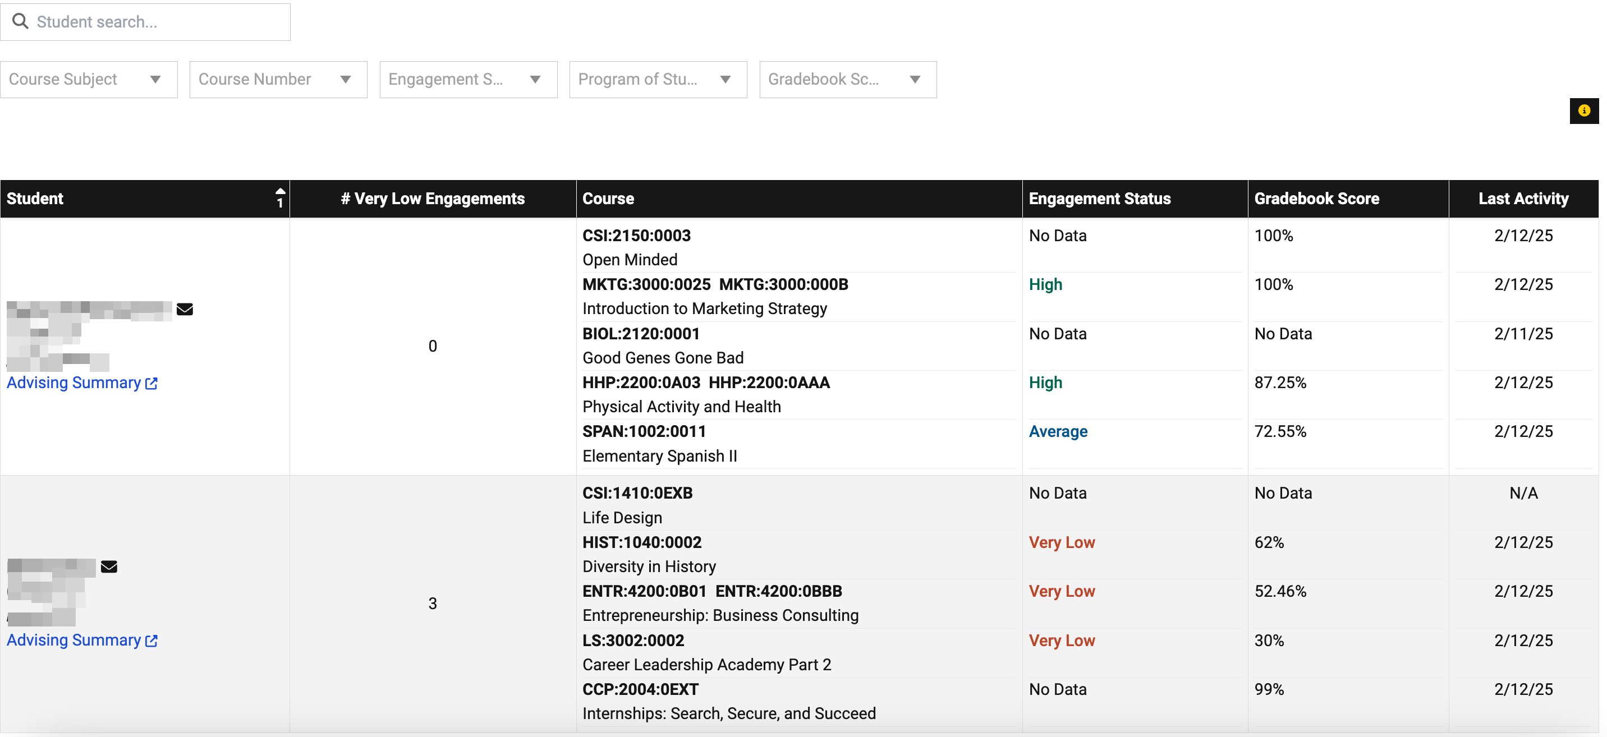
ICON Indicator Dashboard display

Slide 14
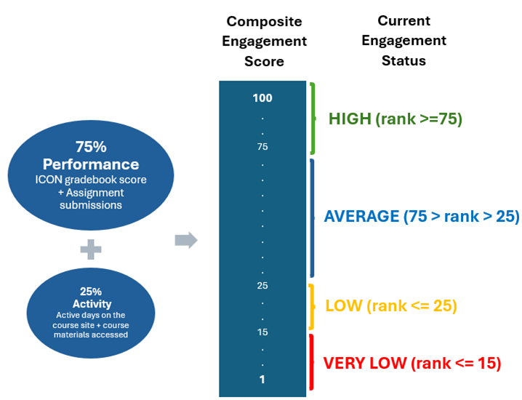

Current Engagement Status - Definition
A weighted average of performance and activity makes up a composite score
This score is used to rank students within a course, so the student with the highest composite score in that course has a percentile rank of 100.
A status of Very Low will generate an alert in MAUI Advising

Slide 15
How to interpret
Performance is the primary component of this status
  Students with a "low" status are likely not performing well
  Students with a "very low" status are likely underperforming and not engaging with ICON
In very easy or difficult courses, interpret with caution
  Status is relative to other students in that course
  Status will be more relevant in larger courses
This status is available early in the semester (week 4)
  Can nudge students while there is still time to improve
  The utility of the status will increase with more high stakes grades (e.g. exams)

Slide 16
Why don't I see an engagement status
•Courses with 10 or fewer students
•Student is auditing or taking the course for 1 Credit Hour
•Course doesn’t use the ICON gradebook
•Courses that don't have grades yet
•Graduate/Professional courses
•Something has gone wrong – Please contact us with any issues on the Pilot teams site you can “@” anna-smith-1@uiowa.edu

Slide 17
Student Data Usage
https://itprivacy.uiowa.edu/safeguarding-privacy-teaching-and-learning-data

Slide 18
Pilot Feedback

Slide 19
Fall 24 Pilot Feedback
35 Pilot Advisors
Qualtrics Survey

Slide 20
How was the tool utilized?
19 advisors* provided details about how they used the tool
  11 advisors used it prior to or during normal planning/advising appointments
  9 advisors used it to check in on students who may be struggling (e.g., students on probation)
  3 advisors used it when emailing students
  Only 1 advisor used it for proactive outreach
How did the tool help them
  Focus conversations on course-specific issues
  Determine which resources to offer or refer
  Information for advising decision making (e.g., if they should consider second grade option)
  To determine if a student was struggling in only one or many / multiple classes
* Some provided multiple uses

Slide 21
Improved your ability to have focused conversations with students?
Enabled you to identify at-risk students earlier in the semester?
To what extent has the ICON indicator…
Improve Conversations | Identify Students
M = 3.56 | M = 3.13

Slide 22
Overall perceptions

Slide 23
Questions?
Ross Miller
Lead Application Developer
ITS – AIS
ross-h-miller@uiowa.edu
uiowa.edu

Slide 24
Thank you
Special thanks:
Maureen Schafer, Jayne Mackak, Jill Trumm - AAC
Rachel Schneberger – ITS AIS
Anna-Marie Smith – ITS OTLT
Kyle Unruh – Unizin
Sara Bolf - Unizin
uiowa.edu

Slide 25
Closing Slide Header

