Slide 1
Ambient Clinical Documentation at UIHC
Jason Misurac, MD, MS
Associate chief health information officer
5/28/2025

Slide 2
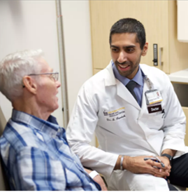


AI Ambient Clinical Documentation
Patient-Clinician conversation
Transcription and extraction
Note generation and formatting

Slide 3
Ambient Clinical Documentation
How it can help
  Time face to face with patients
  Reduce cognitive burden of clinical note-writing
  Free up clinicians to coordinate care, pursue passion projects, do research
Challenges
  Cost (quoted range $100-600/clinician/month)
  Implementation and rollout
  Perception vs reality of AI documentation – both internal and external

Slide 4
Ambient Clinical Documentation at UIHC
Researched and then trialed ambient documentation tools
  Volunteer group of 40 clinicians for 5 weeks for each tool
Selected a vendor (Nabla) based on user feedback and metrics
  Metric: Marked improvement in average burnout scores from 4.2 to 3.2 (p<0.001)†
  Feedback: It works to lessen the workload of documentation
Simple implementation strategy
  Installed EHR integration (~4 weeks)
  All invited to go-live training meeting
    On the same day, the ambient documentation tool was activated in the EHR
†Misurac et al. Appl Clin Inform. 2024 Nov 5. PMID: 39500346

Slide 5
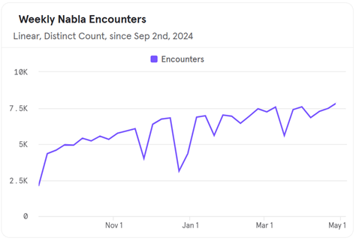
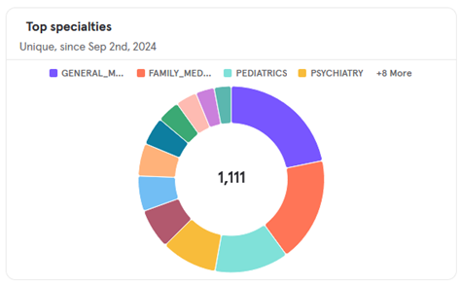
Use Since Launch
Launched Sept 2024, used in >240K encounters
Used across almost every specialty in the organization
Open to all clinical staff
  Physicians, NP/PA, Trainees, Dieticians, Social workers, Psychologists, Nurses, etc.

Slide 6
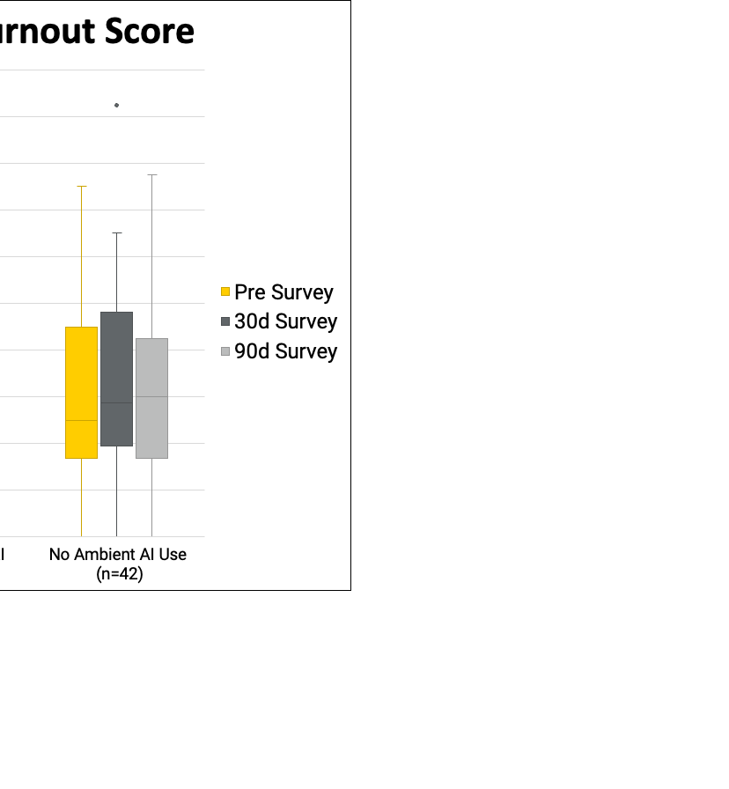
Impact Since Launch
>30% reduction in average burnout score after 30 days, no improvement in non-users
  Persists after 90 days
Average perceived time savings 2.6 hours per week
Average likelihood to recommend to colleague 8.2/10
PFI burnout
cutoff
Notes:
58% promoters (9 or 10/10); NPS of 35

Slide 7
Reasons for Burnout Improvement?
Users surveyed about the effects of Ambient AI report:
  Improved work/life balance
  Improved patient interactions
  Decreased after-hours time
  Less worried about forgetting
Revising draft note requires less cognitive focus than composing from scratch

Slide 8
Reasons for Burnout Improvement - Qualitative Interviews
Jen Van Tiem, Beth Cramer, Chris Iverson, Heather Reisinger and others interviewed 24 clinicians from nine clinical departments using a semi-structured interview guide
Focus on patient, not computer
  More eye contact
  Less concern about forgetting key details
Relevant Quote/Comments:
“I think it frees me to have… a better interaction with the patient...Allows me to sort of be present in that interaction without feeling like I have to type everything to remember it.”
“I was like, ‘wow, I really enjoyed that conversation.’ And I didn't have to spend it typing. And then these few minutes of rest in my brain while I'm confident that Nabla is at least going to remind me of all the important details.”

Slide 9
Reasons for Burnout Improvement-Qualitative Interviews
Jen Van Tiem, Beth Cramer, Chris Iverson, Heather Reisinger and others interviewed 24 clinicians from nine clinical departments using a semi-structured interview guide
Focus on patient, not computer
  More eye contact
  Less concern about forgetting key details
Developing deeper relationships with patients
Relevant Quote/Comments:
“I can just sit and talk with the patients … I think it's really helped with my ability to have encounters where patients feel like I'm more engaged.”
I am doing data entry as they talk to me, but I'm no longer typing verbatim what they tell me. So, right, there's a piece of my cognitive load that now is open and I can really give them more empathy because of that.
I would say Nabla has helped me to give [patients] more attention … and I think patients do appreciate that you listen because many of them have told me that they really feel like I listened to what they had to say.

Slide 10
Reasons for Burnout Improvement-Qualitative Interviews
Jen Van Tiem, Beth Cramer, Chris Iverson, Heather Reisinger and others interviewed 24 clinicians from nine clinical departments using a semi-structured interview guide
Focus on patient, not computer
  More eye contact
  Less concern about forgetting key details
Developing deeper relationships with patients
Decreased after-hours documentation time
Increased willingness to take on difficult documentation
Relevant Quote/Comments:
“[T]here's been an improvement in my job satisfaction in the sense that my notes are being done more timely, I'm having higher quality interactions with my patients, and by virtue of notes being done more timely, I'm having more time outside of work … less pajama time, and more time with my family”
“[F]or the most part I think it is saving me time and energy, and giving me the ability to look at patients and talk to them, and engage with them, and maybe even broach a topic that I wouldn't want to broach if I was going to have to document the whole thing.”

Slide 11
Quality Impact of Burnout in Healthcare
Impact of clinician burnout*
Costs related to clinician burnout
Worsened patient outcomes† & experience
Double the rate of medical errors
Doubles intent to leave
67% greater likelihood of reduced work hours
Increased risk of substance use disorder, vehicle crashes, depression, and suicide
Financial Aspect | Cost
Physician Replacement (recruitment, training, onboarding) | $500K-$1M per physician lost Estimated $4.6B/year†
Medical errors and oversights | Lost inpatient revenue Legal liability
Decreased productivity and reduced work hours | Fewer RVUs
*West CP, Shanafelt TD, et al. J Intern Med. 2018;283(6):516-29.
†Han S, Shanafelt TD, et al. Ann Intern Med. 2019;170(11):784-90.
Notes:
During the past two weeks my job has contributed to me feeling…
a. Less empathetic with my patients
b. Less empathetic with my colleagues
c. Less sensitive to others’ feelings/emotions
d. Less interested in talking with my patients
e. Less connected with my patients
f. Less connected with my colleagues

Slide 12

Future of AI in Healthcare
Ambient documentation tools will proliferate and improve
AI Chart review tools will become integrated into the EHR
All-in-one AI “agents” will enter orders, write notes, and proactively find data exactly when needed
AI will continue to find new and better applications: radiology, pathology, precision medicine, patient coaching, and more

Slide 13

Will Smith Eating Spaghetti (2023)

Slide 14
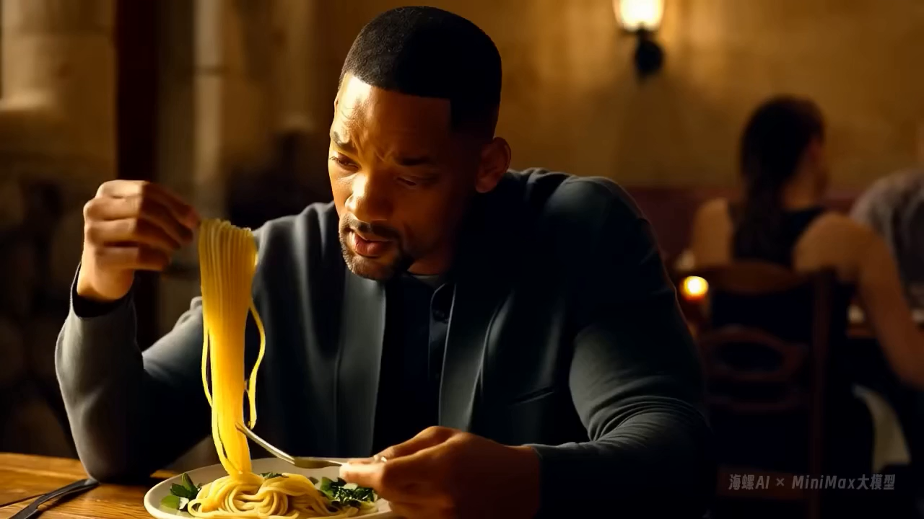
Will Smith Eating Spaghetti (2024)

Slide 15
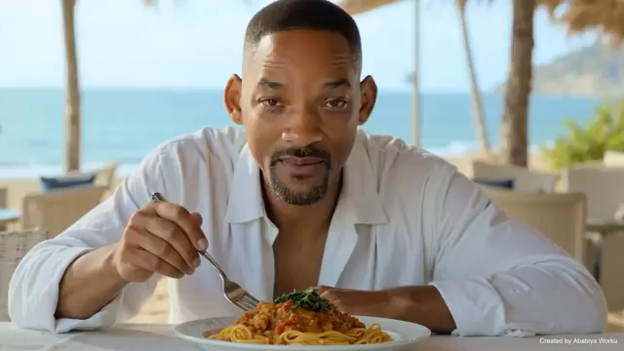
Will Smith Eating Spaghetti (2025)

Slide 16
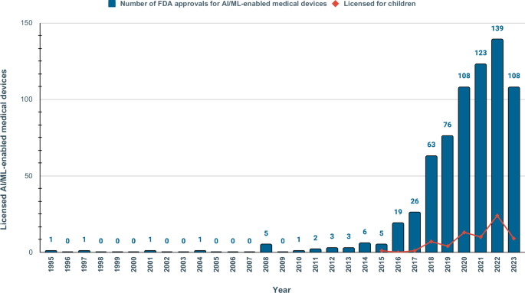
AI is Just Getting Started
AI/Machine Learning on Pubmed
FDA Approved AI Algorithms

Slide 17
Thank You
Jason-Misurac@uiowa.edu

