Slide 1
Agentic AI in Prospector
Enabling Autonomous Intelligence in Prospect Graduate & Professional Recruitment
May 28, 2025

Slide 2
AI Agents vs Agentic AI
AI Agents
Agentic AI
Goal Oriented
Task Specific
Self-directed
Adaptive decision-making
Learns & improves over time

Slide 3
What is Prospector ?
CRM tool for graduate & professional programs to manage prospects.
Sources:
Manual entry
CSV imports
Request for Information forms
Events

Slide 4
Challenge in Current System: Prospector
When a new prospect record comes in:
Is it a completely new record?
Should we auto-merge it with an existing record?
Or is it a dup-set needing human intervention?
How do we know "Alexandar Doe" is the same as "Alex Doe"?
Slight name variations
Typos, nicknames, or incomplete entries
Matching across email, dob, phone or other attributes

Slide 5
AI Model Roles
Vector Embeddings
Numeric representation of data generated by AI models
EX: [0.91, 0.78, 0.22, 0.78…..]
Vector DB:
Used to store vector embeddings and perform semantic search.
Open AI
Used for Embeddings, RAG.
Llama 3
Used for evaluation of AI responses.
AWS bedrock Nova
Used for tools calling, complex interactions with real-world entities.

Slide 6


Preprocessing Prospects
Oracle DB
Vector Embeddings
Enrich Data
Prospect Metadata
Vector DB

Slide 7


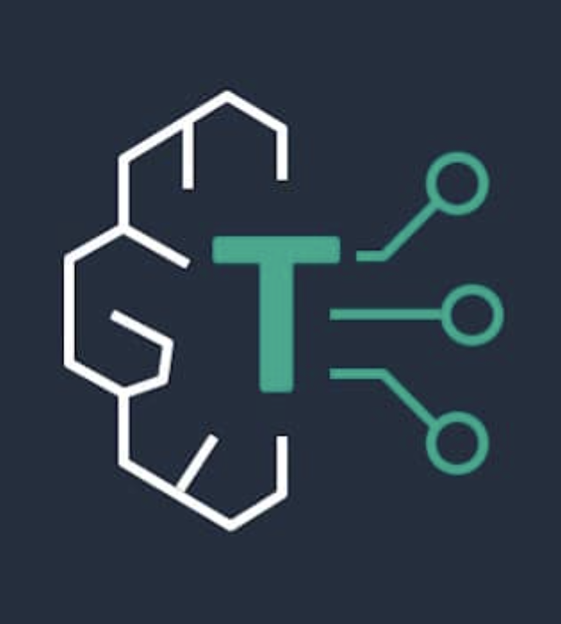
How Agentic AI Helped
System Prompt
New Prospect
Prospector
Similarity Search
Similar Prospects
deduplication decision agent
New Prospect
Dup Set
Auto Merge
Vector DB
Open AI
llama 3
Evaluation Model
Tools
calling
feedback
Accepted
Overridden
Response
Oracle DB
AWS Nova

Slide 8
Thank you
Siddharth Sarathe
Senior Application Developer
ITS-AIS
siddharth-sarathe@uiowa.edu
uiowa.edu

