Slide 1
IT Leadership Awards
June 3, 2024

Slide 2
IT Leadership Awards
Transformational Achievement
Welcoming and Respectful Workplace
Team Achievement
Unsung Hero
Community Engagement
Rising Star
Notes:
Griffin will read the text, advance the slide, and people will walk across the stage to Lee or Steve, where they will hand the certificates to their respective staff. Martin Happ will snap photos.
The IT Leadership Award is sponsored by the IT Leadership Development Team, along with CIOs Steve Fleagle and Lee Carmen.
The IT award is part of a continuing effort to develop, encourage, and support IT leadership for all IT professionals at the University of Iowa.
Each year we receive a host of nominations for deserving leaders in the IT community.
We are excited to announce that we have winners in six categories this year: Transformational Achievement, Team Achievement, Community Engagement, Welcoming and Respectful Workplace, Unsung Hero, and Rising Star.
We would ask that the recipients who are here in person please come up to the stage when their names are called to receive their certificates from the CIOs.

Slide 3
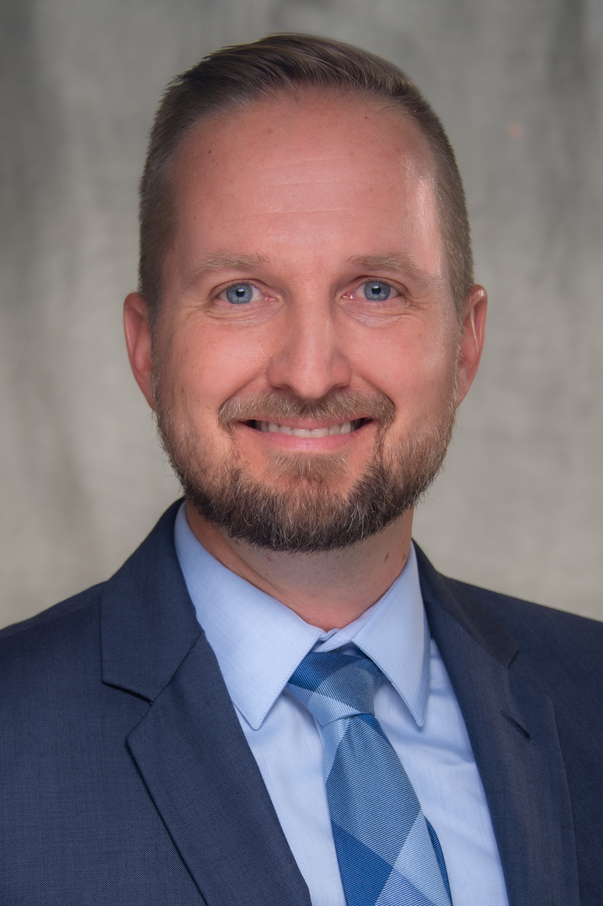
IT Leadership Award
Transformational Achievement
Nick Dreyer
Notes:
The leadership award for Transformational Achievement goes to Nick Dreyer.
Lee gives certificate to Nick.
Nick is the assistant director of Clinical Applications in HCIS and leads a variety of high profile and mission critical Epic applications. Nick has led several significant initiatives related to the electronic release of health information, including the 21st Century Cures Act: Information Blocking project.
He conducted his own review of the ONC final rule, assembled team members, led an evaluation of current policies, and developed a plan to address each area, including workflow, written policies, and technical changes to Epic EMR. He partnered with his team leads, which resulted in his team members having an opportunity to participate and feel ownership of the changes. As a result of Nick's dedication and hard work, UI Heath Care was able to comply with the regulations before they took effect.
He remains steadfast in his analysis and comprehension of the regulations, understands the risks to our organization, and plays an essential role ensuring we comply with requirements.
Congratulations, Nick!

Slide 4
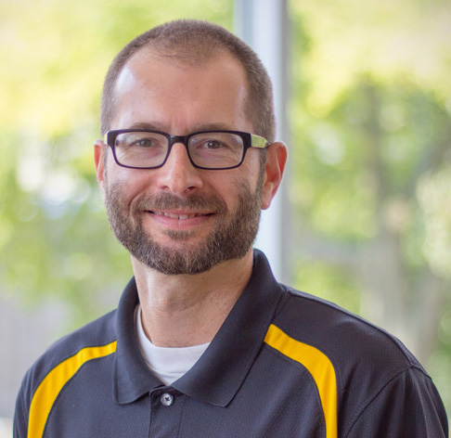
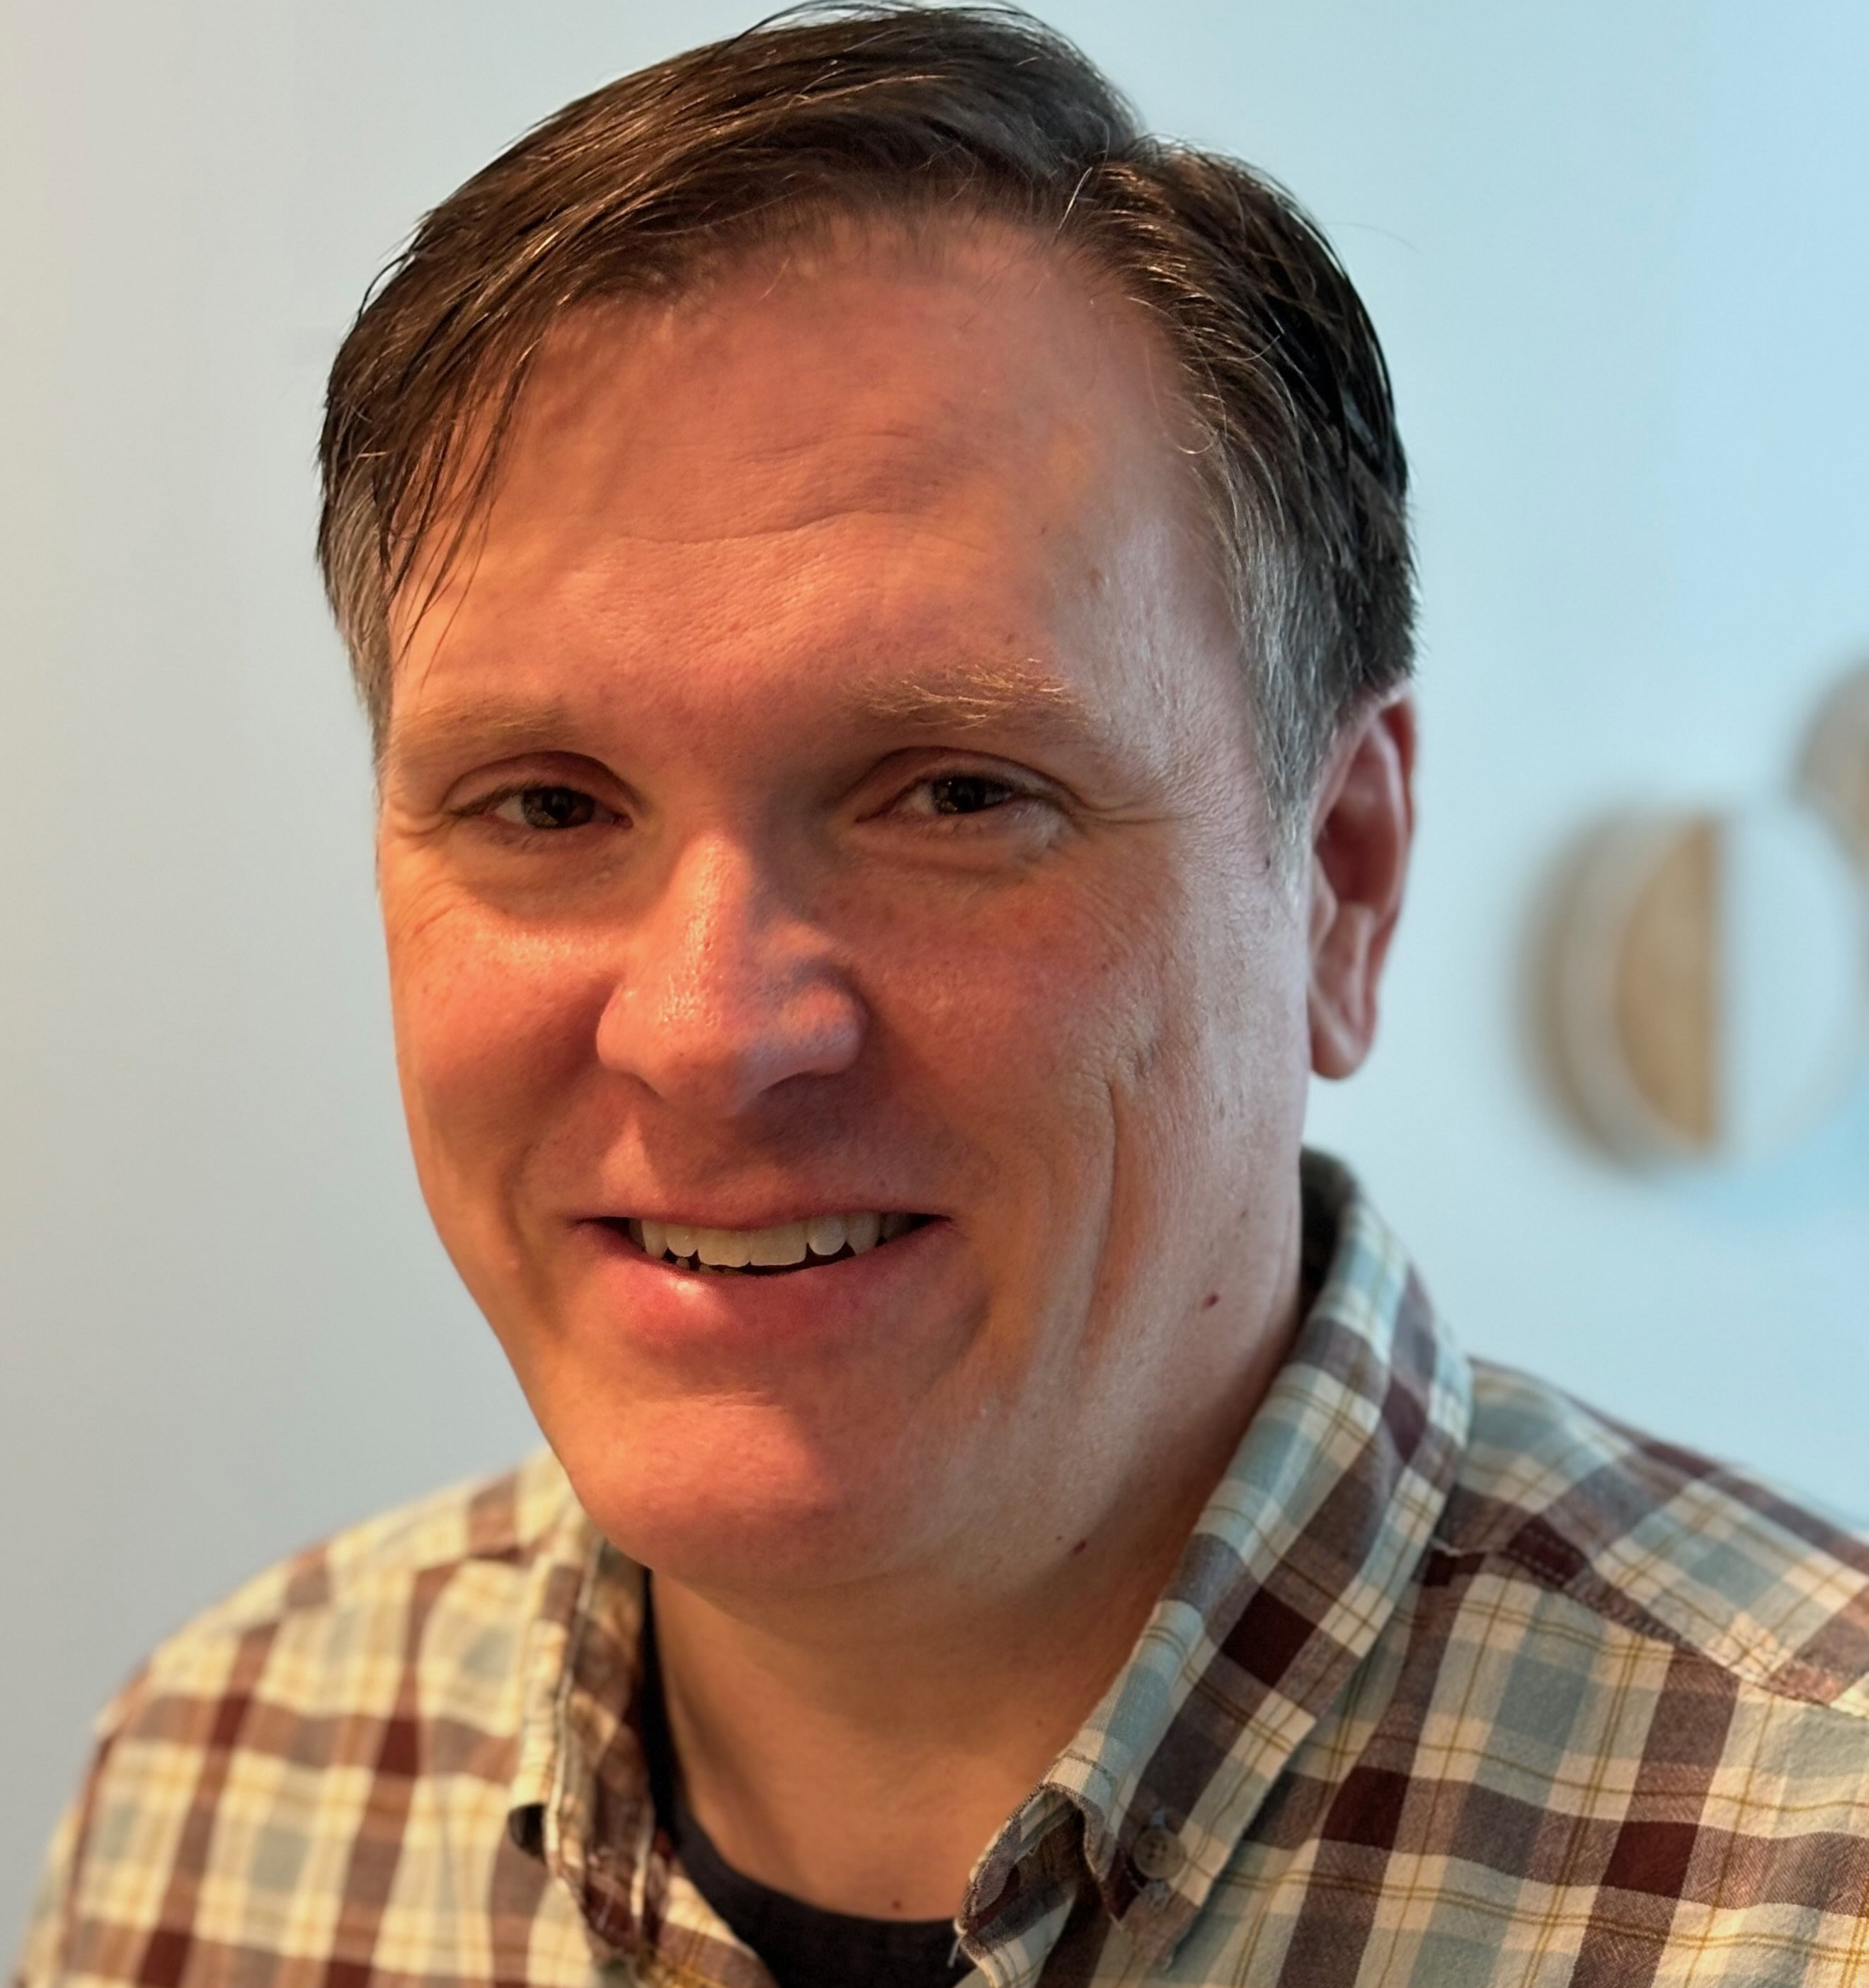
IT Leadership Award
Team Achievement
University Housing and Dining
Greg Nims
Mark Pittillo
Notes:
The next leadership award, for Team Achievement, goes to the University Housing and Dining IT Group: Greg Nims and Mark Pittillo.
Steve hands out all certificates. There’s a team certificate that can be given and posted in a shared area and certificates for Greg and Mark.
Their exceptional work with University Housing and Dining has led to a successful migration of the housing management system to the Cloud server. Greg and Mark tested every piece of the process, built in new and improved features, and collaborated with countless stakeholders to enhance the experience for staff and students.
Although they knew this change was coming, the time and energy required to execute it could not have been predicted. Greg and Mark expertly navigated all of this, and the result of their work was a successful migration that was immediately available to end users.
Their collaborative efforts, problem-solving skills, and unwavering commitment to excellence have transformed the operational landscape of University Housing and Dining.
Congratulations to the University Housing and Dining IT Group!

Slide 5
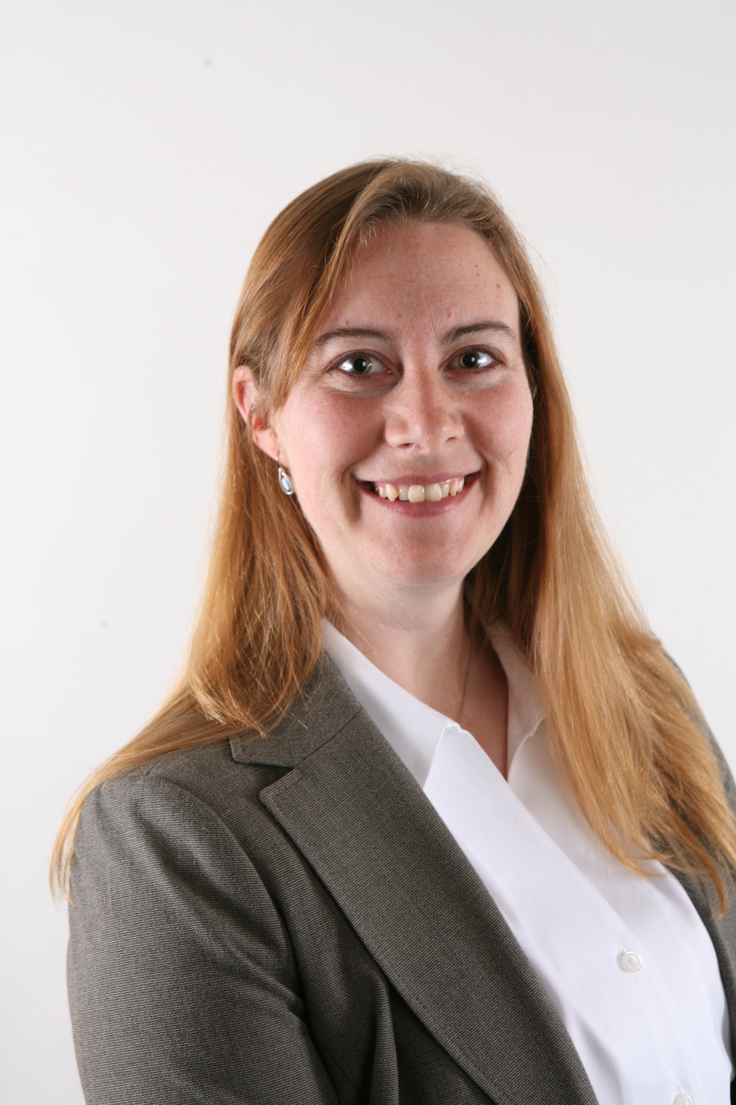
IT Leadership Award
Community Engagement Award
Victoria Maloy
Notes:
The next leadership award, for community engagement, goes to Victoria Maloy.
Steve hand out certificate.
Victoria is the associate director of Academic Technologies in the ITS Office of Teaching, Learning, and Technology. Her contributions have significantly shaped the OneIT community and fostered engagement across campus.
Her notable achievements include leading the Support Community for Instructional Technology (SCIT) and the UI Course Materials Advisory Committee (CMAC) to enhance collaboration and problem-solving. She also revived ICON Day and initiated the ICON All Stars Award to celebrate faculty’s innovative use of instructional technology.
Vicky’s leadership in these initiatives, often beyond her regular duties, exemplifies her dedication to community building and her unwavering commitment to excellence in academic technology.
Congratulations, Victoria!

Slide 6
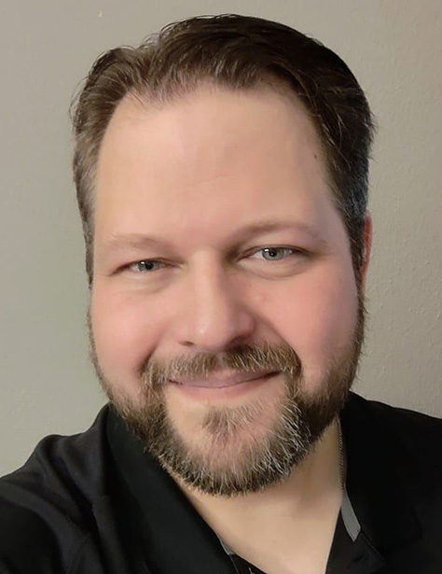
IT Leadership Award
Welcoming and Respectful Workplace
Peter Franke
Notes:
The next leadership award, for a welcoming and respectful workplace, goes to Peter Franke.
Steve hand out certificate.
Peter is a senior IT support consultant in ITS Enterprise Services.
Peter has been an exceptional mentor to a first-year student worker. Peter has gone above and beyond to help the student acclimate to this new environment and feel welcome. He has shared his excitement for technology and made efforts to support the student in developing valuable IT experience.
The student has found reassurance and encouragement in Peter’s willingness to answer questions and share knowledge. Peter’s friendly demeanor and helpful guidance have made a significant impact, leaving the student grateful for the opportunity to work under his supervision.
Congratulations, Peter!

Slide 7
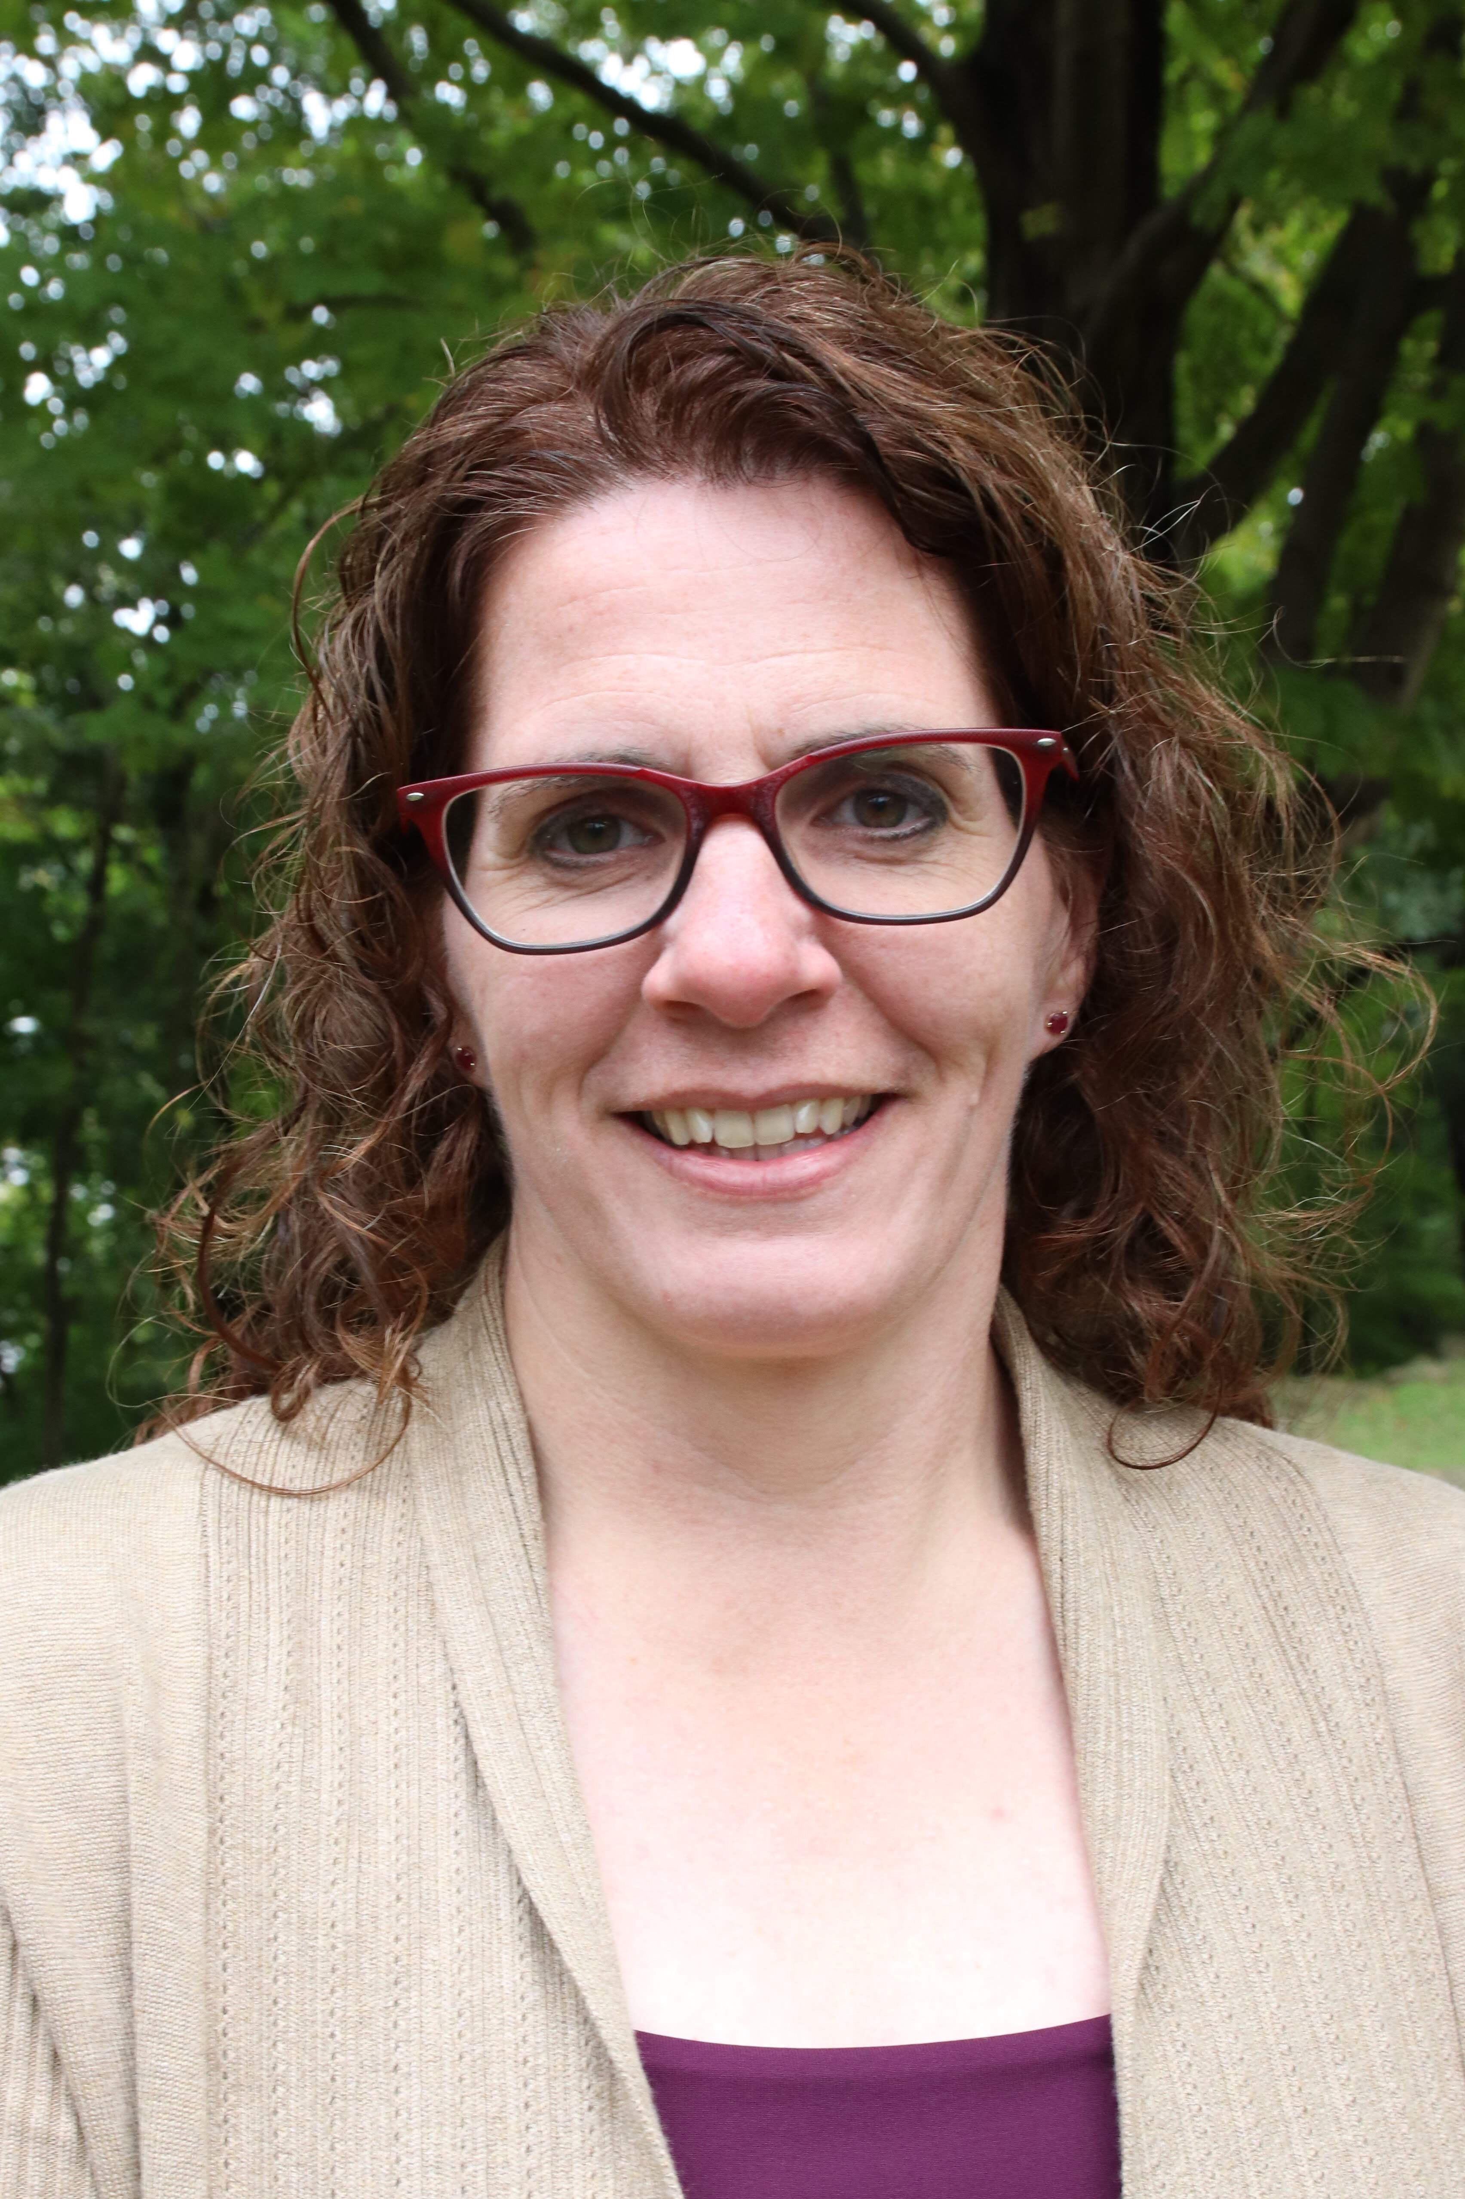
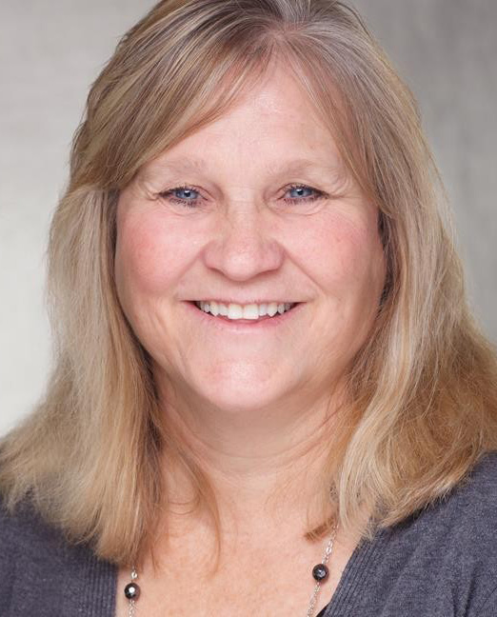
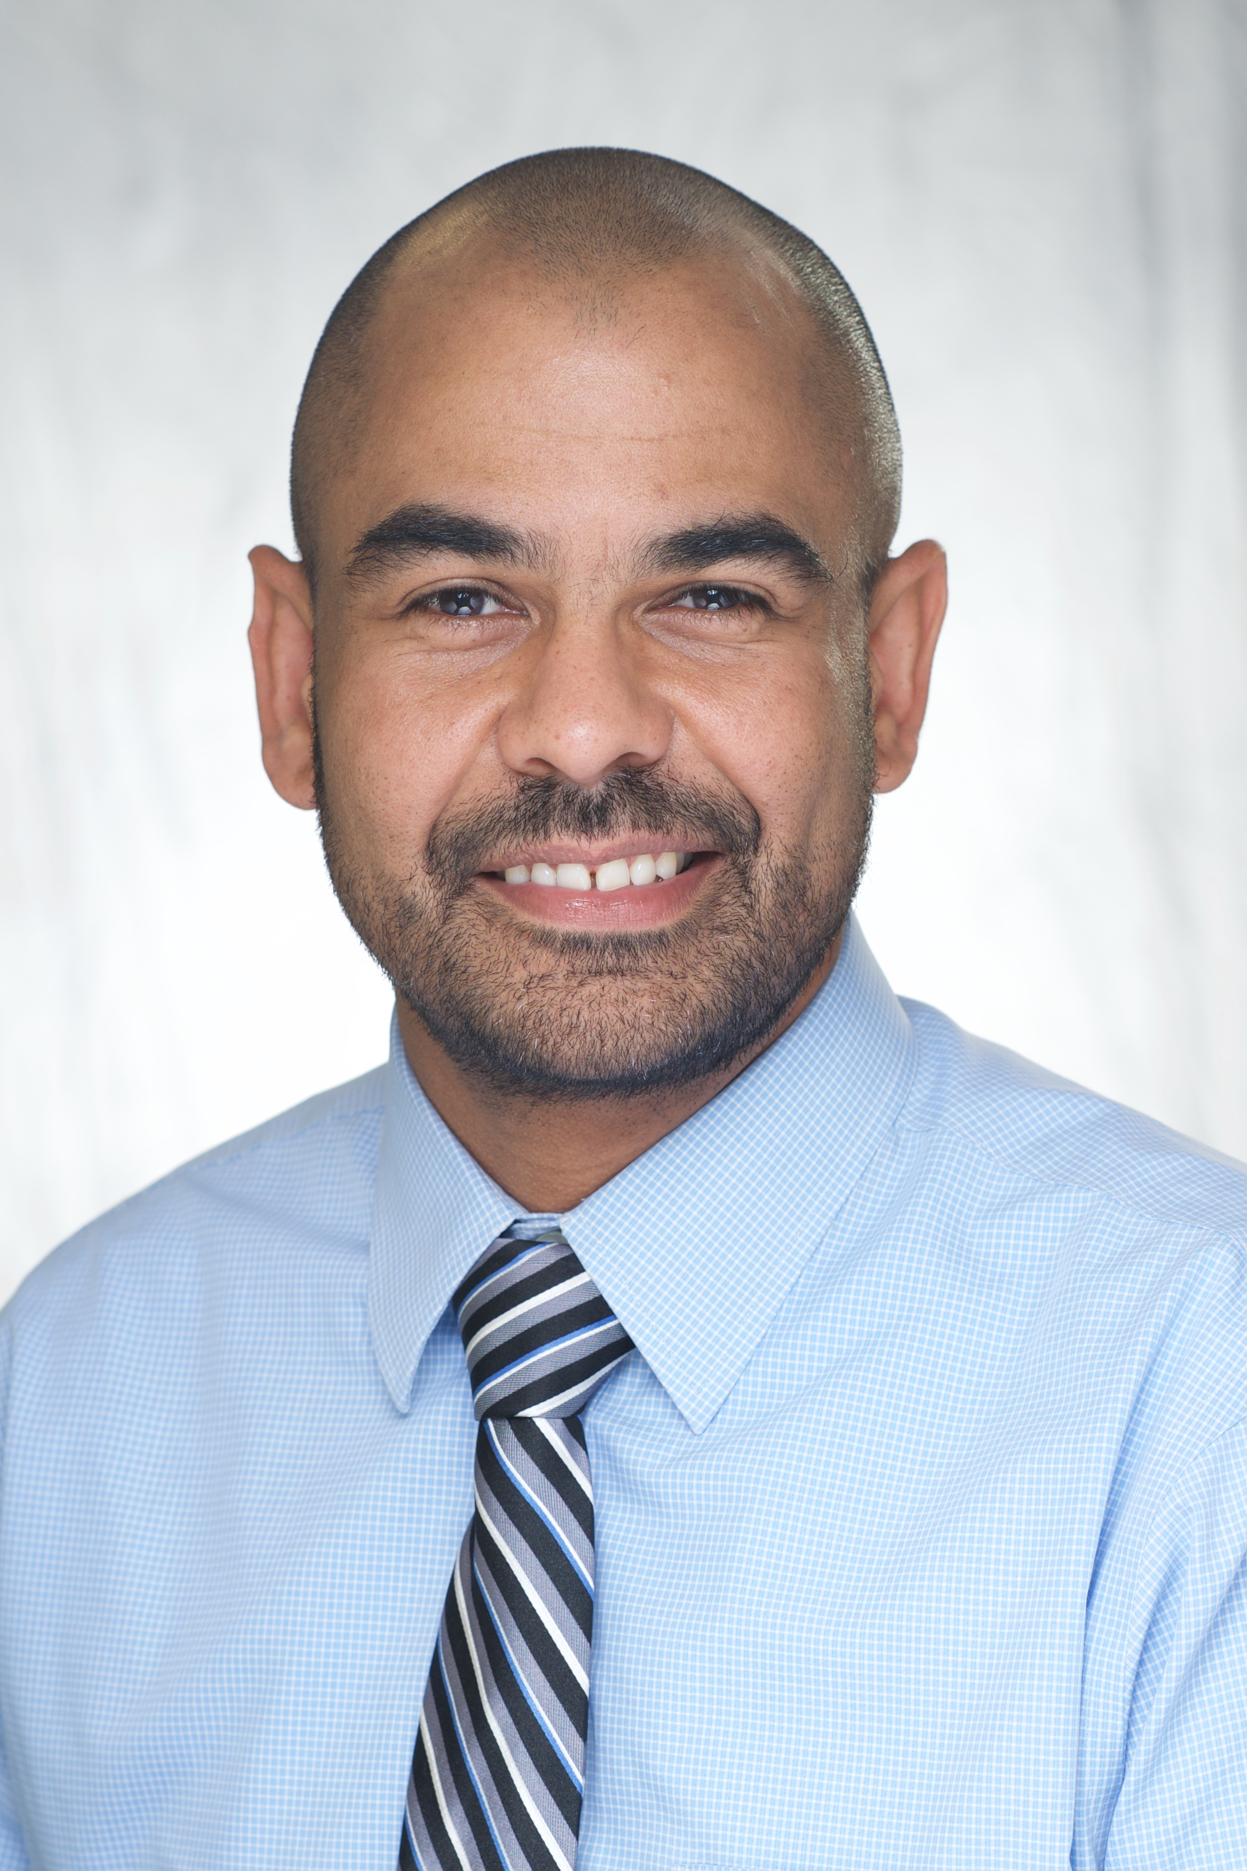
IT Leadership Award
Unsung Hero
Jennifer Graham
Ann Lampe
Warren Staal
Notes:
The next leadership awards we have to present today will go to three unsung heroes who have made significant contributions, often behind the scenes: Jennifer Graham, Ann Lampe, and Warren Staal.
Lee distribute certificate to Ann.
Ann is the lead IT support consultant for the Identity and Access Management team for UI Health Care.
She has dedicated 40 years to the department, and her vast institutional knowledge and leadership have been pivotal in advancing our goals for automation and accuracy. She’s a key figure in defining access rules for new business units and job codes, maintaining crucial documentation on access exceptions, and creating the Epic exception form process to ensure precise documentation for non-clinical access to patient records.
Ann is an unwavering force who leads her team with wisdom and by example. Her leadership is a critical component that significantly contributes to the throughput that the IDAM team achieves and her behind-the-scenes work supports the entire institution.
Steve distribute certificates to Jennifer and Warren.
Jennifer is a senior application developer for College of Liberal Arts and Sciences Technology Services
While the team has been navigating increased workload, Jennifer has not only managed her responsibilities with exceptional skill but has also been developing several key applications. Beyond her technical contributions, she frequently lends a helping hand to junior developers and student employees. Her support uplifts everyone in CLAS Technology Services.
Warren is an IT security architect in the Information Security and Policy Office.
Warren has done extraordinary things for the IT community throughout his many years within the division.
His contributions span across various IT communities and committees. Warren is the go-to expert for intricate processes, such as coordinating with UIPD, HR, and legal during high-risk terminations or managing data access post-employment.
His engagement with IT staff and the Provost Office on DCMA matters showcases his professionalism, often turning challenging situations into positive experiences for students.
Congratulations to Jennifer, Ann, and Warren!

Slide 8
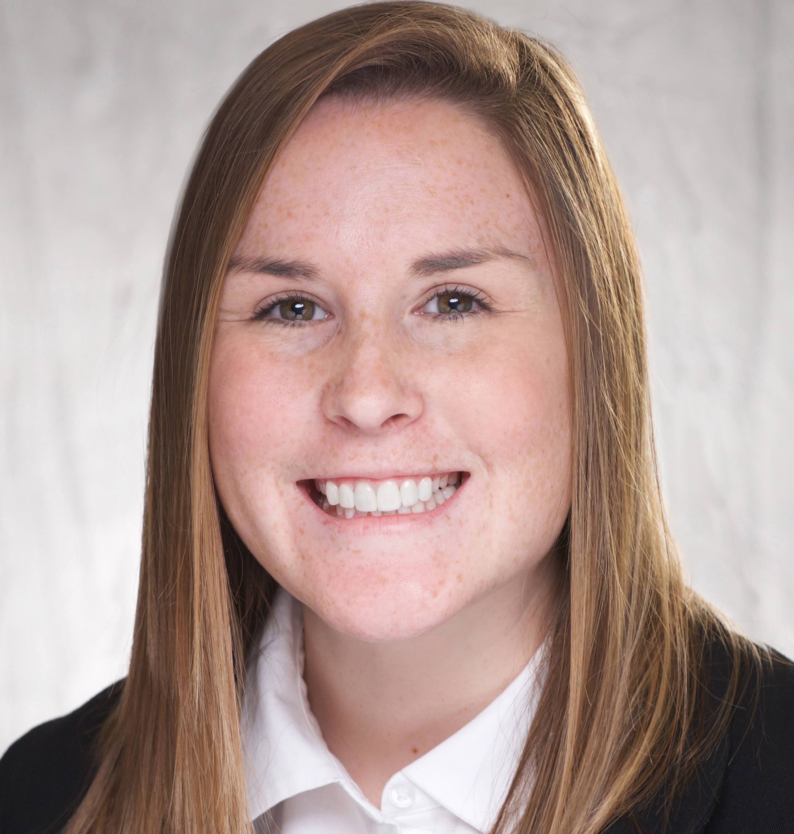
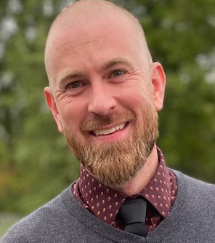
IT Leadership Award
Rising Star
Nikki Cardenas
Nick Carino-Marek
Notes:
The final IT leadership awards we have to present today go to two rising stars: Nikki Cardenas and Nick Carino-Marek.
Steve present certificate to Nick. Note: Nikki Cardenas is virtual.
Nikki is the security operations director in the Information Security and Policy Office.
She has done a great job pulling together various IT groups and identifying the needs of each division to achieve the goals set by the organization.
Nikki worked tirelessly with central and non-central IT groups on campus to determine how best to accomplish the migration to Microsoft Defender for Endpoint for over 60,000 hosts. Within a short timeframe of a few months, Nikki helped lead these groups to achieve this goal.
Nick is a senior IT support consultant with ITS Enterprise Services.
Nick inspires motivation, shows support for all team members, and communicates clearly and consistently. He leads by example with personal investment in day-to-day challenges and shows patience and a willingness to listen carefully before offering an opinion or advice.
Nick defines vision, direction, and support, and he is ready and willing to do anything asked of the team.
Congratulations to Nikki and Nick, and to all of this year's leadership award recipients!

Slide 9
Congratulations!
Read more about the winners at oneit.uiowa.edu

Slide 10
Closing Slide Header

