Slide 1
UI Health Care’s New Intranet
Access the information you need, when you need it
June 3, 2024
CHANGING MEDICINE.
CHANGING LIVES.®

Slide 2
Communication challenges: 2020-2023
Workarounds
COVID-19 pandemic underscored the need for a new intranet solution
Various groups started creating their own
End of life platforms
The Loop (WordPress, public)
The Point (SharePoint on premise)
Lost efficiencies
Security risks
Difficult to find information
Limited design and accessibility capabilities
No centralized process
Notes:
UI Health Care’s previous internal communication tools were The Loop and The Point. The Loop was hosted on a public WordPress site and was not behind a firewall and was subject to security threats.
The Point is hosted on SharePoint on premise and contains hundreds of sites, most no longer updated or relevant.
Groups were creating their own workarounds because the available solutions did not fit their needs.
Additionally, the COVID-19 pandemic underscored the need to have centralized information distributed in a timely manner that was easily accessible to all employees.

Slide 3
Listening to others
More than 1,000
interviews, surveys, and one-on-one discussions with employees about The Loop, The Point, and Drupal
WHAT WE HEARD
No easy way to limit/personalize content for health care needs
Hard to navigate and find info quickly
Poor search functionality
No mobile functionality
No employee collaboration functionality
Notes:
For these reasons and more, members of the UI Health Care MarCom team and HCIS contracted with Centretek, an intranet consultant, to provide strategic direction for a future intranet.
The team reviewed analytics and conducted interviews, surveys, and one-one-one discussions with employees about our current tools.

Slide 4
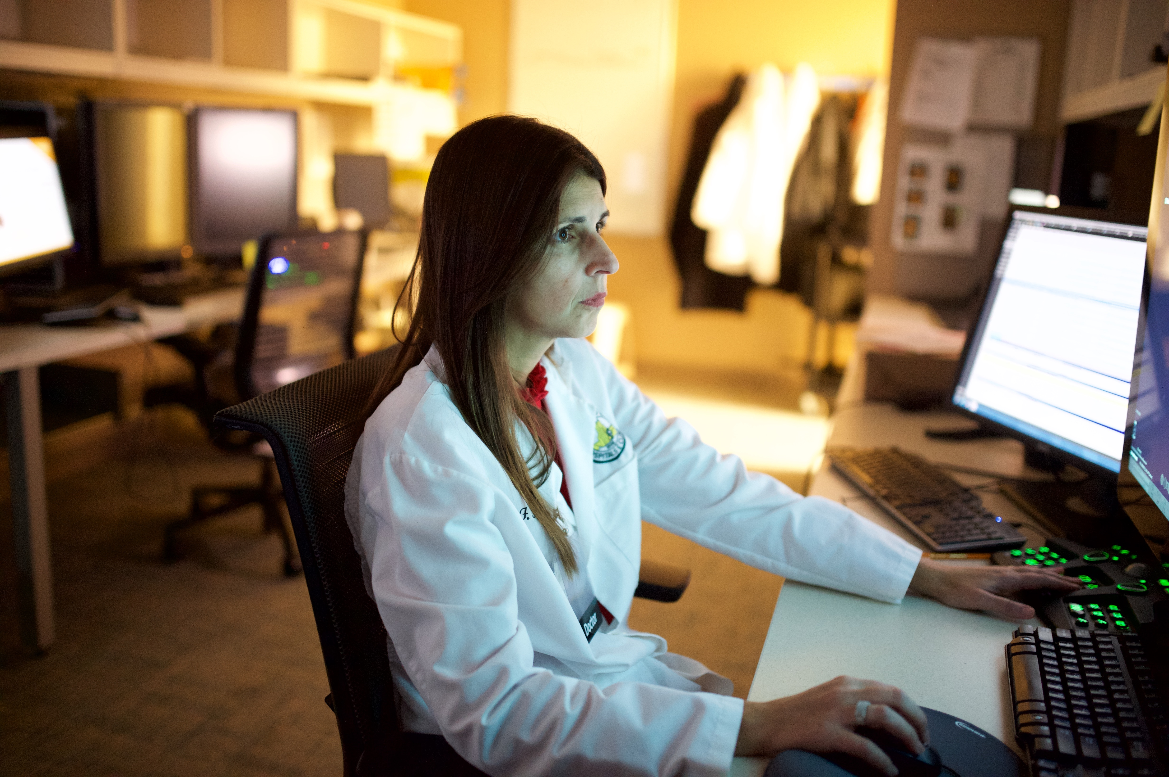
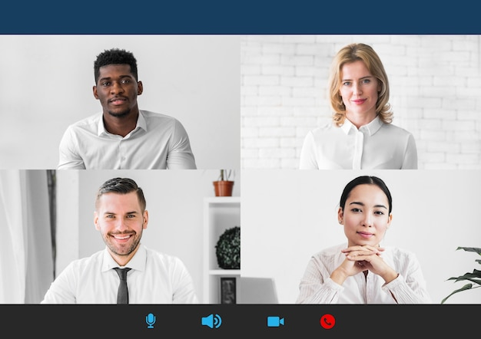
Finding the right solution
Recommendation for health care
Vendor selection
Interact
Out-of-the box intranet solution from a vendor with health care experience Hire an internal intranet team within Marketing and Communications to build and manage site
Outlined needs and requirements and began the RFP process
The team chose Interact; a company experienced in implementing health care intranets with options for personalized, targeted communications
Notes:
Centretek analyzed all the data and recommend purchasing the intranet solution from a 3rd party vendor rather than trying to build a custom solution in-house. Reasons included an accelerated deployment timeframe, cost, and external solutions met all the project needs and requirements. They also recommenced hiring an intranet team to implement and manage the new intranet.
Senior leadership approved the recommendation, and a selection team was comprised of various leaders from MarCom, HCIS, HR, and others to choose a vendor and a hire a team to manage the intranet.
Numerous vendors were interviewed and ranked on modern feel, ease of use, collaboration features, data retention, analytic capabilities, email promotion, and other tool integrations.
Interact was selected as the vendor and the contract was signed at the beginning of January 2023. The hiring of the intranet team was completed in Feb. 2023 with a communication manager, specialist, and coordinator roles.

Slide 5
Implementing the intranet
Process
Features
Next steps

Slide 6
Managing the scope
We divided implementation into two primary projects so that we could launch the new site faster.
Project One The Loop upgrade
Began Feb. 2023
Launched Dec. 13, 2023
Project Two Departmental content and The Point transition
Began Feb. 2024
Ongoing
Notes:
Project kicked off in Feb with a small core project team and then pulled in various groups for specialized components.
Quickly realized the scope of trying to build an intranet and move all the department content and The Point content wasn’t feasible.
We held a couple of strategy workshops to figure out the most pressing needs and decided to form two different projects.

Slide 7
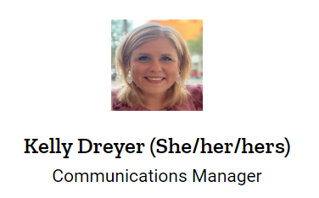
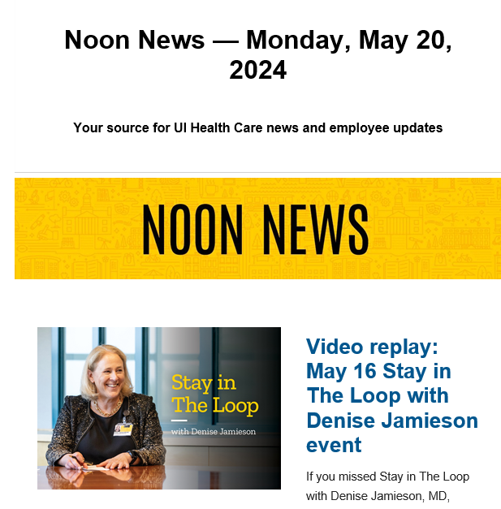
Project 1: Launching the new Loop
Technical integrations
Strategy
Framework and design
Content review and build
Communication
Support from HCIS and ITS:
Email
Employee data configurations
HawkID login
MS O365
Governance
Compliance
Mobile
Metrics and analytics
Navigation
Brand
Collaboration features and notifications
Calendar and directories
Transferred six months of news content
Other relevant information
Created Using the Loop site
Presentations
Leader emails
Loop articles (old site)
Graphic countdowns
Notes:
Weekly meetings with the Interact team to setup and implement:
Technical integration support from HCIS and ITS:
Employee data configurations for sync with university email, O365, HawkID/password, employee profiles, org charts, and ERMA/HRIS data.
These different integrations allow for personalization and targeted employee communications filtered by ancillaries, job title, department, and organization; and the ability to use the intranet to send a daily newsletter to all UI Health Care employees.
Strategy
Worked closely with Interacts strategist and various UI Health Care teams to implement governance, compliance, and mobile access to UI Health Care. Created flexible site framework to adapt to changes and plan for future growth
Framework and design
Designing user-friendly navigation to work in conjunction with search was crucial, especially because the organization is so vast in the different types of content. Took the perspective of what does everyone employee need to know and then expanded. We will constantly be visiting navigation needs with Project 2 as department sites and communities are created and more information is moved into The Loop.
Training the project team to learn functionality at the same time building the system
Analyzing features, deciding which ones made the most sense to deploy in phase 1 or should be launched later.
Creating templates and standards for enterprise communication needs.
Content Review
Reviewed all content on the old Loop site and decided to transfer 6 months of new content and archive the rest
Built on COVID-Hub, Infection prevention, technologies and tool sections, and linking to other relevant information (University HR)
Really focused on the high-level organization needs
Created new training site called Using the new Loop, included videos, FAQs and other reference information
Communication and change management
Started updating key groups and leader 6 months before launch to socialize concept and listen to feedback
3 months till launch – started updating all the various groups within UI Health care – targeted leadership, HR, and various administrative groups to help spread information
Presentations, leader emails, department communicators, and admin flow down were highly effective and well-received
2 months before launch we started teasing the new features in Noon News. We opened access up to select groups, leadership, department communicators to pilot the site and provide feedback
For launch we had count down graphics and posters. The day of the launch Herky handed out QR codes with new URL and we had Herky and hula hoopers in fountain lobby – used the slogan Hula Hoop for the new Loop.

Slide 8
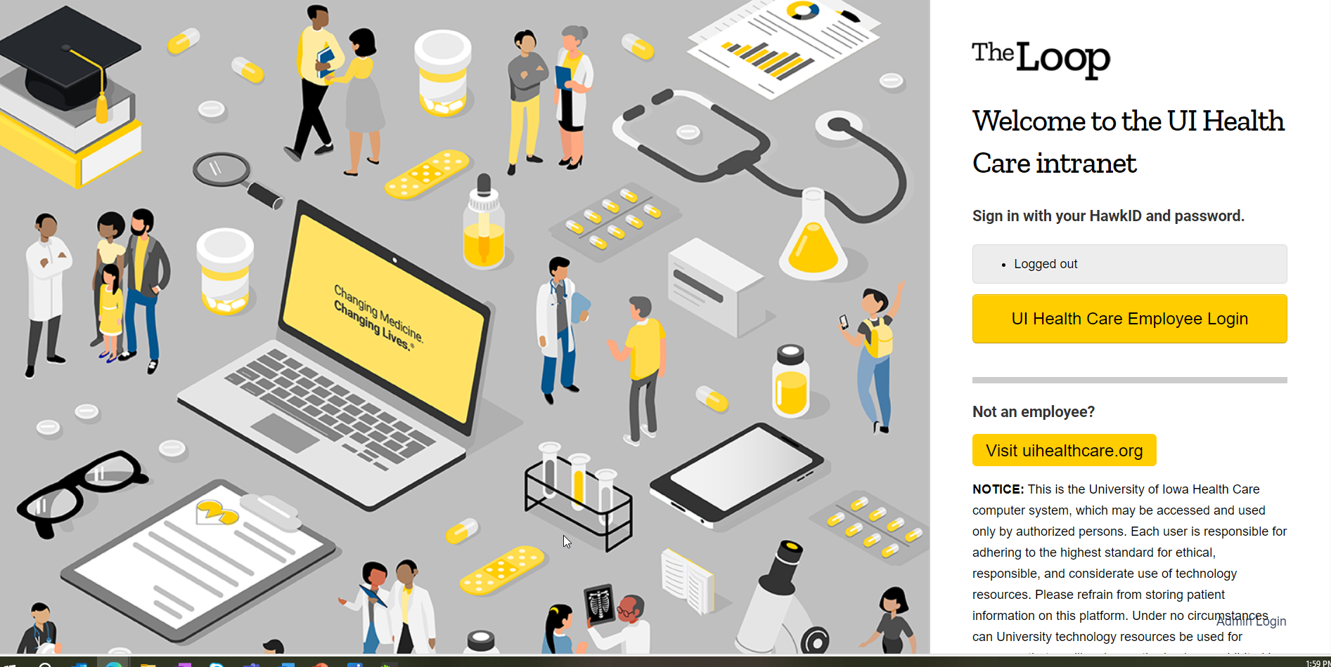
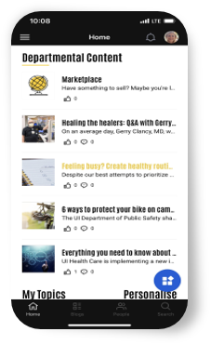
Accessibility
Accessible, usable, and friendly on phone or tablet; can access critical information from any device
Works with all current, modern browsers
Single sign-on options to protect your personal information​
Easy authentication with HawkID and password
Notes:
Feature we were able to implement in Project 1:
Accessibility – Any UI Health Care employee can login from any device - you don’t have to be on the UI Health network to have access.
Because it’s hosted in the cloud, it is still accessible if the UI Health Care network is experiencing issues.

Slide 9
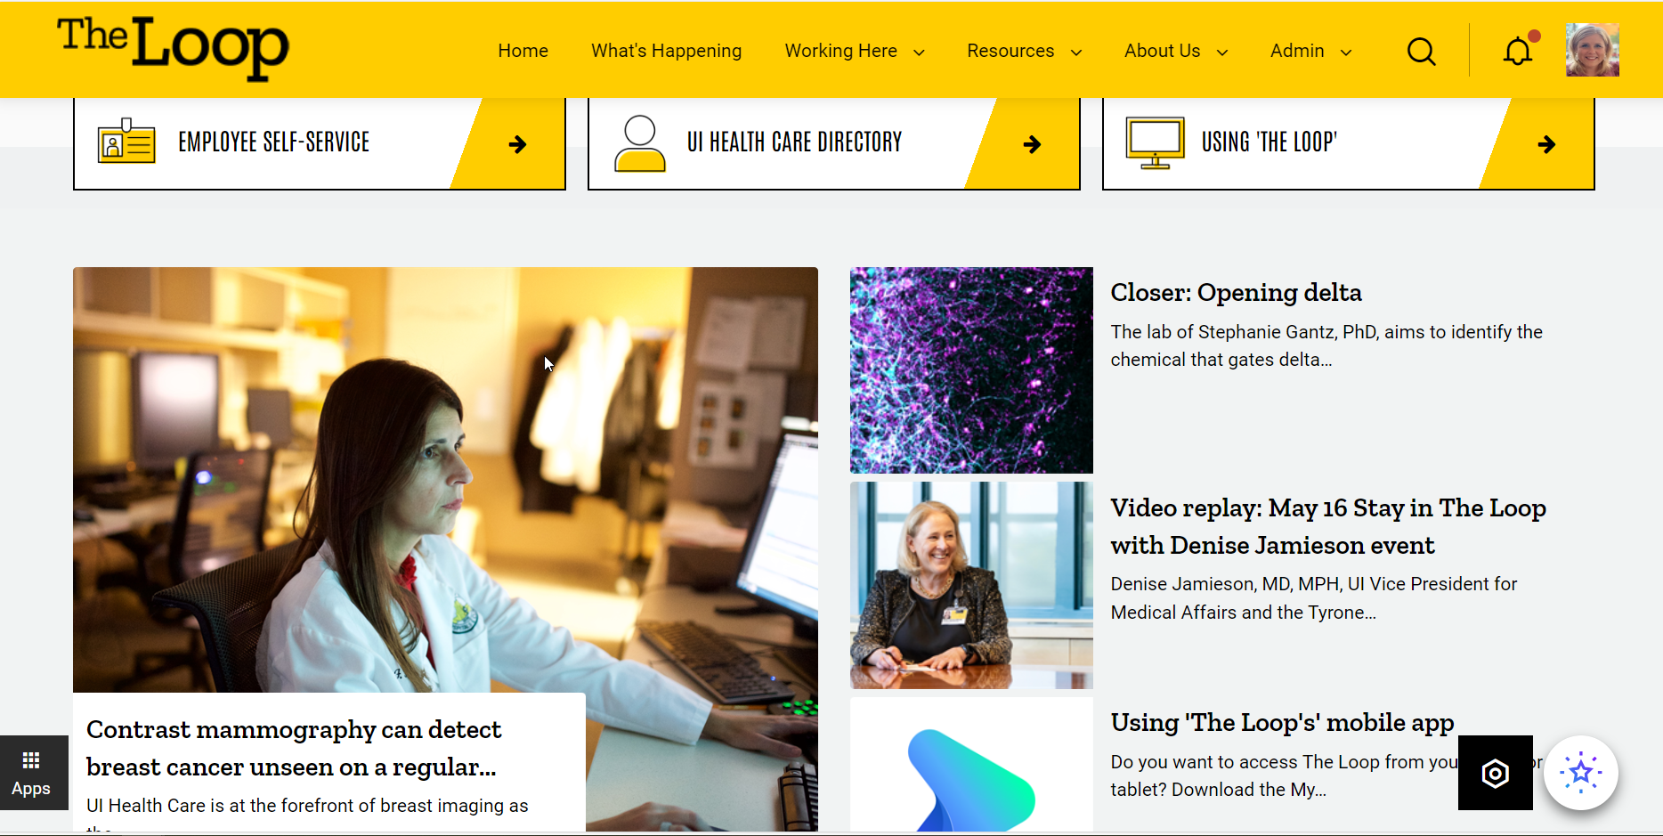
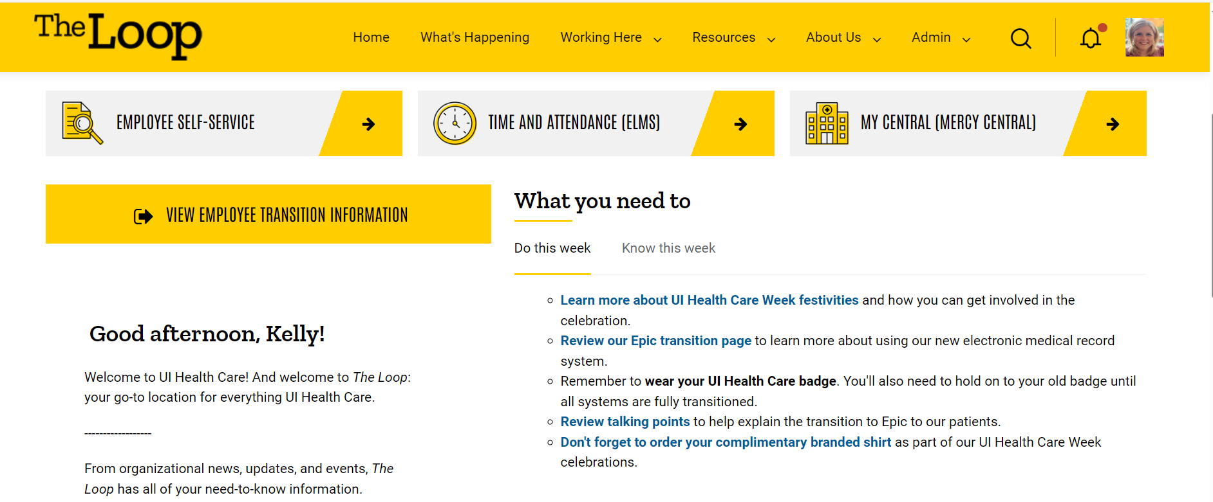
Personalization
Customized homepages with
relevant information
Content can be targeted and filtered
Permission-based viewing
Profiles with system fed org charts
Notes:
Multiple ways to create custom content for individuals using a variety of different methods.
Example on the right targets zone-based personalization using personas.
Example on the left is a dedicated homepage permissioned out the downtown campus and focuses on specific actions they need to complete for the week.
Depending on the specific need, there are many ways to create personalization and just in time communication.

Slide 10
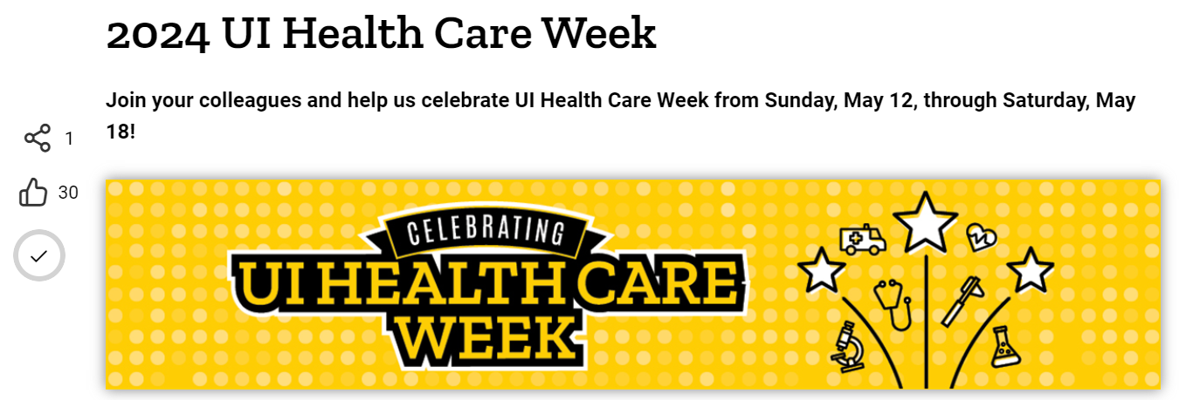
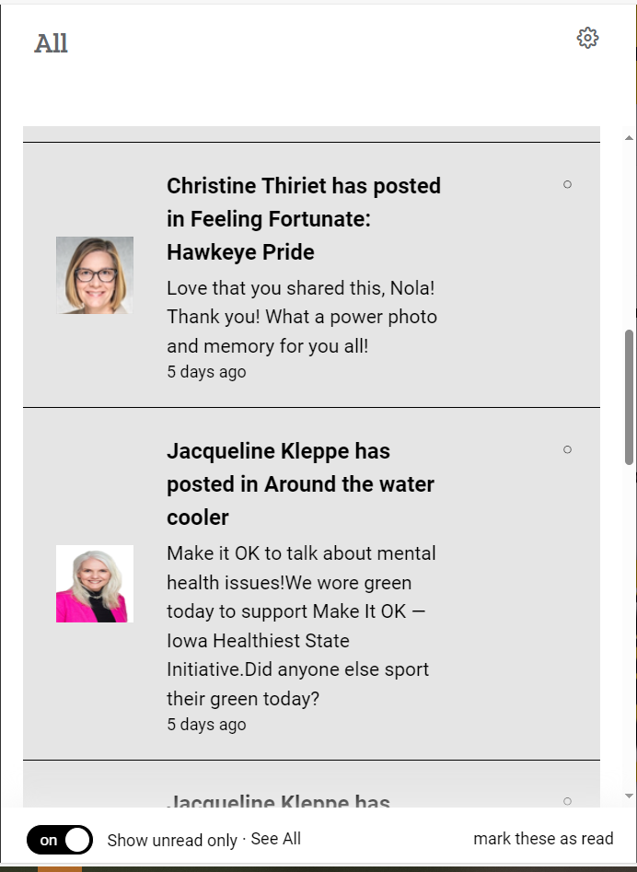
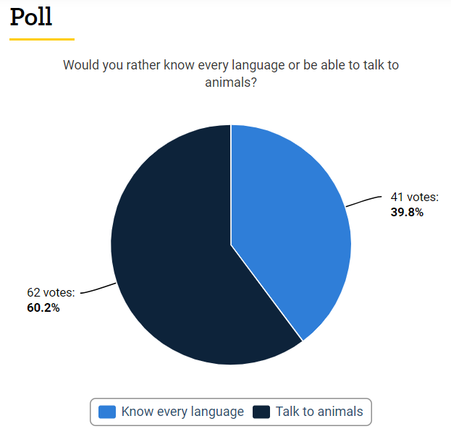
Collaboration
Promote a page
Targeted distribution groups managed through HRIS/ERMA
Share, like, and comment
@mention
Notifications and subscriptions
Forums, polls, and pulse surveys
Broadcasts and required reads
Notifications
Notes:
There are so many new collaboration features now available.
Promote a page – sends directly from the intranet, we no longer use Dispatch or Outlook to send Noon News, which goes to ~25,000 people daily. Can use to send department information that would normally go in an email
@mention via a comment or share to quickly distribute information. You can also like and favorite content.
Notifications can be sent via email or a bell icon and provides you a list of all the different content you have been tagged in. System wide notifications are set, but individuals can also change their personal notification settings
You can also subscribe to pages you are interested in receiving updates on.
Additional collaboration features include the ability to create forums, polls, and surveys.
Broadcast and required reads can be used to communicate emergency situations or compliance requirements.

Slide 11
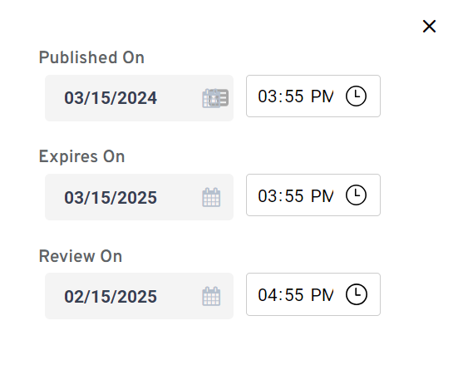
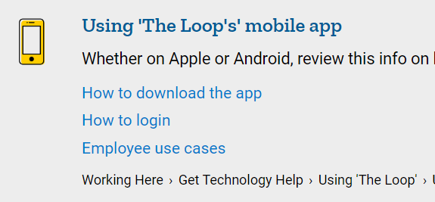
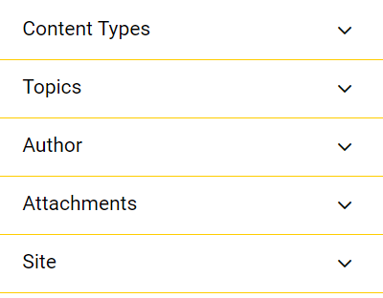
Search and data retention
Customized results
Searches different document types
Data retention
Best Bets, topics, and other content filtering options
Searches various locations​ and O365 permission-based documenting viewing
Review settings are customizable with built in archives.
Notes:
New ways to tag and filter content to find information quickly such as best bets, topics, and the capability to choose specific filters.
Search will search all information you have permission to see and pull relevant information from The Loop and Teams and OneDrive (but only what you are permissioned to see)
Each page created has data retention automatically built-in. Will automatically set for one year but can be customized based on needs. Never deletes a page but will archive and take from review on the Expires on date.

Slide 12
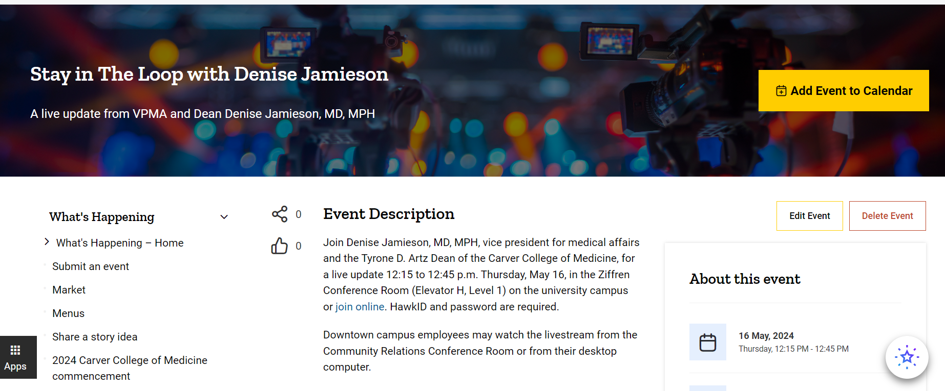
Additional features
UI Health Care calendar
UI Health Care directory
Communities
Analytics
Notes:
We created a UI Health Care calendar that employees can submit their events and it will add it the event to your Outlook calendar. It also has rsvp capabilities and count down graphics of the event.
The UI Health Care directory pulls from ERMA/HRIS and can be filtered by job title and department.
Virtual communities are a great space to encourage conversation and interaction between employees. You can choose whether to make your community open so everyone can be included or private so only those who are invited or accepted by an administrator can participate or keep hidden for more confidential purposes.
Interact offers several ways to capture analytics, you can view the intranet wholistically, as a site or community, or down to analytics on an individual page. You can also see data by login history, author, page quality scores, and collaboration usage.

Slide 13
Building a custom solution for each area
PHASE 1​ TECHNOLOGY/CONTENT AUDIT
PHASE 2​ INTRANET SITE LAUNCH
Kick-off meeting with department leadership to learn about the department’s communication needs
Discuss roles and responsibilities – designate a team
Strategic vision and audience(s)
Content review and plan for moving content (The Point, file shares, etc.)
Training for site administrator
Framework and navigation
Build content pages
Training of authors/approved authors
Editorial calendar
Pilot
Launch communications
Metrics and analytics
Notes:
Our goal is to build a custom site depending on the individual requestor’s wants and needs. It could be project based, a department site, a research community or a simple page or two. We also talk through the audiences that will need access and that will dictate what type of site we build. Groups may get a combination of sites depending on the information that needs to be shared from a confidentiality perspective.
Interact is widget based, so content can be sent to various places and spaces throughout the intranet without having to recreate the content. One of the intranet team’s main goal is to be the central connector of information and how we make information dissemination easier.
This process can move as fast or slow as needed.

Slide 14
What to expect
This change has felt a little like making a snowball. The functionality is growing and becoming more robust as we migrate content and use the site and search features.

Slide 15
Thank you
Crystal Hardinger
Director, Strategic Communications
Marketing and Communications
319-384-9793
Crystal-Hardinger@uiowa.edu
Kelly Dreyer
Intranet Manager
Marketing and Communications
319-356-8445
Kelly-Dreyer@uiowa.edu
uihc.org

