Slide 1
IT Service Management
Tech Forum 2024
June 3, 2024
Notes:
Introduce ourselves
Text on slides, but won’t be reading them, more conversation, read it on the website

Slide 2
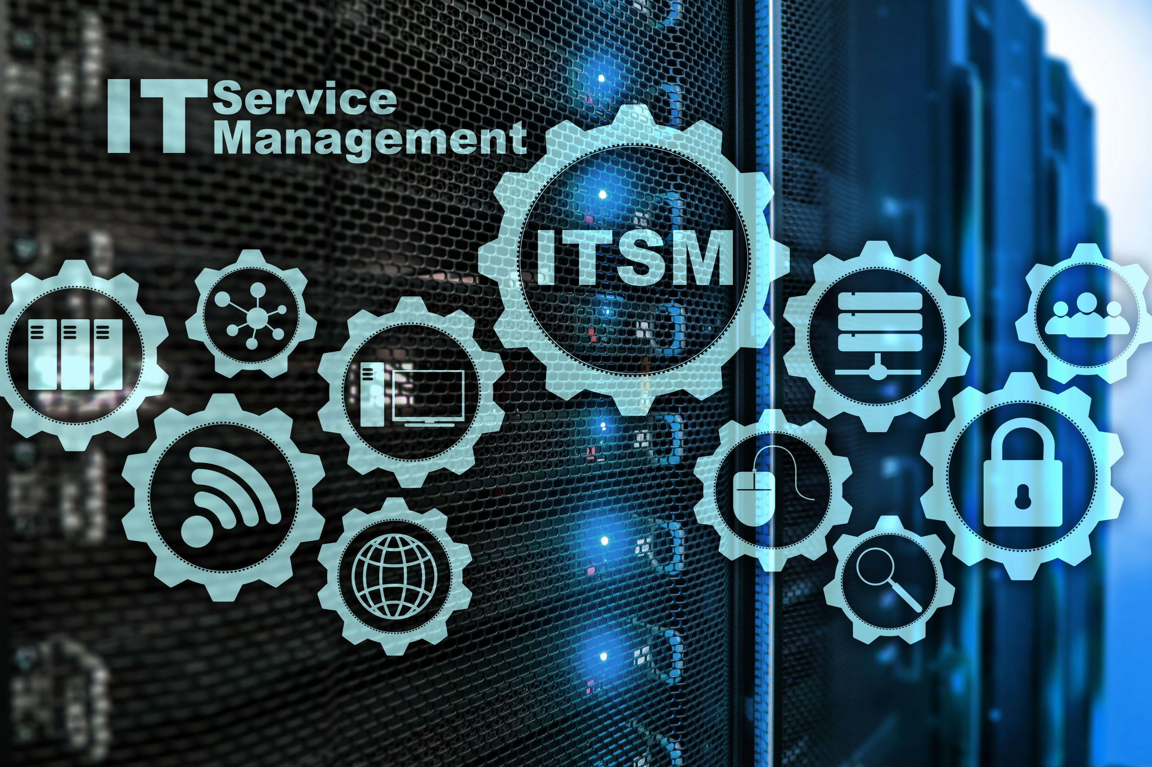
What is IT Service Management?
The ability to deliver IT services to your customers in the most efficient way, enabling customers to be successful
Benefits:
Enables cross team collaboration
Teams are speaking the same language
Repeatable ways to deliver services to the customer
Stability, consistency, and clarity for users who use IT services
Notes:
Dave: IT services, how we deliver IT services, framework, etc.

Slide 3
How do you define a service?
The delivery of technology related support and solutions to end-users or customers. These can be systems, platforms or infrastructure that provides value to the business
Examples:
Email, document management, voice, computer & hardware management, nurse call, patient interactive system
Both software & application, cloud services, physical items. Such as Computers, Printers, other equipment
People, process, technology. Such as Service desk, User Consulting, Training
What do you think is a service?
Notes:
Dave: IT services, how we deliver IT services, framework, etc.

Slide 4
ITSM concepts you can use today:

Slide 5
Putting the customer first
How to put your Customer first:
COMMUNICATION
Customer visibility: Give the customer a voice. Surveys, user focus groups, feedback, etc.
Understanding the need or expected outcome from the customers perspective.
Continual Service Improvement
Notes:
Dave: IT services, how we deliver IT services, framework, etc.

Slide 6
Change
Change management (ITIL process)
Documenting a change
Change awareness/visibility
Communication to the customer about a change
What if a change fails, what is the process or ability to rollback to the prior state
Do it on Test before we do it on Production
Even if you don’t have a formal change process, these concepts can be useful
Notes:
Dave: IT services, how we deliver IT services, framework, etc.

Slide 7
LEAN strategies
Lean is all about eliminating or reducing any work that is considered non-value-adding to a process.
VISUALIZE: Physically map out your current activities, look at or study them, see where you can eliminate waste, remove and try again.
Notes:
Dave: IT services, how we deliver IT services, framework, etc.

Slide 8
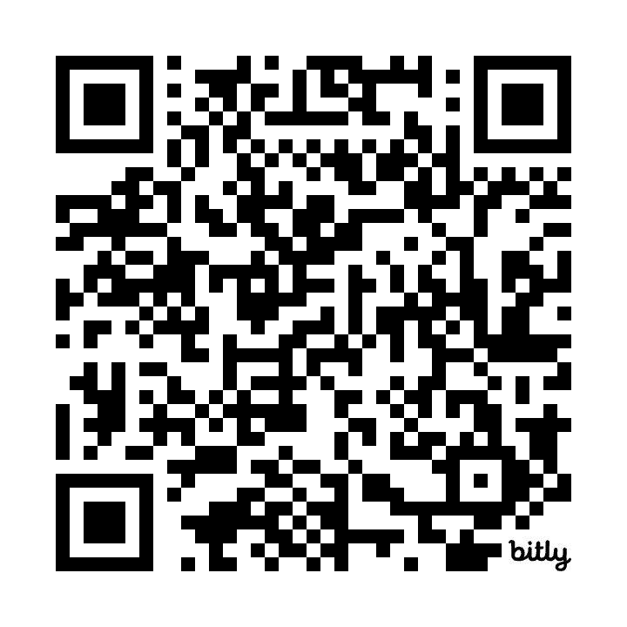
Would you like to learn more?
QR code to shared a shared word doc
Includes some resources we have found useful
You are welcome to add your own!
bit.ly/TechForum2024_ITSM
Notes:
Dave: IT services, how we deliver IT services, framework, etc.

Slide 9
Thank you!
jennifer-reinier@uiowa.edu
dave-long@uiowa.edu

Slide 12
Other frameworks

Slide 13
Roll back strategies

Slide 14
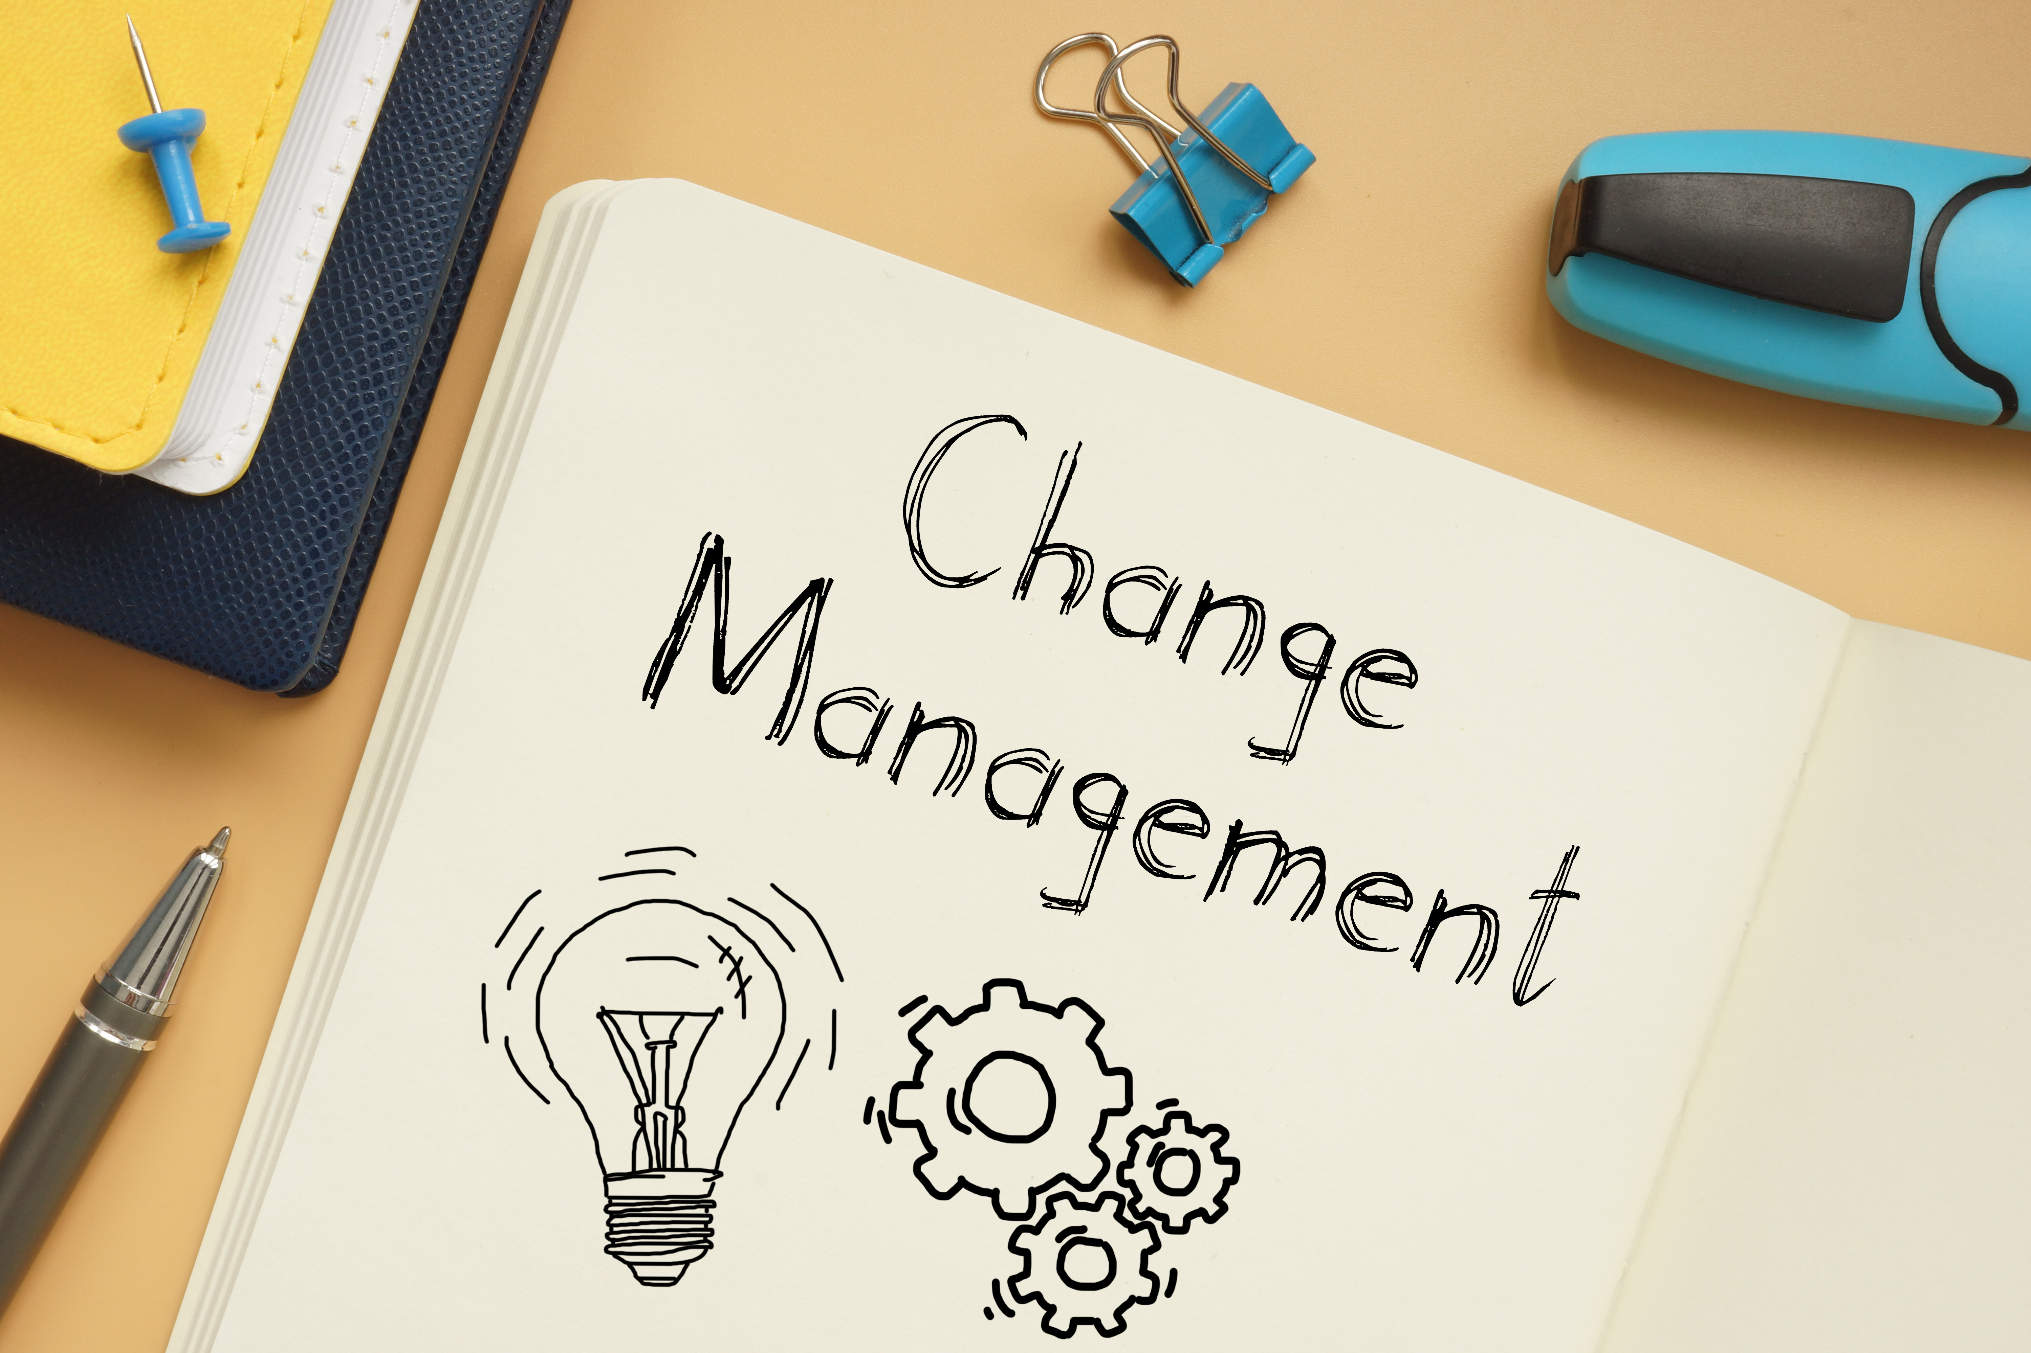

Slide 15
Putting the customer first
COMMUNICATION
Customer visibility: Give the customer a voice
Understanding the need or expected outcome from the customers perspective
Continual Service Improvement

Slide 16
Vocabulary
Incident: something is broken, I can’t do what I used to do
Service Request: you need to get an IT provided service

