Slide 1
Copilot Studio
Tech Forum
June 3, 2024

Slide 2
Introduction
https://copilotstudio.microsoft.com (not available unless you have a license)
Copilot Studio is NOT a service currently, and we don’t have support
It is currently being tested and evaluated along with other tools
More Information - https://learn.microsoft.com/en-us/microsoft-copilot-studio/

Slide 3
Overview of building a chatbot
Leverage information from public web sites, SharePoint sites, documents and more
Deploy to multiple channels (Teams, public web site, mobile app, email and more)
Create custom process flows (e.g. during business hours escalate to an agent, after hours create a ticket)
Ask questions and change response based on answer (e.g. student, faculty or staff)
Add Skills allowing the chatbot to book an appointment, send an email, etc.
Much more…

Slide 4
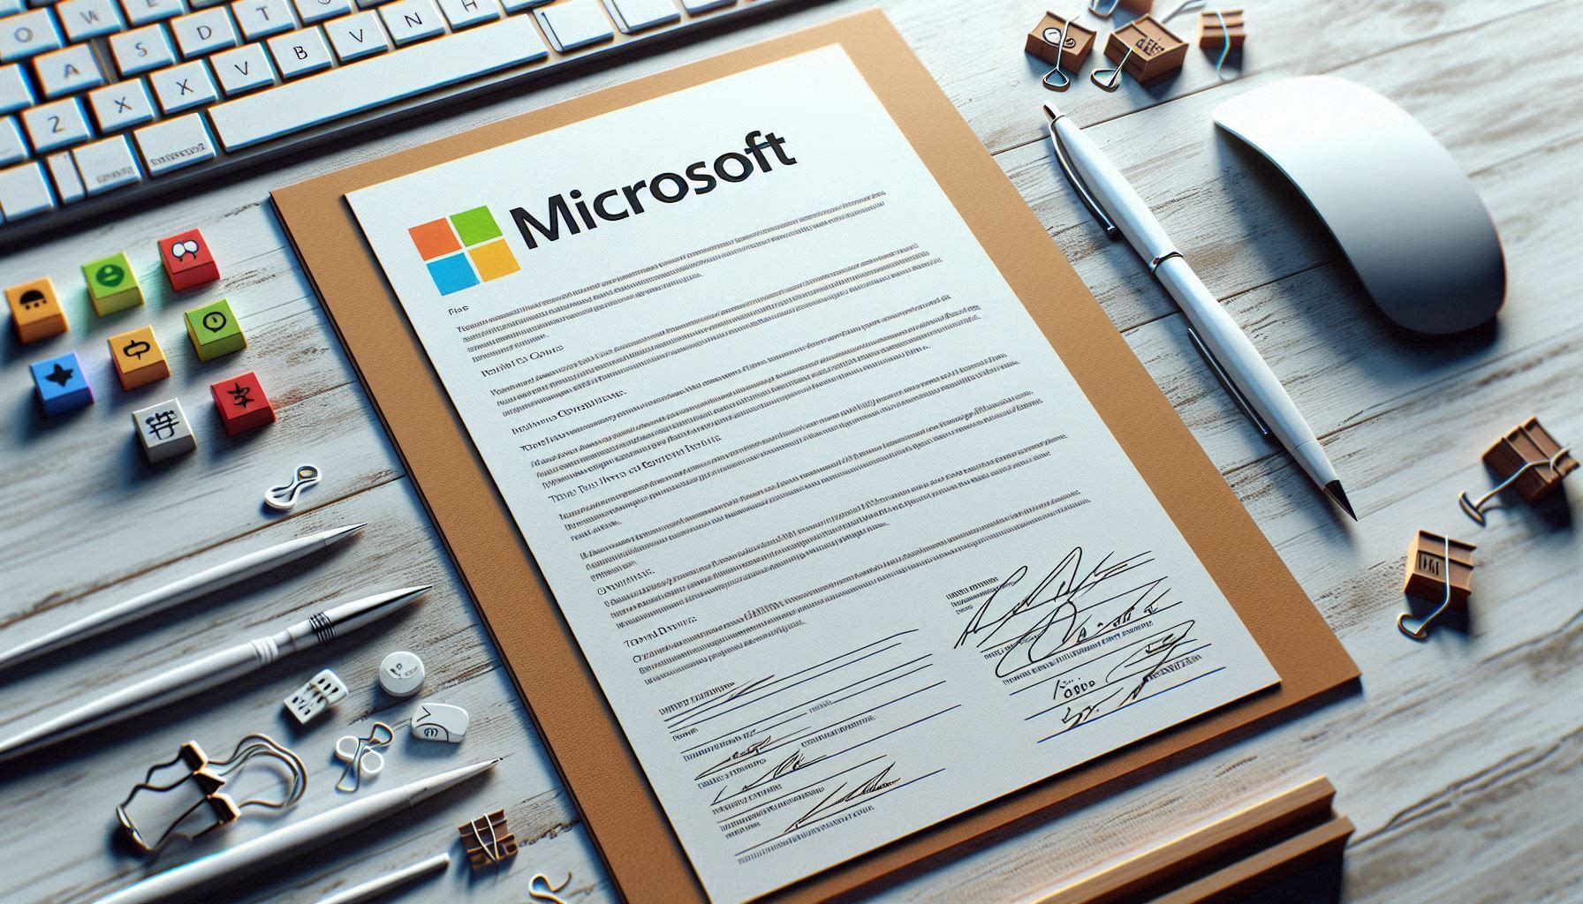
Licensing
Copilot for Microsoft 365 License
Free Copilot Studio Licenses (allow you to build chatbots)
Deploying a license for public use is where costs come in
$121/month for 25,000 “Messages”

Slide 5
Considerations
Clear goal on what you are trying to solve; start small
Realistic expectations; a chatbot isn’t going to eliminate the need for people to answer support questions
Accuracy of the knowledge the chatbot is leveraging
Monitoring and refining – chatbot is not a set it and forget it tool
Guardrails – how does the chatbot respond if someone asks something unexpected?

Slide 6
Let us know if we can help
Manda Marshall (manda-marshall@uiowa.edu)
Tracy Scott (tracy-scott@uiowa.edu)

