Slide 1
UI Accessibility Support Interest Group
A Collaborative Approach to Academic Accessibility
June 3, 2024

Slide 2
TM Weissenberger, Digital Accessibility Coordinator, ITS Information Security and Policy Office Maggie Jesse, Exec. Director, ITS Office of Teaching, Learning, and Technology
Notes:
Hi everybody. Welcome to TechForum 2024. It's always a great event. Thank you to our speakers today for sharing their expertise and thanks to every last one of you for your role in our OneIT community here at the University of Iowa. Today Maggie and I have been tapped to…

Slide 3
Notes:
Today Maggie and I have been tapped to talk about cheese. Well, not exactly cheese, but ASIAGO. Let me tell you what happened...

Slide 4
Notes:
In October of 2022—or actually it goes back a little bit further back—in September of 2022 the urgency of pandemic began to subside, and our campus was finding ways to reconcile our new and old normals. At that time I began to receive a higher-than-typical number of service requests on various accessibility topics—pandemic-related things like remote conferencing, captioning, and also more conventional things like electronic documents, OER materials, and Canvas, just to name a few—from stakeholders in the Office of Teaching Learning and Technology and in the Center for Teaching and from Student Disability Services. What these requests had in common was that they all related in some way to academic success, accommodations, and accessible technologies—all in the realm of teaching and learning. The fact that so many service requests were arriving from such adjacent groups suggested that there might be an opportunity to develop sort of a unified process for addressing accessibility within the domain of academic technology.

Slide 5
UI Accessibility Support Interest Group
(a)
Notes:
So in October of that year we convened the first meeting of what was initially known as the University of Iowa Accessibility Support Interest Group, a name which eventually fell prey to our internal propensity for acronym

Slide 6
Notes:
And that’s why today we’re here to talk about ASIAGO.

Slide 7
Who is ASIAGO?
UI Accessibility Support Interest Group (ASIAGO)
Informal group of staff
Care deeply about these issues
Spend significant time supporting students with disabilities
Started meeting in October 2022 – members from across campus
Student Disability Services
Center for Teaching
Distance and Online Education
Division of Access, Opportunity, and Diversity
ITS
University Libraries
Some collegiate staff
Notes:
So it’s a pretty wide-reaching effort now, with folks from all over the place working collaboratively. How did we get here? Well, there were two sort of indicators that we need to expand our collective perspective:

Slide 8
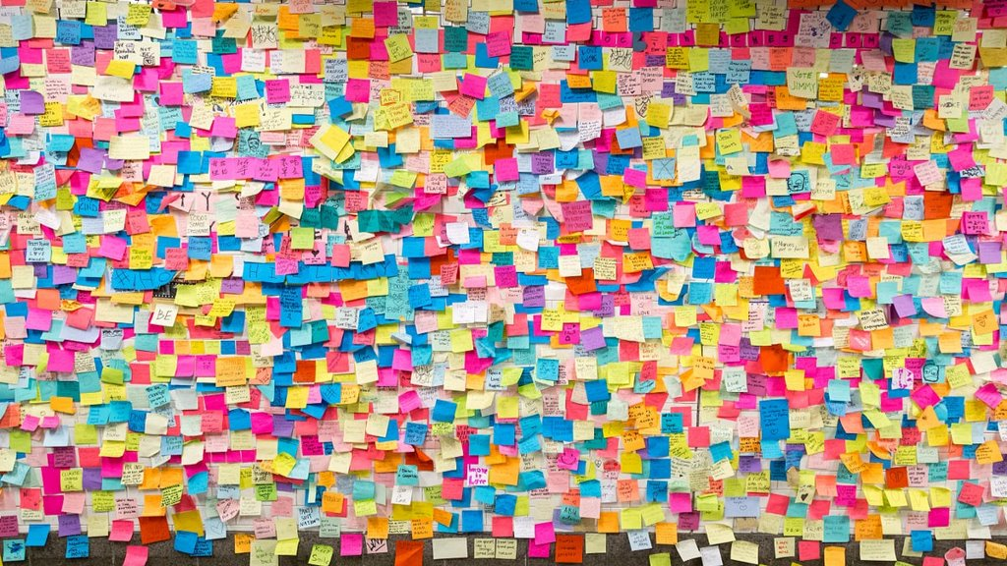
Notes:
The second was a backlog of issues we identified that needed to be addressed, We began to look more closely at real opportunities around accessibility in the Teaching and Learning community. We asked questions like “What about the SITAs”, “Can we track accommodation tickets in Cherwell?”, and “Who is really the service owner for a given assistive technology?” If I’m being honest, some tasks turned out to be more aspirational than actionable and a few of the questions were probably out of scope for the group but we also answered some questions. We learned that Cherwell might not have been exactly what we were looking for. We found the owner of that technology. We answered some questions.

Slide 9
ASIAGO Then…
Generated backlog of accessibility-related opportunities
Identified dimensions of accessibility in teaching and learning domain
Units represented at initial meeting
4

Slide 10
Dimensions of Accessibility for Teaching and Learning
Policy & Standards
Tools
Pedagogy
ADA Title II
Standards (e.g., WCAG, 508)
ICON
Panopto
Digital Textbooks
Zoom
UDL
Iowa Regents Policy
Support
OTLT
Pressbooks, Top Hat, Etc.
Documents/OER
SITAs
SCIT
SDS
ITS (ETS, Help Desk)
Syllabus
IT Accessibility Policy
Section 504
Center for Teaching
Instructional Designers
Other?
Other?
Other?
Libraries
Other?
Course Notes/Recording
Inclusive Language
Professional Development
Notes:
The first was a visual—I’d sketched out some dimensions of the teaching and learning ecosystem and where accessibility knowledge and practice might fit into those. These dimensions: policy/standards, support/people, tools, and pedagogy have a lot of crossover and can be really intersectional, so we reached out and invited participation from other interested parties and now we have a robust, cross-functional group of passionate individuals.

Slide 11
...and now
Created inventory of tools to support student accommodations
Developed accessibility tactics for consideration in OneIT Strategic Plan
Reviewed peer programs such as Northwestern’s Mission Accessible and Minnesota’s Accessible U
Established service ownership for unmanaged software
Interviewing faculty, students, peer institutions
Reviewing candidates for enterprise teaching and learning tools
Preparing report for Provost's Office
…?
Units represented at recent meeting
8

Slide 12
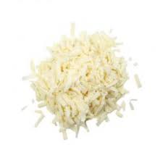
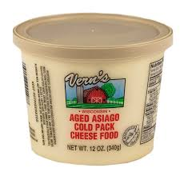
Notes:
So what is ASIAGO then? The ASIAGO group has been meeting monthly for almost two years now. We're not really a committee, we're not really a project, not really a grassroots movement, not quite a community of practice—I would characterize ASIAGO as a response to some gaps that at some point became more evident and grew into opportunities. Like Maggie says, sometimes the most effective path to progress is to capitalize on shared passion among individuals with a variety of skills and roles. And speaking of Maggie, here she is now to talk about one of ASIAGO's important current efforts.

Slide 13
Came to the attention of leadership….
In December 2023, ASIAGO was charged by the Provost’s Office to: “…undertake a landscape analysis to develop an inventory, or campus environmental scan, of campus strengths and gaps regarding accessibility and accommodations in the teaching and learning environment at the University of Iowa.”
Target completed report by end of May 2024
Notes:
In December 2023, we came to the attention of leadership in the Provost’s Office who approached us to do a “campus environment scan to identify strengths and gaps regarding accessibility and accommodations” with the scan being scoped to the teaching and learning environment.
This focused project provided the group an opportunity to respond to stakeholders’ concerns (students, faculty, and staff) and develop recommendations leading to a roadmap for improvements and new opportunities to serve the campus in more effective and efficient ways.

Slide 14
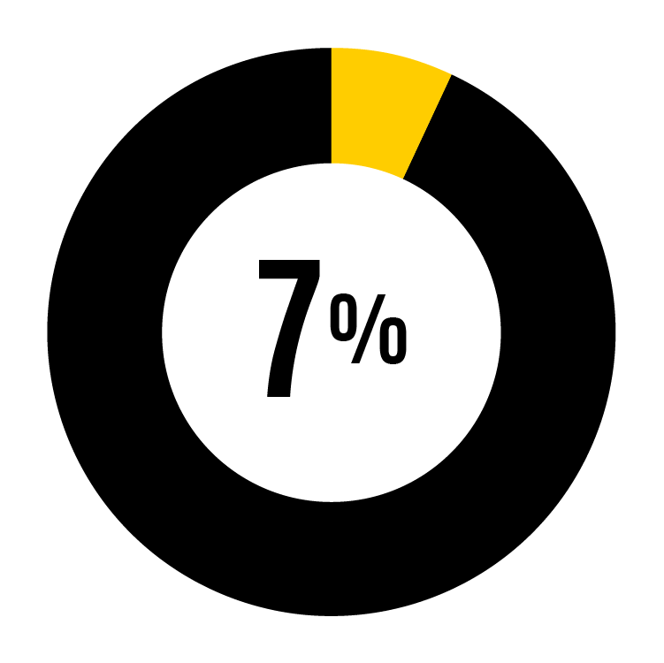
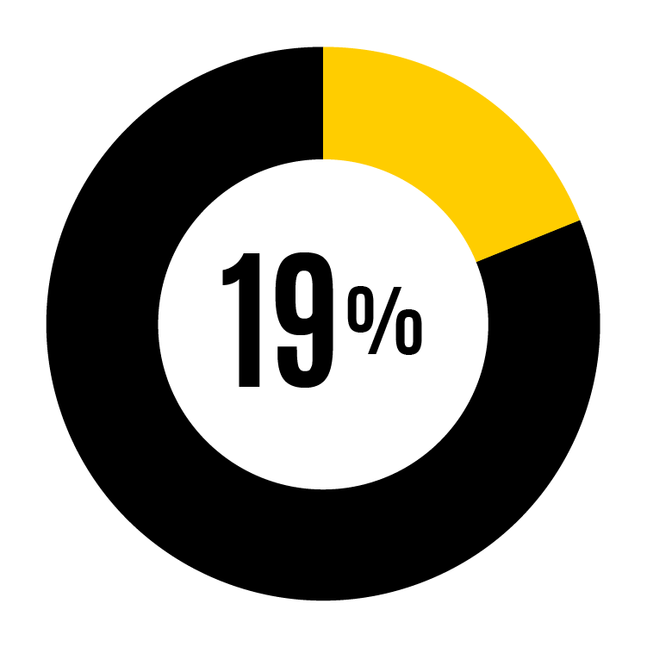
Increase in services and accommodations
Fall 2008
Fall 2023
2008-2023 changes
Total enrollment: 30,561
Total accommodations: 2,085
Percentage of student body with accommodations:
Total enrollment: 31,452
Total accommodations: 5,850
Percentage of student body with accommodations:
Enrollment: 3% increase
Accommodations requests: 180% increase
180%
increase
Notes:
Leaders know that there is growing demand, increased concern, and external pressures to ensure that we’re effectively supporting students with disabilities. The pandemic required that all of us - faculty and support providers – learn to use technology more efficiently and effectively. It increased campus confidence in our ability to rapidly improve the teaching environment for student success. At the same time, we saw rapid increase in the numbers of students identifying the need for additional support and accommodations, particularly for formal support through Student Disability Services. These services and accommodations include extended learning time, reduced distraction testing environments, and technology tools to support learning challenges. Luckily, the technologies to support these activities are rapidly evolving, sometimes through the addition of artificial intelligence, but also just through a better understanding of student needs and our own skillsets in improving digital content and course delivery that universally supports all students with any learning challenge.

Slide 15
2024 ASIAGO Report
Between January and May 2024 ASIAGO members
Interviewed or held focus groups with dozens of
Collegiate leaders
Faculty
Students
Support staff
Met with Big Ten peers to identify best practices
Collected and analyzed data
Synthesized the outcomes
Preparing final report for executive sponsors
Notes:
While ASIAGO was initially visioned as an informal group of passionate supporters for improved accessibility and accommodations in the teaching and learning environment, we were also pleased to have a targeted and potentially impactful opportunity ahead of us. We began immediately to identify the appropriate stakeholders for interviews and engagement, collect supporting data, and identify recommendations to create momentum towards impactful improvements.

Slide 16
High-level recommendations
Develop new guidance resources for faculty
Identify funding for and implement technology tools and other supports that will increase efficiency and effectiveness
Provide human support opportunities
Notes:
Our work has identified three high level recommendations that will need to be supported through a number of tactical long and short term projects and initiatives.

Slide 17
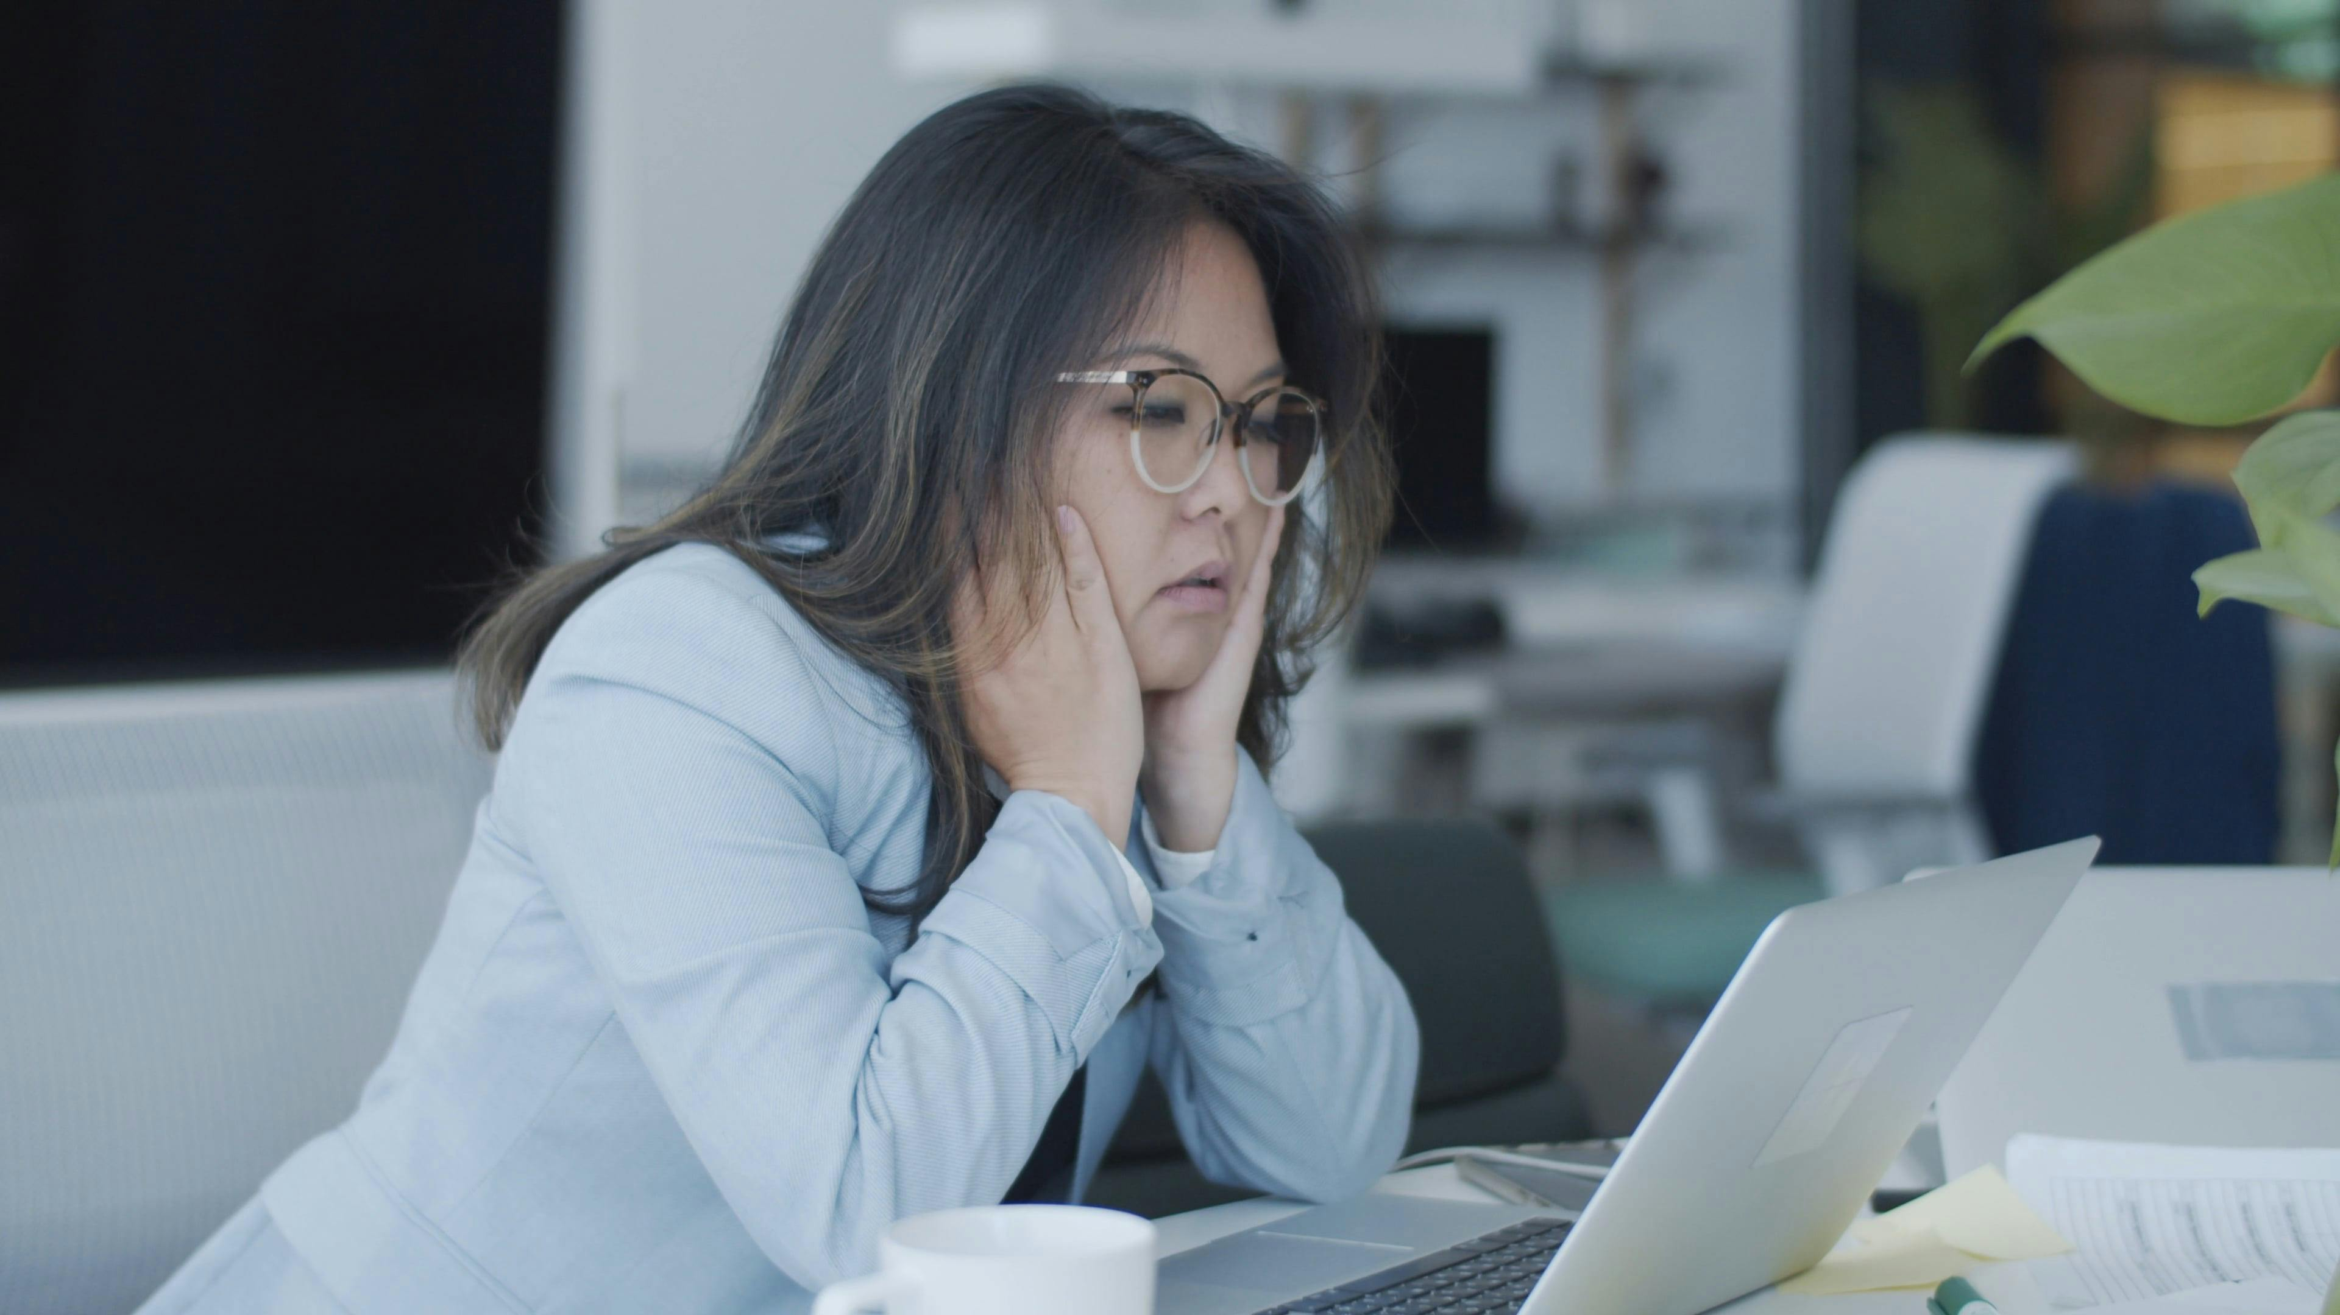
Risks and concerns
180%
increase
DEMAND!!!
Recent Department of Justice Ruling gives higher ed institutions until April 24, 2026, to provide fully accessible web and mobile content.
Demand for accommodations is rapidly rising, while service availability is not growing.
Current demands on faculty time will make it difficult to place all the burden of digital accessibility and accommodation needs on their shoulders.
Notes:
What if we DON’T do these things? There are certainly risks and concerns that were identified during the campus scan and we will need to identify ways to mitigate or eliminate these concerns. They include:
-The recent Federal Department of Justice ruling that requires us to provide fully accessible web and mobile content, including all systems behind authentication (ICON, Panopto, etc.) by April 24, 2026 – which is a daunting task.
-Demand has been rapidly rising for many years and there is no sign that the trend is slowing.
-Much of this work will fall on the shoulders of faculty to support our students in their learning environment. We need to identify ways to increase skillsets for creating accessible content, streamline content creation with appropriate tools, support broader video captioning, and offer more supports around accommodation requests.

Slide 18
Opportunities
The technology to identify, report, and even remediate some issues online has become quite sophisticated and could help with these burdens.
AI is rapidly becoming a potentially, powerful tool to assist with things like auto captioning of video, screen reading, etc.
We have a solid community of people, as evidenced in ASIAGO, who are passionate and willing to step up to the challenge.
Notes:
But we discovered great news on this campus as well.
The technology to identify, report, and even remediate some issues online has become quite sophisticated and could help with these burdens.
AI is rapidly becoming a potentially, powerful tool to assist with things like auto captioning of video, screen reading, developing study aids such as class notes, etc.
We have a solid community of people, as evidenced in ASIAGO, who are passionate and willing to step up to the challenge.

Slide 19
NEXT STEPS
Identify the specific tactics needed to accomplish the high-level goals
Get executive sponsor approval
Lay out project plans, timelines, etc.
Implement!

Slide 20
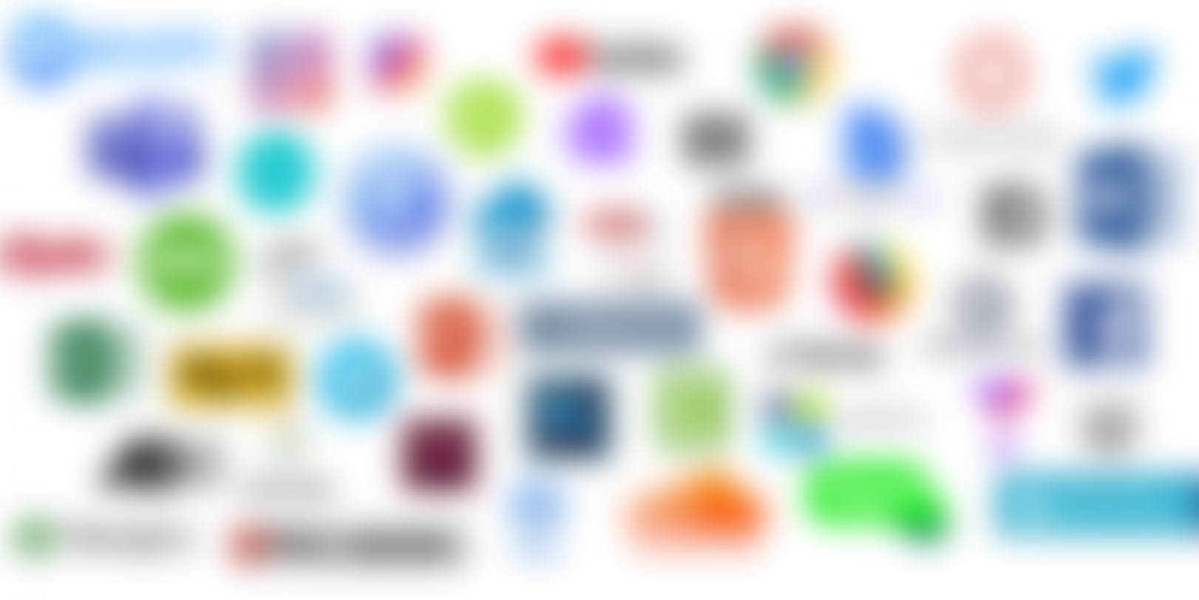
What is Digital Accessibility?
Notes:
Digital accessibility means that documents and media, websites, hardware, software, and other IT systems are designed for equitable use by all users, including people with disabilities.
Digital accessibility is the goal of a managed process for designing, developing, acquiring, deploying, and supporting information technology. Digital accessibility is the result of many factors, including intentional strategic and tactical decisions, application of real-world practice, institutional policy support, adherence to applicable standards, compliance with legal requirements, and empathetic awareness of the diversity of user experience.

Slide 21
You could be the next ASIAGO
Find your place in the process
Break down silos; embrace the expertise of others.
Learn about accessibility—it makes better tech.
Do something—small wins count

Slide 22
Thank you for your time!
Contact for more information
TM Weissenberger todd-weissenberger@uiowa.edu
Maggie Jesse maggie-jesse@uiowa.edu

