Slide 2
Microsoft Teams
Present and Future Direction
Tracy Scott | June 5, 2023
Notes:
Hello my name is Tracy Scott and I’m here to talk about Microsoft Teams.
My hope is to provide a brief overview of the product, provide a few useful tips, give you an update about some of the larger projects involving Teams and talk about a few upcoming new features in Teams

Slide 3
Teams Overview
Chat (IM)
Teams and Channels
1:1 or Group Meetings
File Collaboration
OneDrive
Calendar
3rd Party Apps
Tasks
Notes:
These are some of the tools and features available in Microsoft Teams
You can access your OneDrive from the Files icon
3rd-party apps allow you to integrate a number of apps directly into Teams. We have most of these disabled by default, but we have all the Microsoft apps enabled and approximately 20 or so of the most common apps that people have used. We request that users talk first with their local IT before adding an app. We typically cannot offer any support for that 3rd-party apps.

Slide 4
Teams Use Cases
Project team sites
Workgroup collaboration
Hiring committees
Document collaboration
Notes:
Microsoft teams has a number of use cases – really any activity that involves 1 or more people may benefit from using Teams
OneIT has stated that Microsoft Teams is our primary collaboration tool and one of two primary online meeting tools (the other being Zoom)

Slide 5
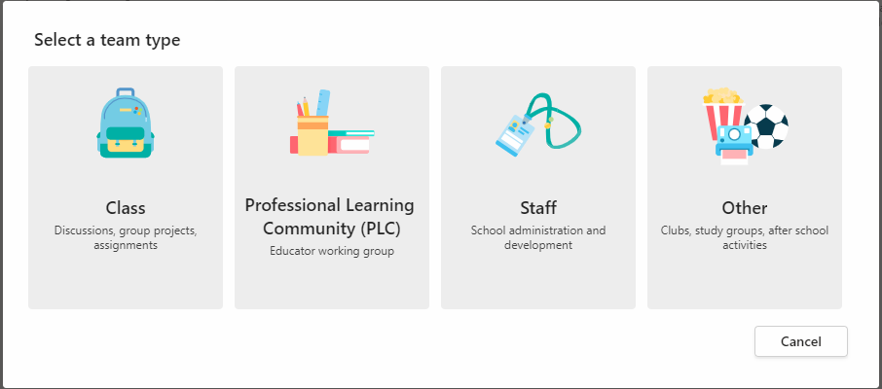
Tip #1: Creating a Team
Notes:
One area we sometimes see people get tripped up on is when creating a new team, they don’t know want to choose. When you or your customers see this screen when creating a team, our recommendation is to always choose “other”
Other provides you with a blank slate to build and create your own team structure.
We also often asked can we customize this screen or create our own templates? Unfortunately, we can’t because we have an education tenant in O365 and that is one limitation.

Slide 6
Tip #2: Channels
Standard
Private
Shared
Notes:
When Teams first launched all it had were standard channels, now it has 3 types of channels.
Standard – this is the default type, anyone who has access to the Team has access to a standard channel.
Private – private channels are for a subset of the team members. So if you have a team with 10 people and 3 are going to work on a sub-project they could create a private channel and only give access to those 3. The other members wouldn’t be able to see the private channels.
Shared – shared channels are a new type of channel. A shared channel can have people added who aren’t members of the top-level Teams site. So in my previous example of 3 people working on a sub-project, if they had a 4th person they need to collaborate with who was not a part of the original team, they could use a shared channel and add the person.
A key thing to keep in mind about private and shared channel is they have some limitations about which apps will work with them – including many of the Microsoft apps. Both private and shared channels work well for collaboration and file sharing.

Slide 7
Project #1
Rollout Microsoft Teams
Online Meetings
Teams Telephony
Notes:
While Teams has been used more and more within OneIT and HCIS as well – we know there are lots of people out there who don’t really know what Teams is or how they can use it to help them collaborate.
This effort will develop resources to help market, communicate and train on Microsoft Teams. We plan to focus college by college and department by department to better rollout Teams to campus.
We plan to collaborate with HCIS on this effort and share information as it is developed.

Slide 8
Future: New Teams Client
Faster
Consume less memory
New interfaces
Collaborate better across organizations
Notes:
A new Teams clients is coming out later this year. At times it has been called Teams 2.0.
It is supposed to be much faster, consume less memory (current client can be a memory hog), will have some new interfaces and allows for more seamless collaboration across multiple Office 365 organizations.
Microsoft has started to roll the client out in preview, but it is not available for the Education space yet.

Slide 10
Tip #3: LinkedIn Learning
LinkedIn Learning
Viva Learning
Notes:
Who here uses LinkedIn Learning?
Did you know that you can access all of the linkedin learning content directly within Teams?
One of those Microsoft apps that we talked about before is called Viva Learning. You can add that to your left-hand navigation and access content from LinkedIn Learning and Microsoft Learning. You will need to authenticate to the LinkedIn Learning content, but that is a pretty seamless experience right within the app.
You can then share videos and courses with other people through the chat and team tools.

Slide 11
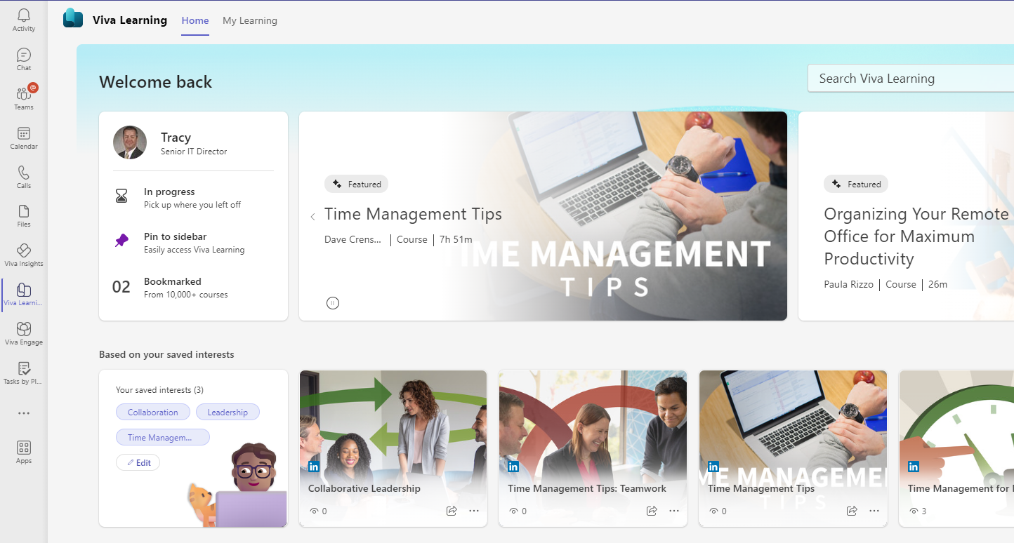

Slide 12
Project #2
Rollout Microsoft Teams
Online Meetings
Teams Telephony
Notes:
On the first slide, I provided a list of some of the tools and features that Teams provided. Another feature Teams can provide is Telephony.
Microsoft has indicated that their collaboration and telephony roadmap is Microsoft Teams, not Skype for Business.
We are working on a project now to replace Skype for Business Telephony with Microsoft Teams Telephony.
Skype for Business has a current end of support date of October 2025. We plan to replace Skype functionality with Teams by then with the plan to retire Skype for Business at the end. So we’ll have one less tool in the collaboration space.
This project is for OneIT customers only and does not involve Healthcare.

Slide 13
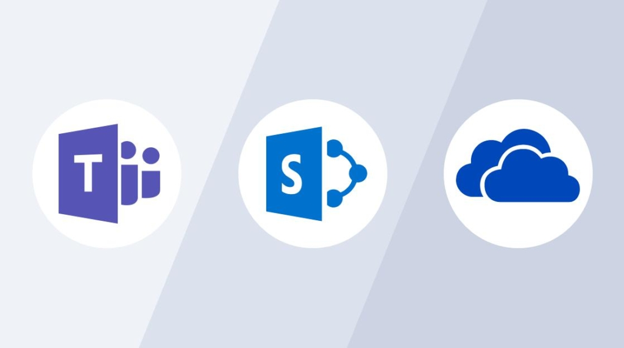
Tip #4: OneDrive vs Teams vs SharePoint
When to store files where
Notes:
One question we often get is when to use OneDrive vs Teams vs SharePoint and where should I store my files.
OneDrive is for your personal work files, you can share files from here and collaborate on documents, but no long-term or official workgroup or departmental documents should be stored here. A key thing to remember is that OneDrive accounts go away after someone leaves.
For Teams and SharePoint, a key thing to remember is that every Teams site has a SharePoint site automatically provisioned on top of it. All of the files stored in Teams actually live in the SharePoint site. For most collaboration, team work, etc. – we would recommend going with just a Teams site. It puts a nice front-end on a SharePoint site that is easier for most people. If you get into some of the advanced needs around pages, lists, etc. then SharePoint may more likely come into play.

Slide 14
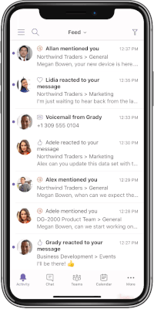
Tip #5: Teams Mobile Client
Notes:
Final tip I wanted to share. If you haven’t downloaded and tried the mobile Teams app, I would encourage you to give it a try – it works great.
Available on both Android and iOS
Access chats, meetings, channels, etc. all from mobile app
Transfer call/meeting from laptop to mobile device or vice versa

Slide 15
Project #3
Rollout Microsoft Teams
Online Meetings
Teams Telephony
Notes:
The final large effort I wanted to highlight is an effort to increase the number of online meetings happening with Teams.
Zoom is the primary online meeting tool today by far and we have just renewed it for another 4 years.
However, one of the complaints we often hear is that we have too many tools and people don’t know when to use what. Zoom continues to add more collaboration tools to compete with Teams and this will likely cause more confusion and more challenges. Cost is also a consideration.
So while we have both tools for the next 4 years, we plan to make investments to move more towards Teams for online meeting over that time. Over the next 4 years we’ll make a decision about the future of Zoom. We’ll continue to monitor this strategy and make changes as we need too.

Slide 16
Future: Intelligent Meeting Recap
Additional Licensing
Automatic Action Items
Automatic Meeting Summary
Notes:
I wanted to highlights a couple of features that aren’t available to you today but give you an idea of where Teams is going.
Additional licensing required (no plans to site license) – Teams Premium License – includes several features, but the one I wanted to highlight is Intelligent Meeting Recap
All the talk these days about AI
Meeting summary
AI provided meeting summary notes
AI captured action items
Search recording to find specific topics, when your name was mentioned, etc.
Can get this for meetings you don’t even attend
This is a feature I’m interested in because I’m not very good at taking notes or capturing action items.

Slide 17
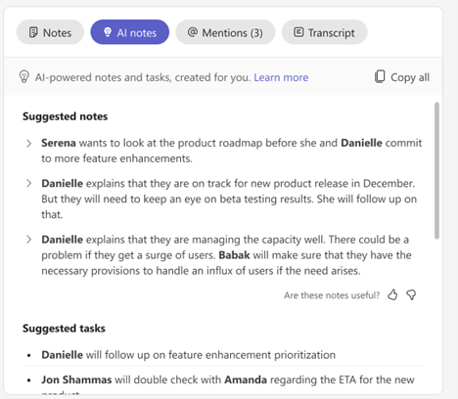

Slide 18
Future: Teams Copilot
Additional Licensing
Helps with common tasks
Brings AI “copilot” to Teams
Notes:
The 2nd feature I wanted to highlight is Microsoft Copilot which Microsoft is rolling out to basically all of their products including Teams.
Additional licensing likely required (no plans to site license) – Microsoft hasn’t shared how this will be licensed or the costs
Give examples of Copilot
Join meeting late, ask what you have missed
Create a table of pros and cons for [topic being discussed]
What decisions were made and what are some suggested next steps?
Help scheduling your next check-in

Slide 19
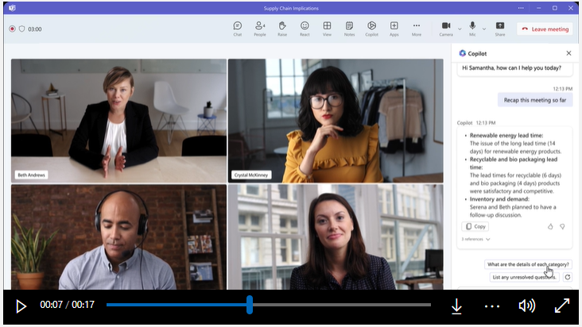

Slide 20
More Information
its.uiowa.edu/teams
its.uiowa.edu/linkedin-learning
its.uiowa.edu/its-training
Notes:
The first URL has a significant amount of content about Microsoft Teams – I encourage you to take a look when you have time. Can be useful to your end users as well.
We now have a campus IT trainer on the OneIT side and that second link provides information about the classes that we provide. We can offer small group training for Teams or any aspect of Teams to all support staff in OneIT – please reach out to Manda Marshall with requests. Unfortunately, these instructor-led classes are geared towards OneIT staff and not Healthcare.
Finally, linkedin learning is a great way to learn more about Teams with many courses available. And remember you can access them all directly from within Teams.

