Slide 1
Cultivating Belonging
Through Conversation
Notes:
The OneIT DEI Committee and the OneIT Belonging Committee today will share two different versions of a conversation between two people who are meeting for the first time. Listen closely to see if you can spot any differences between the first and the second conversation.
Remember that cart transcriptions are available online in zoom and here in the room.

Slide 2
Conversation Take 1

Slide 3
Conversation Take 2
Notes:
We just heard the beginning of one conversation between Jose and Giang. Let's rewind the clock, and hear a different version of the same conversation. Listen closely to see if you can spot any differences between the first and second conversation.

Slide 4
Conversation Analysis
Notes:
Reflecting back on these two conversations, there are three things we wanted to call out that are different between the two versions:

Slide 5
Notes:
First, Jose, who has been on campus longer spoke first, after noticing someone new. It might have just been someone he hadn't worked with before or, it could be someone who is new to Iowa. In the second conversation, Jose took steps to Initiate the discussion and reached out to someone he did not know.

Slide 6
Notes:
Second Giang, the new employee did not use the word crazy in the second conversation. This word is often used to describe a stressful situation, but can also reveal an unconscious bias.

Slide 7
Notes:
Third, Jose offered to have Giang contact him again, or he could contact Giang himself if that was ok with her. In the second conversation, Jose was taking steps to Invest in the conversation and the beginning of a new connection.
There are certainly other differences between the two conversations. But the critical thing here is that the second conversation was more welcoming and inclusive. It might not be your first week at Iowa, or your tenth year, but having good conversations is a way to build relationships and stay connected to your community of IT professionals and others at Iowa.

Slide 8
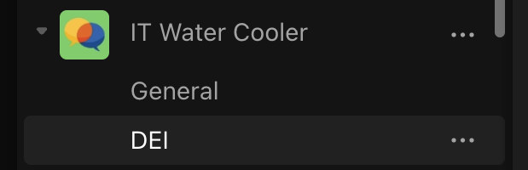
OneIT Conversation Partners:
oneit-belonging@uiowa.edu
Notes:
If you want to connect with other OneIT professionals you may not encounter on a daily basis, contact the OneIT Belonging team to be added to the list of OneIT conversation partners.
If you want to join us in discussions about the differences between these conversations and learn more about how to be more inclusive to others, feel free to join one of the DEI coffee chats hosted monthly by the OneIT-DEI committee. You can also checkout the DEI channel under the IT Water Cooler team in Teams.
Links for Zoom chat:
oneit-belonging@uiowa.edu
https://intranet.oneit.uiowa.edu/event/2023/05/june-oneit-dei-coffee
https://teams.microsoft.com/l/channel/19%3aa52aef80a38d4b608f940c63a03acfc2%40thread.tacv2/DEI?groupId=27e56e70-4fa2-442c-b24e-646e41234a19&tenantId=1bc44595-9aba-4fc3-b8ec-7b94a5586fdc

Slide 9
Notes:
Lastly, At the next break or at lunch, we encourage you to reach out to others at Tech Forum that you haven’t talked with before, and introduce yourself. After introducing yourself, you could ask where they work at the university, how they are finding Tech Forum, what things they enjoy doing outside of work, or anything else that comes to mind.

Slide 10
Notes:
Thank you.

