Slide 1
Extended Reality, the metaverse & Tippie College

Slide 2
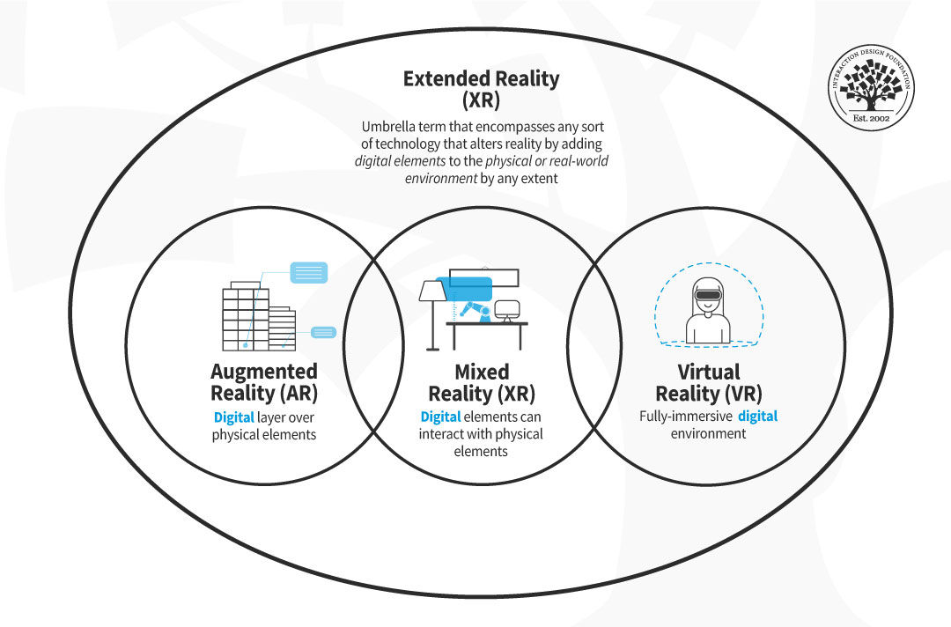

Slide 3
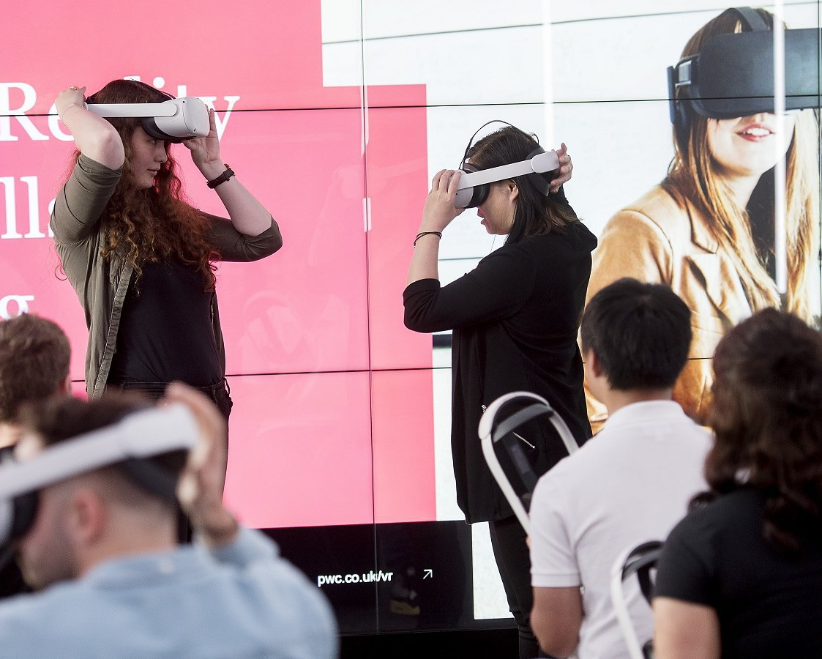
PWC Study 2020
Learners in VR were:
4x faster to train than in classroom
275% more confident to apply skills
3.75x more emotionally connected to content
4x more focused than e-learning partners
Learning is more cost effective @ scale

Slide 4
Some of Our Partners who use XR already
Reali

Slide 5
Uses for XR
Meetings
Training
HR
Marketing
Analytics
Data Visualization
Facilities
Design
Real Estate
Tourism & Travel

Slide 6
Marketing

Slide 7
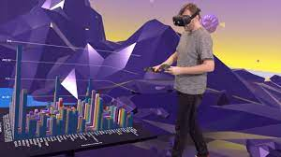
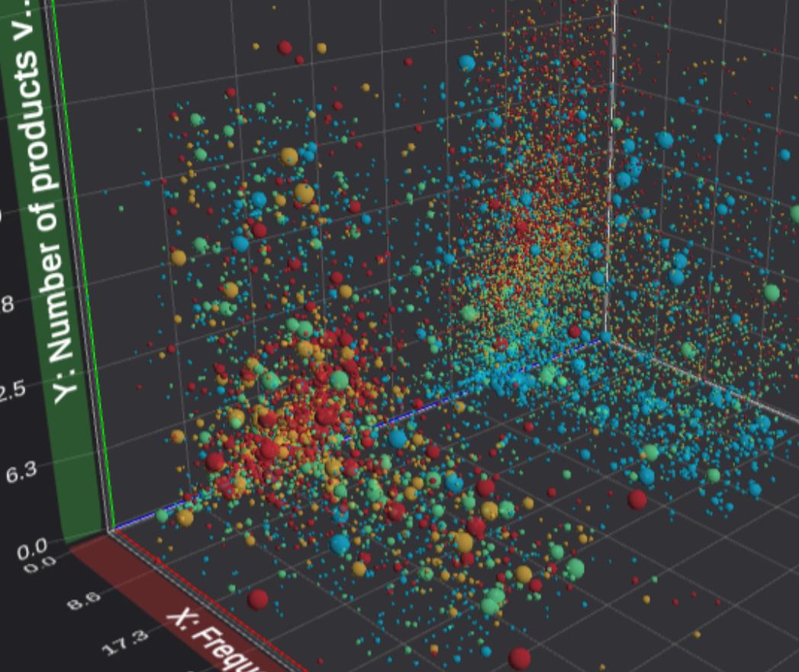
Visualization

Slide 8
Robotic clerks run by VR

Slide 9
Bodyswaps training & research

Slide 10
What are we using All this for??
Recruiting & Admissions
Data visualization
3D walkthrough instead of flat spreadsheets
Marketing
Research –who buys what & why
Real estate tours
Museum
Soft skills
Active listening
Resolving Conflict
Interview simulator

Slide 11
What are we using it for
MBA Innovations in Technology Class
Examine the fundamental concepts relating to Virtual Reality such as history, spatial computing, psychological, and health related effects.
Explore materials and processes used in immersive virtual reality.
Explore uses of virtual reality in several different professions and relating VR to the students’ own area.
Assess the use of VR regarding different industries, social issues, experiences, and new/innovative related technologies such as AI and Haptics.

Slide 12
Meta First Steps
Engage
Explore the Nomad Experience
First Touch
Notes on Blindness
Travelling while Black
Brink Traveler
We live Here
Adam Savage Tested VR
Gravity Sketch App
BodySwaps app
Now is the Time
Hand Physics Lab
Home Design 3D
Visualizer
Ecosphere
Home After War
Anne Frank's House
Occupational Safety & Health Simulator
High Voltage Electrical Simulator
Transformer Oil Sampling Simulator
YouTube VR Experiences
Nanome
Airport Ground Handling
Arkio - Samples
Resolve - Open Demo Project

Slide 17
Remember it’s all about tomorrow!

Slide 18
Questions?
Jim Chaffee
James-chaffee@uiowa.edu

