Slide 1
The New Tools of Podcasting
Adam Kempenaar
June 5, 2023

Slide 2
Background
2002-2022: Vice President, Marketing & Content – Chicago Blackhawks
2022-2023: Adjunct Instructor – Podcasting for Sport and Recreation Professionals
Starting Fall 2023: Professor of Practice, Sport and Recreation Management // Journalism & Mass Communication

Slide 3
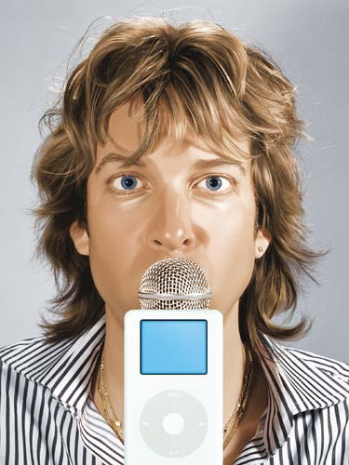
Podcasting Beginnings
Feb. 2005: Wired – "Adam Curry Wants to Make You an iPod Radio Star"
March 5, 2005: Cinecast (now Filmspotting) debuts
Early July 2005: iTunes launches Podcasting
Late July 2005: HawkCast (now Blackhawks Insider) debuts

Slide 4
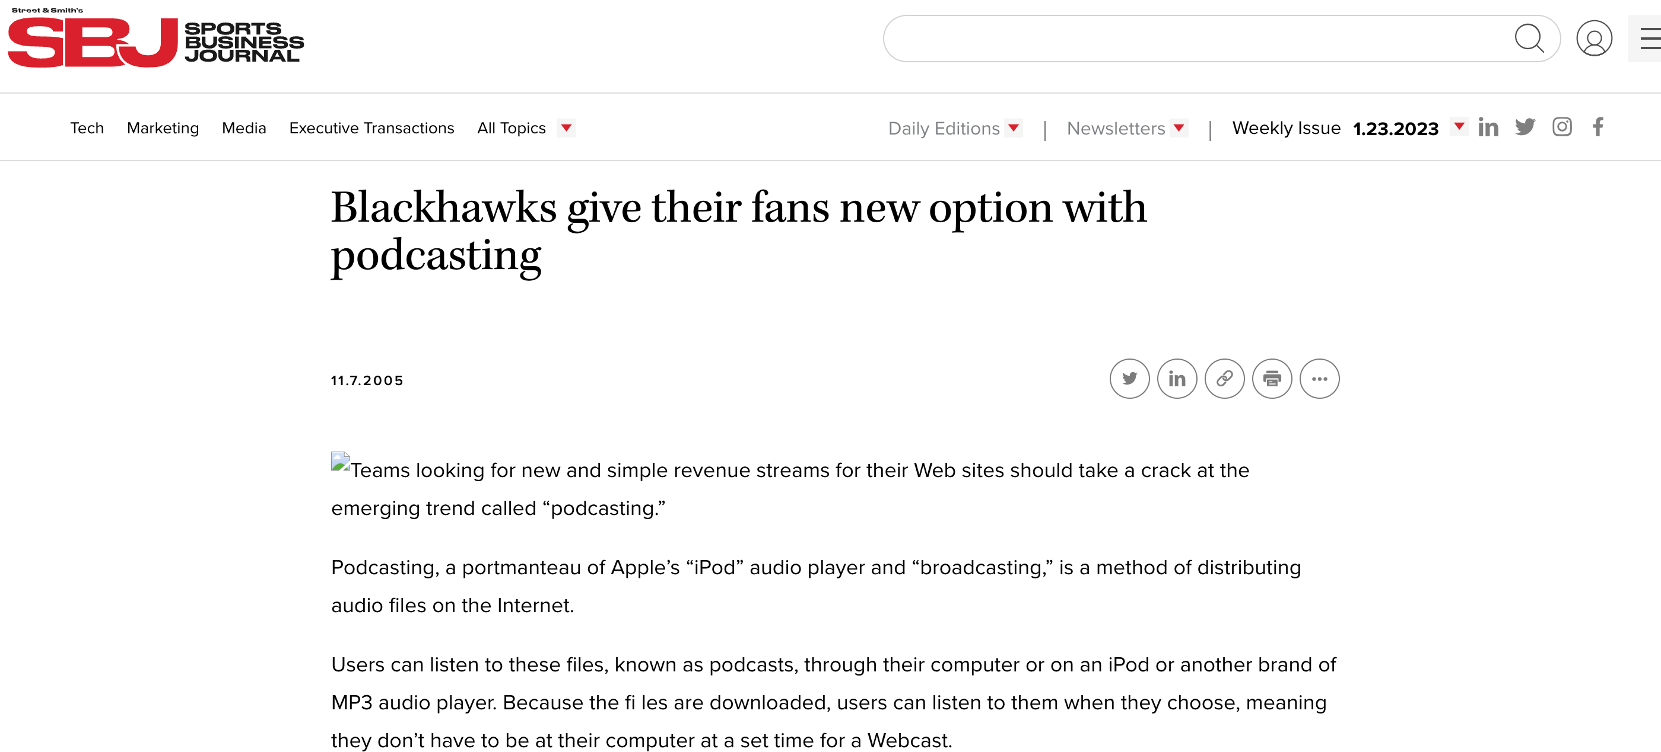

Slide 5
Creating a Pilot Episode
Imagine
Introduction to Podcasting / What makes a good podcast?
Developing Your Concept
Plan
The Team
Legal Issues, Equipment, and Budgeting
Audio & Interviewing Fundamentals
Create
Interview Sessions
Editing
Producing (Structure, Scripting, Sequencing)
Share
Branding
Marketing
Monetizing
Publishing

Slide 6
Traditional Tools
Recording Equipment
Mics
Headphones
Stands, Cables, Other Accessories
Recording Device or Laptop or Online Recording Studio (Riverside, Squadcast)
Digital Audio Workstation (DAW)
Audacity
Adobe Audition or Premiere
REAPER
Publishing Platform
Libsyn
Simplecast
Spotify for Podcasters (formerly Anchor)

Slide 7
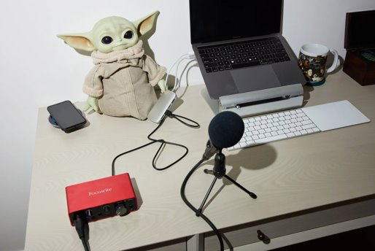

Slide 8
New Tools
One tool for your full workflow
Descript is the only tool you need to write, record, transcribe, edit, collaborate, and share your videos and podcasts.

Slide 9
Three Key Features
Transcription / Edit by Script
Studio Sound
AI

Slide 10
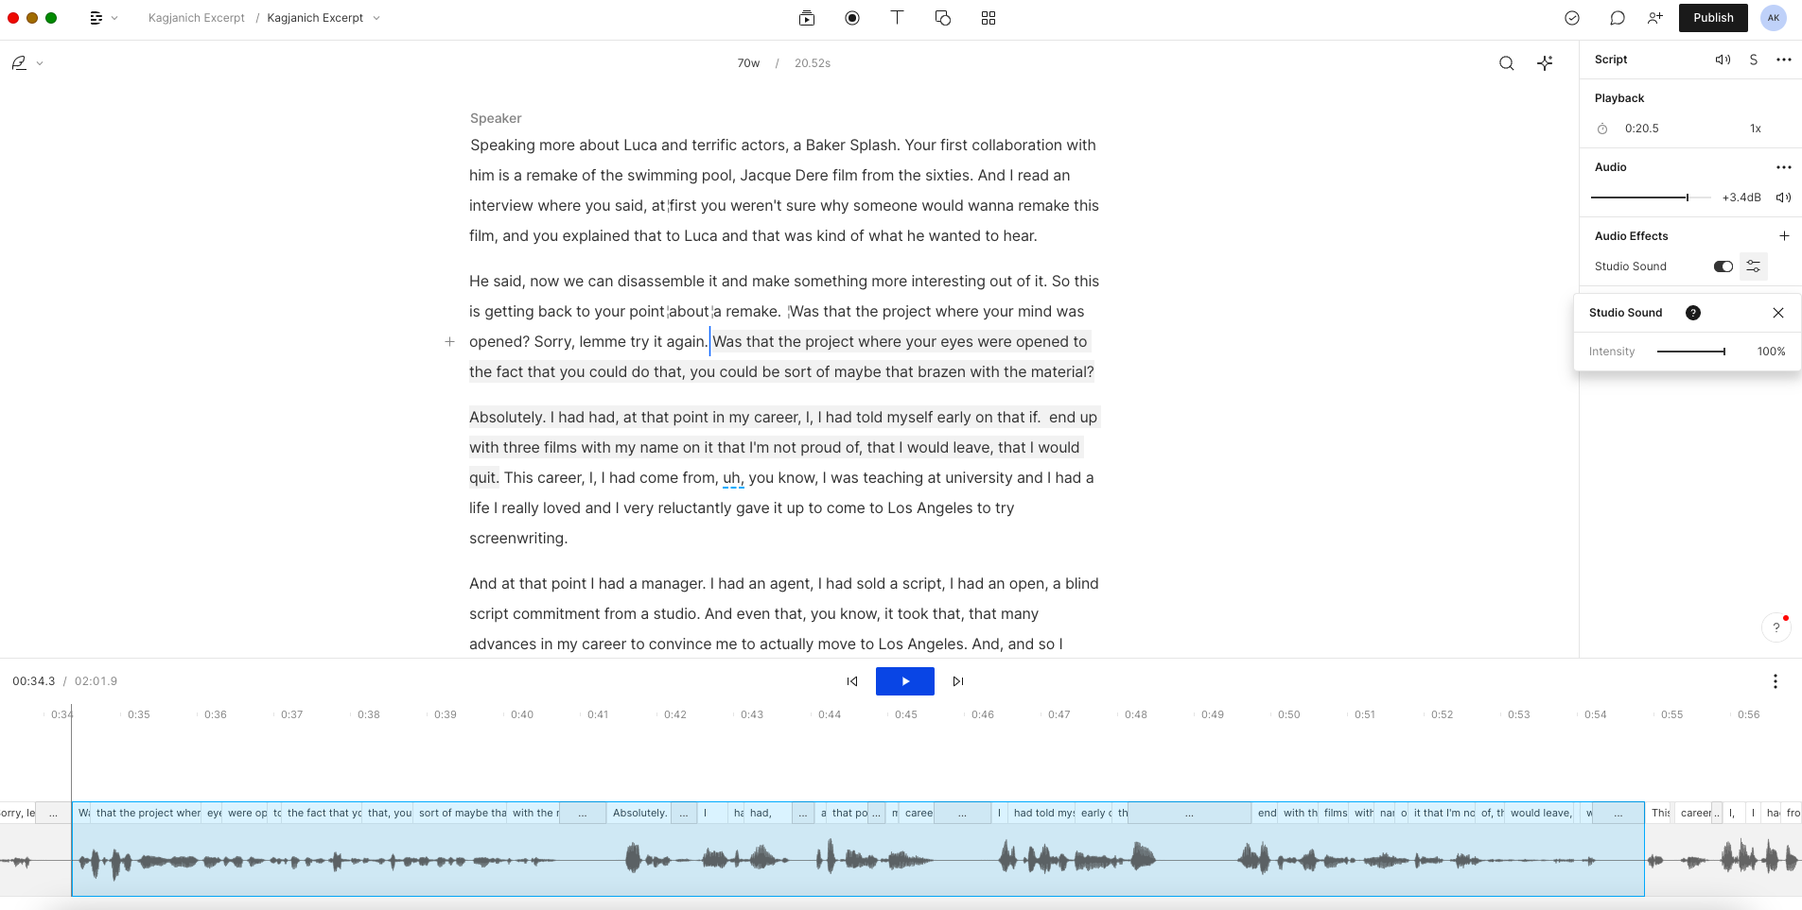

Slide 11
adam-kempenaar@uiowa.edu UISRM Podcasts – Apple, Spotify Filmspotting – Apple, Spotify, Filmspotting.net

