Slide 1

The Iowa Health Data Resource (IHDR)
Heath Davis MS, MLIS, FAMIA (they/them)
Assistant Director Iowa Health Data Resource
June 5, 2023

Slide 2
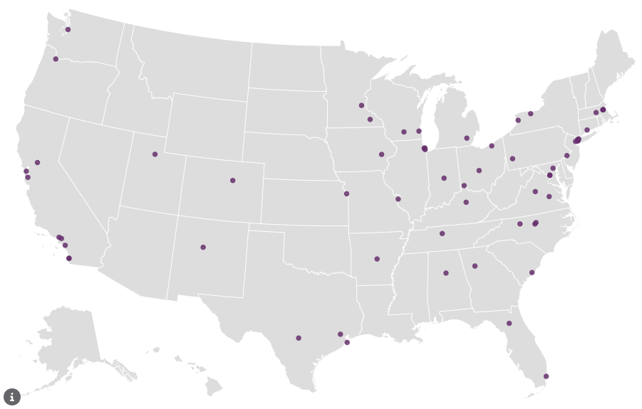
NIH* Clinical and Translational Science Awards (CTSA) Program Hubs
More than 50 medical research institutions across United States
Recipients of a UL1 award Led by National Center for Advancing Translational Science (NCATS) with a linked KL2 and optional TL1
At Iowa: Institute for Clinical and Translational Science (ICTS)
  PIs: Winokur & Hansen
*National Institutes of Health

Slide 3
Biomedical Informatics Core - ICTS
Provide campus wide services for clinical and translation research
Honest brokers for clinical data for research
  including a custom data service
    Real World Health Data
Prior to this project - Small data team
Provide self-service data tools for research
  which resulted in increased interest
    The pandemic restricted what types of research people could do, which also increased interest in using data for research
As interest broadened, demand increased, understanding decreased
  More researchers wanted 'all the data’
  Perceptions increased that the service was slow
  Lack of computational environment intensified the issue
Notes:
As interest broadened, demand increased from a much larger community of researchers, some who had never used real world data, or don’t practice clinically, with that we saw understanding of the data decreased

Slide 4
Enterprise Data Warehouse for Research (EDW4R)
A CTSA Informatics Working Group​ (Knosp et al.) began in examining Data Warehouses in 2019
  Semi-structured interviews with CTSA informatics leaders
  Results: 3 JAMIA Papers and a Maturity Model
Learned a lot:
  Iowa wasn’t unique in it’s struggles
    – common themes across academic health care centers
  Allowed Iowa to assess best practices & identify pain points
    small team, not enough MD/PhD scientists, data literacy, computational environment
Notes:
At Iowa learned from this research
Iowa wasn’t unique in our struggles, there were common themes across the consortium.
To our advantage, other institutions that were more mature than us, had good solutions.

Slide 5
P3 Project - Iowa Health Data Resource (IHDR)
Gaps Identified:
Access to data
Wait times
Scientific expertise
Need for better tools
Data Governance*
Data literacy*
Workforce development*
Building the Future of Health Informatics at the University of Iowa
Notes:
To address the gaps we identified, we applied for A Strategic Public Private Partnership Grant (P3), from our University.
• The overarching gaps we identified: access to data, wait times, scientific expertise, and the need for better tools
.

Slide 6




Iowa Health Data Resource (IHDR) Goals
People
Technology
Data
Improve the understanding and availability of health data on campus
Establish a data enclave……
and more
Build transformative data sets for health science research
Notes:
One of Iowa’s strengths that we leveraged is that Iowa is very collaborative
We have tight funding, Tight growth and very lean operations
We are motivated to work together – its Iowa’s superpower

Slide 7
People
Improve the understanding and availability of health data on campus

Slide 8


















People – Strategy
Formal Training
Formation:
IAI* Team
Brainstorming
$$ slice % FTE
Join the BMI Team
These faculty and staff are immediately able to add additional clinical, scientific and domain expertise to the team, elevating what we can accomplish as a group.
Continuous
Feedback
Feedback & Specific
Gaps
Team Science Training
Experiential
Leaning

Slide 9
People: Results Learning Timeline
Liaison to college
Triage Meeting
Triage Meeting
Triage Meeting
Triage Meeting
Triage Meeting
Triage Meeting
Triage Meeting
Data Request Meeting
Triage Meeting
Data Request Meeting
Data Request Meeting
Data Request Meeting
Data Request Meeting
Translate Requests
Data Request Meeting
Data Request Meeting
Data Request Meeting
Team Science Training
Week
Collaborate
W/ faculty
Ad-Hoc
Consult
Create Datasets
Ad-Hoc
Consult
Ad-Hoc
Consult
Ad-Hoc
Consult
Orientation
Experiential
1
Week
2
3
4
5
Week
6
7
8
Experiential
Formal
END
Formal
Week
Week
Check-in & Feedback
Check-in & Feedback
Data Governance
Deep Dive
Data Requests
Overview EDW4R &
Data Request Workflow
Demo Self Service Tool
IT Security Training
Research
Network(s) Review
Present on data
tools & services
IRB CITI Training
Self Service
Tool Training
HIPAA Training
Two months, 4-5 people per cohort, 9 cohorts to date 40-60 hours, ongoing .5-4 hours/week
Notes:
The resulted in a new learning timeline, both experiential and formal,
Two months, typically 4-5 people per cohort, 40-60 hours depending on responsibilities
Ongoing .5-4 hours a week

Slide 10
People: Results - Core Competencies
Self Service Tool(s)
Resource & Mentor (Faculty)
Able to demonstrate Self Service Tool
Act as a resource for research faculty across the institution. Mentor faculty & staff in the IHDR. If applicable lead a transformative data set
Act as Data Liaison
Promote IHDR
Serve as a liaison to home org/unit for research data requests
Regularly communicate out about resources, processes, status of projects and data.
Clinical & Scientific Expert Guidance
Manage Data Requests (Staff)
Provide guidance to investigators for developing datasets, provide feedback to informatics team.
Manage data requests start to finish for home college or organization.
Feedback
Lead Grants & Pubs (Faculty)
Provide feedback for continuous improvement
Lead grants, manuscripts and if appropriate a transformative data

Slide 11
People: Results trained IAI Data Liaisons Y1
Role | Department | College
Associate Dean for Information Technology | Informatics, Medicine IT | Medicine, CTSA
Assistant Director for Biomedical Informatics | Informatics, Medicine IT | Medicine, CTSA
Senior Research IT Support Consultant | Informatics | CTSA
Research IT Support Analyst | Informatics | CTSA
Research IT Support Consultant | Informatics | CTSA
Lead Application Developer | Informatics, Medicine IT | Medicine, CTSA
Research Associate Professor | Obstetrics and Gynecology | Medicine, CTSA
Research Specialist | Epidemiology, Informatics | Public Health, CTSA
Program Director | Epidemiology | Public Health, Medicine
Professor | Epidemiology | Public Health
Associate Professor | Internal Medicine | Veteran's Administration
Research Associate | Health Services Research | Pharmacy
Assistant Dean | Dental Informatics | Dentistry
Associate Professor | Psychiatry | Medicine
Associate Professor | Nursing | Nursing
Assistant Professor | Informatics | Pharmacy
Research Specialist | Epidemiology | Public Health
Clinical Assistant Professor | Pediatrics | Medicine
18

Slide 12
People: Results trained IAI Data Liaisons Y2
Role | Department | College
Clinical Research Data Analyst | Informatics | CTSA
Associate Professor | Dows Institute-Research | Dentistry
Clinical/HC Research Assistant | Nursing | Nursing
Research Specialist | Cancer Center | Medicine
Administrative Director, Translational Research | Cancer Center | Medicine
Associate Professor | Nursing | Nursing
Clinical Research Data Analyst | Informatics | CTSA
Assistant Professor | Nursing | Nursing
Clinical Associate Professor | Nephrology | UIHC
Professor | Radiology | UIHC
Clinical Professor | Urology | UIHC
Assistant Professor | Pathology and Microbiology | Medical Center*
Assistant Professor | Nursing | Nursing
Clinical Research Coordinator | Psychiatry | Medicine
Application Developer | Dental Informatics | Dentistry
Fellow Associate Physician | Internal Medicine | Medicine
Senior Application Developer | Informatics | CTSA
Senior Informatics Specialist | Nursing | Nursing
30+ new people that can mentor, are clinical & domain experts, that can provide direct support and lead data driven projects.
30+
18

Slide 13
People: Results Improved Service Metrics
Start of IHDR
Days to delivery
The big take away: time from data request to data deposit has been reduced by more than 50%, increasing efficiency, while capacity for complex custom requests has increased by 30%.

Slide 14
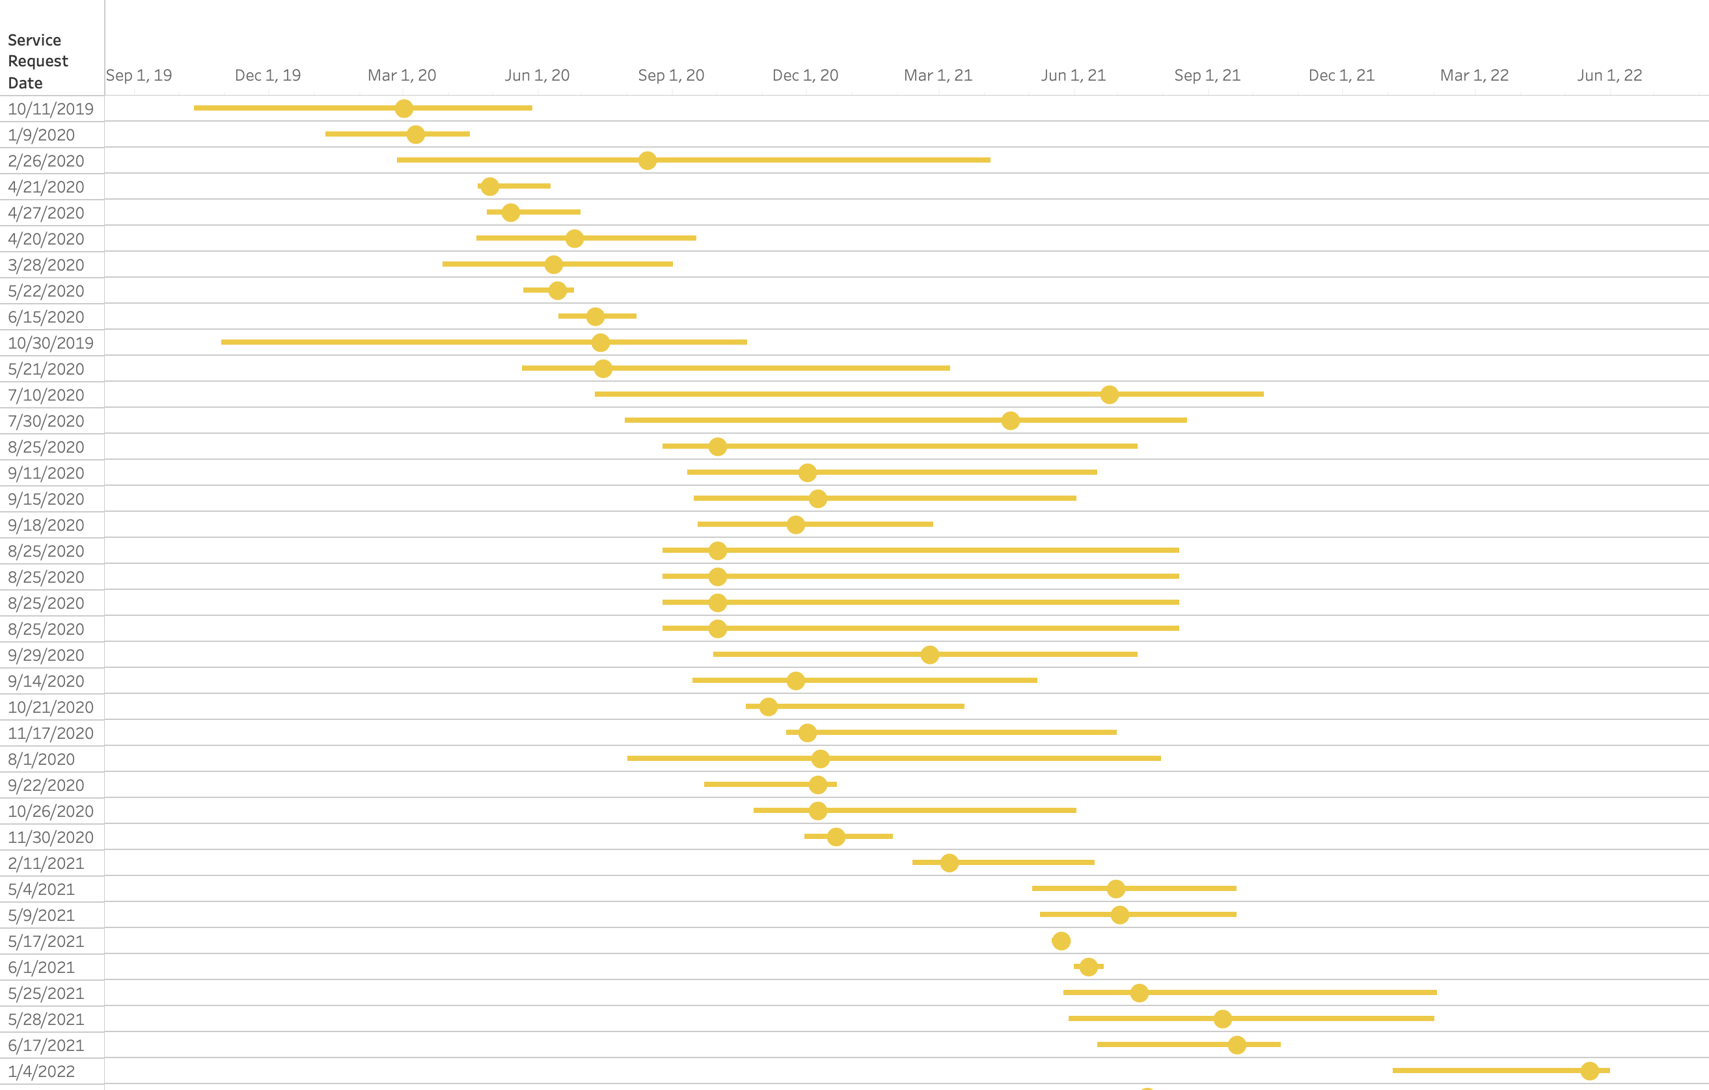
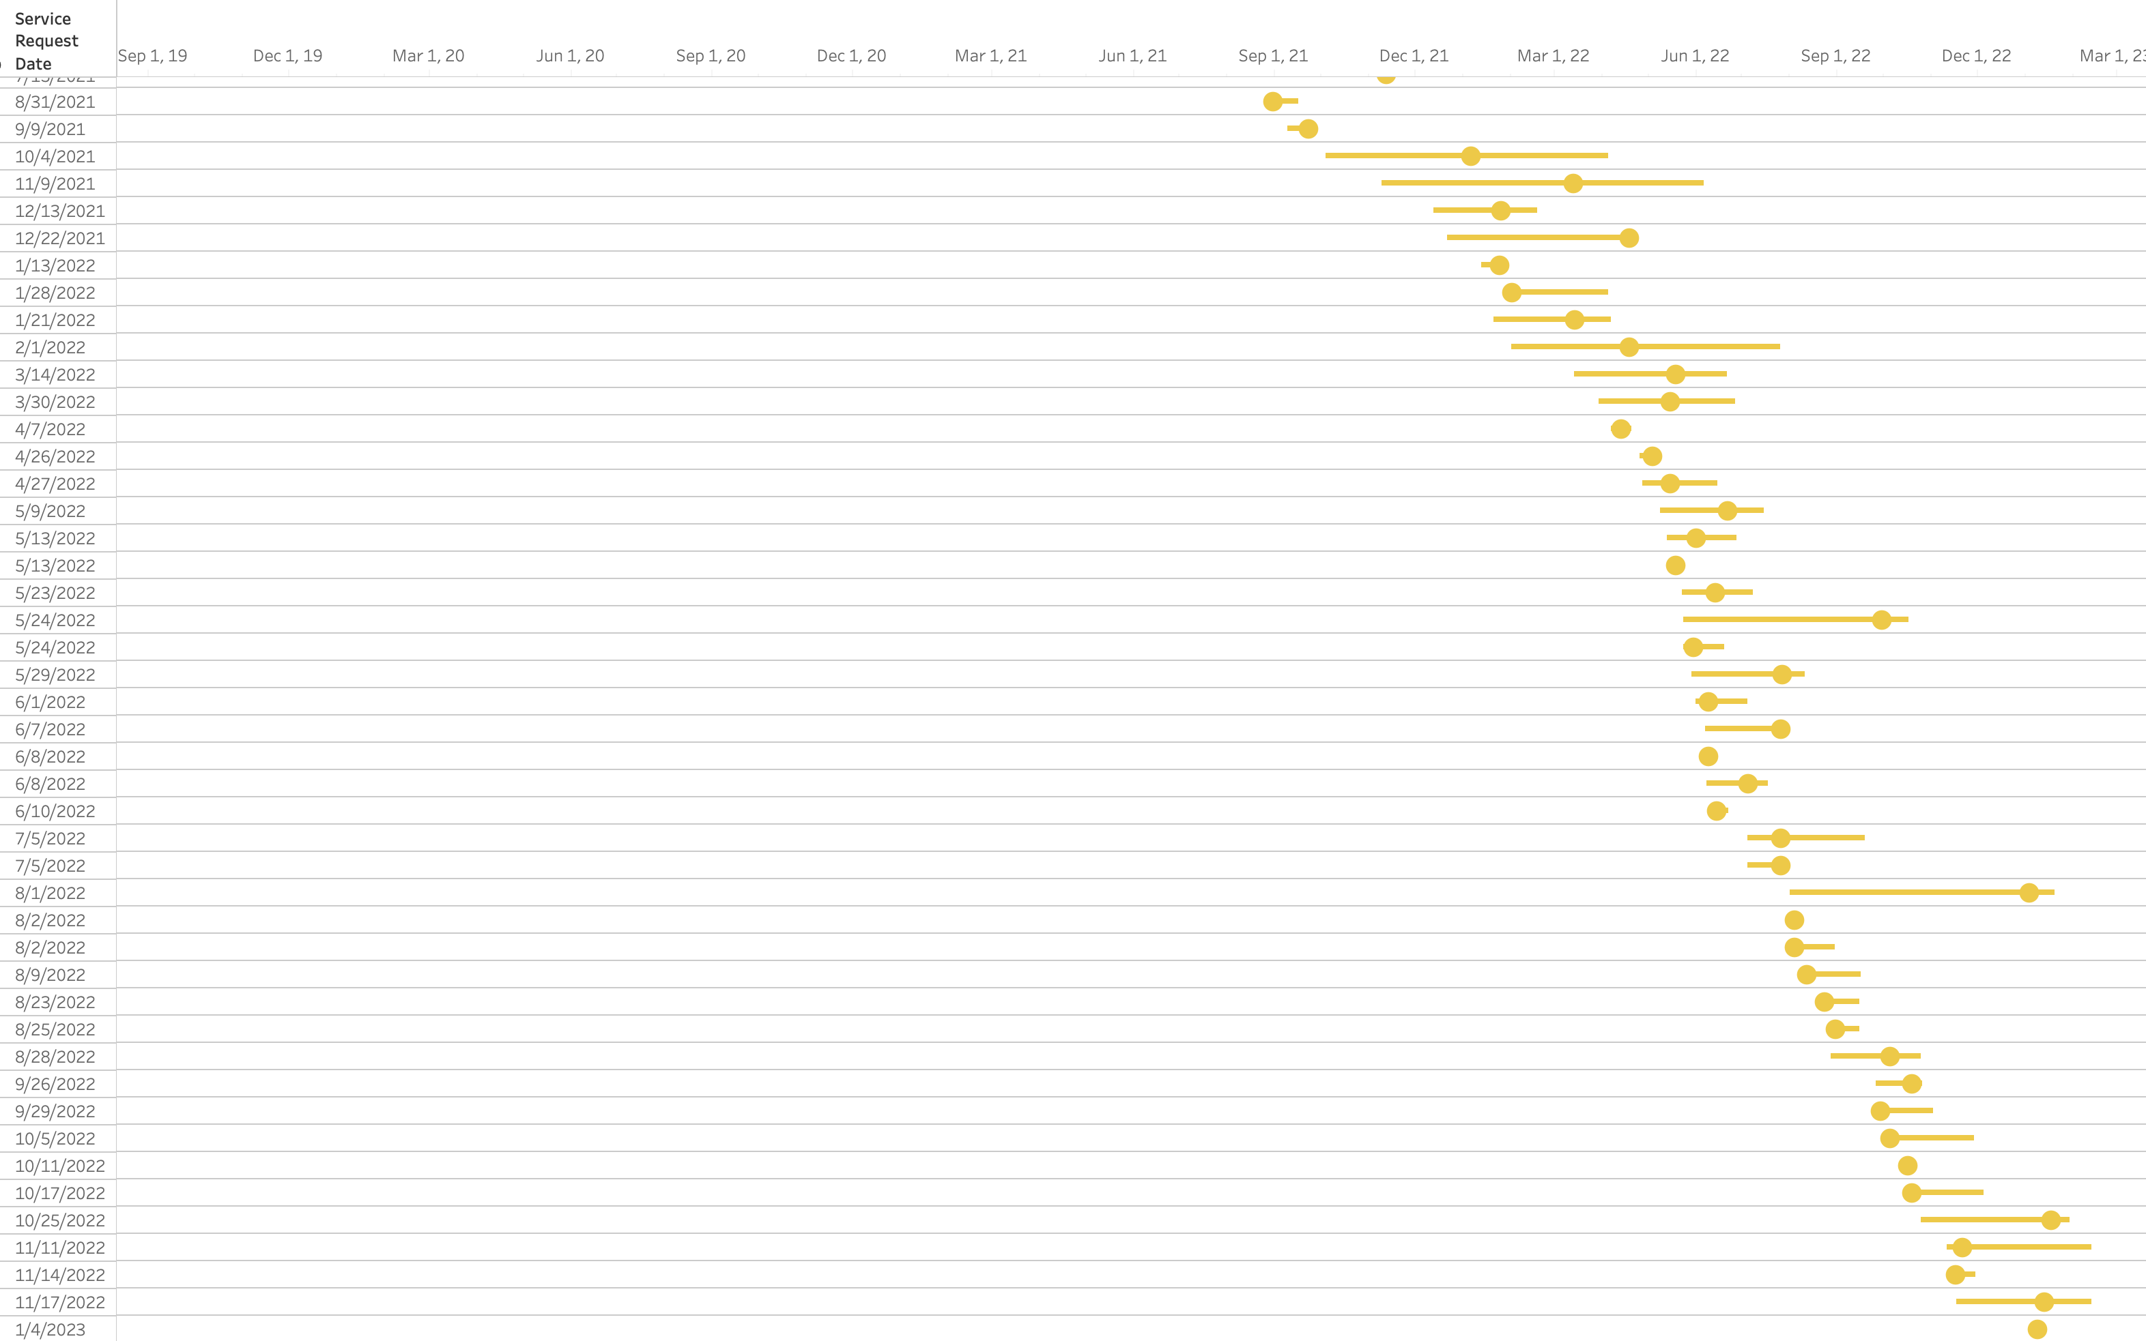
People: Results Improved Service Metrics
Pre IHDR IAI Team
Post IHDR IAI Team
Complex requests
Complex requests
Notes:
Same info, different visualization, you can see the tightened timeline for complex data (T4) requests

Slide 15
Technology
Establish a data enclave….. and more…….

Slide 16



Technology - Methodology
UI Health Care IT Data Center
OneIT - Campus IT Data Center
Data Enclave
HPC Cluster
Argon
Data
extracts
via Biomedical Informatics
Secure storage
Interactive Data Analytics Service (IDAS)
HIPAA training, CITI training &
IRB documentation required
Requirements included two key features:
datasets remain in the hospital data center
access is controlled and managed by UI Health Care IT employees.
Mount points via Health Care managed credential
group
Goal: Scientists able access datasets in the enclave from existing computational resources such as campus Interactive Data Analytics Service or the central high-performance computing cluster
Notes:
Most straight forward part of the project
To address our second goal, technology we implemented a data enclave that serves as a protected computational resource for studies involving patient data University of Iowa Health Care.
Created through a collaboration between three campus organizations, OneIT team, UI Health Care IT , and IHDR team,

Slide 17
Technology: Data Enclave - Results to date
Study | Collaborating Departments
A Data-Driven Approach to Classify Safety Criteria for ICU Patient Mobility Readiness | Nursing, Acute and Critical Care, Design, Biostats & Ethics
Functional Decline Among Patients with Sepsis | Nursing, Acute and Critical Care, Industrial Engineering,
Prediction of Substance Use Outcomes | Pathology, Computer Science,
Post-Acute Neurological Sequelae of COVID-19 Compared to Influenza | Infectious Disease, Biostatistics
Advancing symptom science using hidden symptoms and chronic conditions in patients with acute myeloid leukemia | Acute and Critical Care, Management Sciences, Computer Science, Business Analytics
Use of machine learning n the detection of eyelid malignancy using clinical photographs | Ophthalmology & Visual Science, Computer Network
Retrospective Electronic Health Record Analysis to Predict Preeclampsia | Community and Primary Care, Management Sciences, Nursing Research Center
Retrospective Neonatal Research Studies Involving Sickbay | Pediatrics, Engineering Research
Machine Learning, Multimorbidity, & Symptom Science: Mobile App Intervention Development | Community and Primary Care, Management Sciences, Statistics & Actuarial Science, Computer Science, Business Analytics
Deep learning in cardiovascular magnetic resonance imaging | Radiology
Automating Cohort Selection with an Attention-Based Neural Network | Internal Medicine, Engineering Research, Electrical-Computer Engineering
Eliminated the need to duplicate computational infrastructure inside the hospital firewall, tools investigators are already familiar with.
To date this has resulted in – 13 abstracts/posters, 3 papers, 3 grant proposals, and 3 funded grants using this resource.
Notes:
You can see a smattering of the projects and collaborations using this resource
The resource has been live for nearly a year
This eliminated a bottleneck of researchers waiting for access to computational resources
This eliminated the need to duplicate computational infrastructure inside the hospital firewall.
Thus, reducing infrastructure, hardware and human resource costs while leveraging the existing expertise embedded in the campus research computing team

Slide 18
Data
Build transformative data sets for health science research

Slide 19
Transformative Datasets Defined
Novel (does not already exist as a resource)
Domain Specific
Concepts that are hard to reflect directly from the EHR or source data
Comprehensive (as defined by the scientists)
Non-static – not a snapshot in time, a living breathing data source
Contains data points from EHR(s)
May contain data points from other data sources NACCR (national cancer data), biospecimen data, subject reported outcomes, etc.
Contains computationally created variables
  e.g. cancer episode, pregnancy episode, mom baby relationship, gestational age, substance use, twice gifted, pre-eclamptic, neurodiverse.

Slide 20
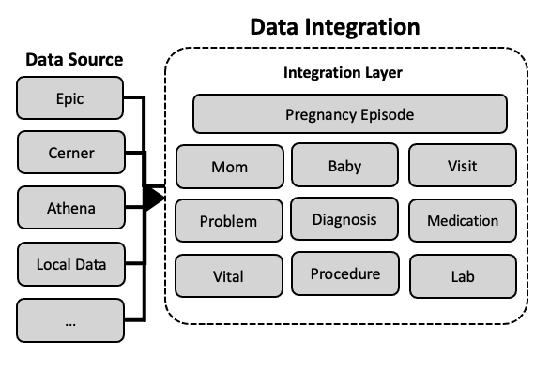
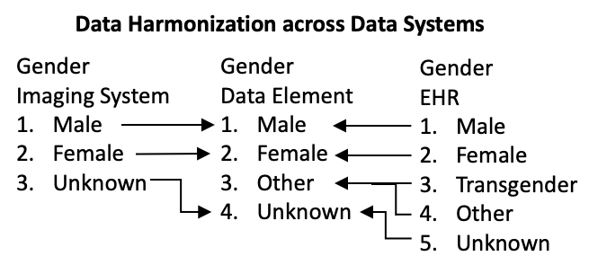
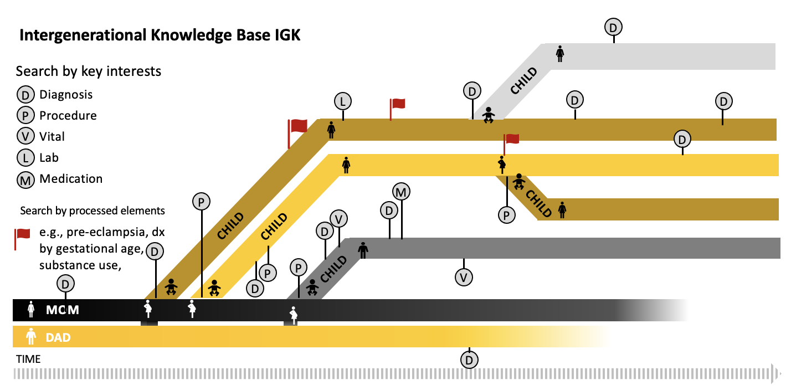
Data – Transformative Dataset Methodology
Build transformative datasets
  Exemplar(s) – Mom baby → Intergenerational Health Knowledgebase, UI Bioshare
Methodology
  Scientist engagement
  Structured Interviews
  Formal Project Management practices
  Community Base Decision Making
    Collaborative, cooperative, iterative design
  Bootstrap from previous work and from the Enterprise Datawarehouse for Research
Discovery is a Datamart creation protocol
Intergenerational Health Knowledgebase

Slide 21
Data – New Transformative Datasets
Dataset | Purpose | Sources | Lead | Status
Intergenerational Health knowledgebase (IHK) | Next version of the of MCKB dataset tracking intergenerational changes | Epic, Axium, UI Bioshare, PRO, Community Connect | Ob/Gyn | ✓
Dental-medical data mart (DMDM) | Cross referencing medical and dental data | Axium and Epic EHRs | Dentistry | ✓
Neuro developmental registry (NDVR) | Detection and tracking of mental health | Epic, Registries, PRO data | Psychiatry | ✓
Nursing Care Dataset (NCD) | Extraction of nursing data | Epic flowsheets – symptom and nursing care data | Nursing | ▲
Cochlear Implant Knowledgebase* | The Iowa Cochlear Implant Clinical Research Center | Epic, Auditory Testing, PRO, | Otolaryngology | ▲
Rural impact on Health (RIoH) | State-wide mapping of health information | Epic & axiUm EHRs, State hygienic lab data, claims data, PRO, HIE | UI Health Care | ▢
Imaging EHR dataset (IEHR) | Linking patient data to image data | UIHC imaging systems and Epic EHR | Radiology | ▢
complete |  | In progress |  | in planning
Notes:
Example PI of IHK
She estimates she can now do in a few days with would have taken 6-8 weeks minimum to complete completely in the past for a single research question

Slide 22
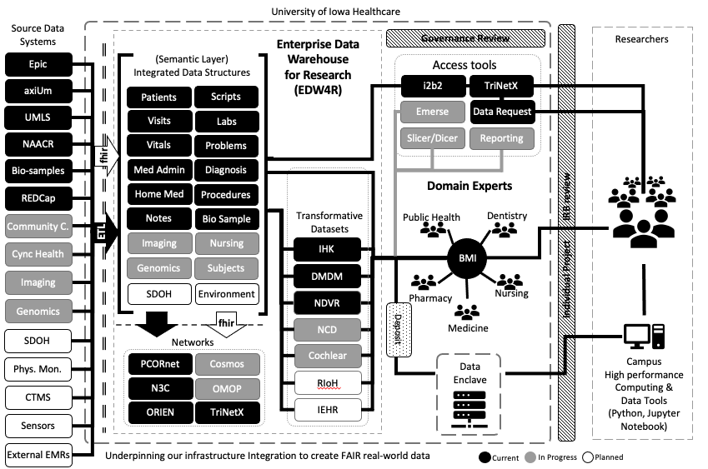
IHDR Big Picture
Notes:
ICTS’s CTSA competitive renewal figure of our infrastructure, our enterprise data warehouse for research (just awarded 7 years 28 million)
– the big picture so to say we have improved our ecosystem
People – Growing and developing out workforce in place and adding clinical and scientific expertise by adding IAI data liaisons
Technology - Establishing a data enclave
Data - The additional of several domain specific transformative datasets to support health research led by a faculty
Using the IHDR for Faculty Recruitment
Working IHDR in the curriculum
UMLS-Unified Medical Language System
NAACR-North American Association of Cancer Registries
SDOH-Social Determinants of Health
CTMS-Clinical Trial Management System
FHIR-Fast Healthcare Interoperability Resources
OMOP-Observational Medical Outcomes Partnership
N3C-National Covid Cohort Collaborative
BMI- Biomedical Informatics
IHK-Inter-Generational Knowledgebase
DMDM-Dental Medical Data Mart
NDVR-Neuro Developmental Registry
EHRMIR-EHR Medical Imaging Resource
NCD-Nursing Care Dataset
Cochlear - Cochlear Implant Datamart
RioH – Rural Impact on Health
IEHR – Imaging EHR datamart

Slide 23


Slide 24
Acknowledgements
James M. Blum, Lee T. Carmen, Ryan Carnahan, Tara Carr, Marian F. Carson, Martha Carvour, An Gie L. Cech, Cole Chapman, Betsy A. Chrischilles, Douglas J. Van Daele, Rhonda R. DeCook, Scott J. Egerton, Elaine Dettner, Jennie Embree, Sean B. Fain, Steven R. Fleagle, Mike S. Frangi, Carol Geary, Stephanie H. Gilbertson-White, Brian M. Gryzlak, Shannon Hampton, Joseph Hetrick, Ash Hoberg, Genevieve R. Johnson, William Keating, Aaron K. Kline, Lindsay A. Knake, Brendel Krueger, Anna E. Krupp, Laura Jacobus, Karen D. Lopez, Chuck McBrearty, Brad D. McDowell, Jason Misurac, Kenneth G. Nepple, Chris Ortman, Diva Perez, Justin Perez, Kirk T. Phillips, Robert C. Piper, Barbara A. Rakel, David L. Roman, Mary Vaughan-Sarrazin, Gi-Yung Ryu, Scott D. Stiegelmeyer, Lucas D. Van Tol, Julie Vignato, Joseph F. Wagner, Jessica S. Wolf, Xian Jin Xie, Erliang Zeng… and many more
Funding provided by the Iowa Health Data Resource, a University of Iowa Public Private Partnership (P3) project.
Supported by the National Center For Advancing Translational Sciences of the National Institutes of Health under Award Number UL1TR002537. The content is solely the responsibility of the authors and does not necessarily represent the official views of the National Institutes of Health.

Slide 25
Selected References
Knosp, B., Dorr, D., & Campion, T. (2023). Maturity in Enterprise Data Warehouses for Research Operations: Analysis of a Pilot Study. Journal of Clinical and Translational Science, 1-14. doi:10.1017/cts.2023.23​
Santillan DA, Davis HA, Faro EZ, Knosp BM, Santillan MK. Need for Improved Collection and Harmonization of Rural Maternal Healthcare Data. Clin Obstet Gynecol. 2022 December 01; 65(4):856-867. doi:10.1097/GRF.0000000000000752
Santillan DA, Santillan MK, Davis HA, Crooks M, Flanagan PJ, Ortman CE, Faro EZ, Hunter SK, Knosp BK. Implementation of a Maternal Child Knowledgebase. AMIA Annu Symp Proc. 2022 January; 2022:432-438
Knosp BM, Craven CK, Dorr DA, Bernstam EV, Campion TR, Jr. Understanding enterprise data warehouses to support clinical and translational research: enterprise information technology relationships, data governance, workforce, and cloud computing. Journal of the Medical Informatics Association 2021;doi:10.1093/jamia/ocab256​
Campion TR, Craven CK, Dorr DA, Knosp BM. Understanding enterprise data warehouses to support clinical and translational research. Journal of the Medical Informatics Association Jul 1 2020;27(9):1352-1358. doi:10.1093/jamia/ocaa089​
Knosp BM, Barnett WK, Anderson NR, Embi PJ. Research IT maturity models for academic health centers: Early development and initial evaluation. Journal of Clinical and Translational Science. 2018;2(5):289-294. doi:10.1017/cts.2018.339

Slide 26
Thank you
Heath Davis, MLIS, MS, FAMIA
(they/them)
Assistant Director for Biomedical Informatics
Assistant Director, The Iowa Health Data Resource
Institute for Clinical and Translational Science
Carver College of Medicine
The University of Iowa
h-davis@uiowa.edu
319.384.5409
icts.uiowa.edu

Slide 27
Closing Slide Header

